Slide 1
Coincident anomaly detection for a particle accelerator
Jun 16, 2025
D. Ratner
SLAC National Accelerator Laboratory

Slide 2
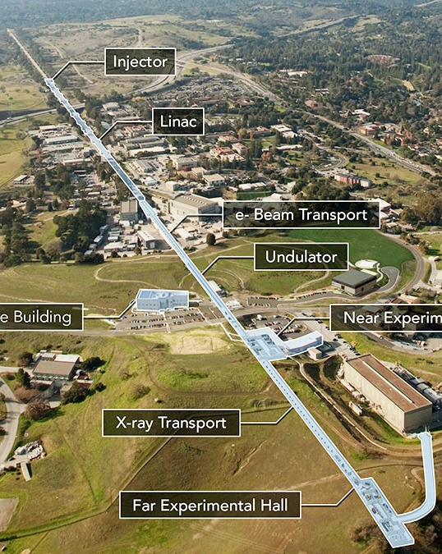
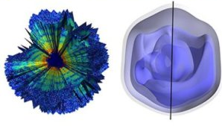
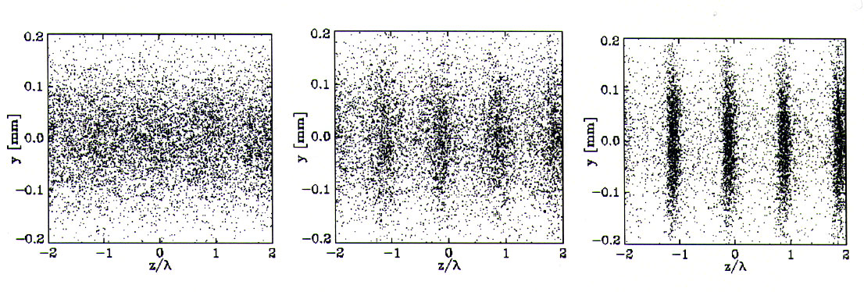
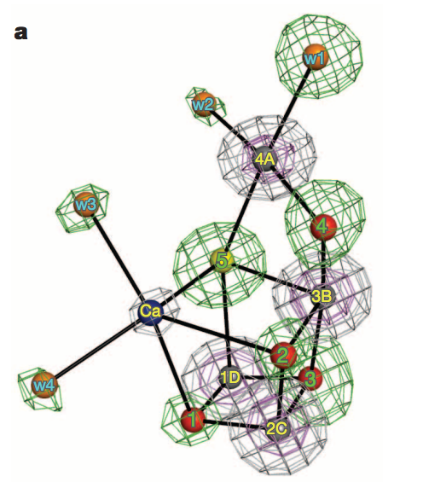
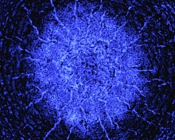

Introduction to X-ray Free-Electron Lasers (XFELs)
X-ray free-electron lasers: Accelerator driven x-ray sources to study ultrafast, ultrasmall scale phenomena
Single particle imaging (Mimivirus)
Ekeberg et al.,
Shock waves in extreme conditions
Photosystem II
Suga et al.
Si
Milathianaki et al.

Slide 3
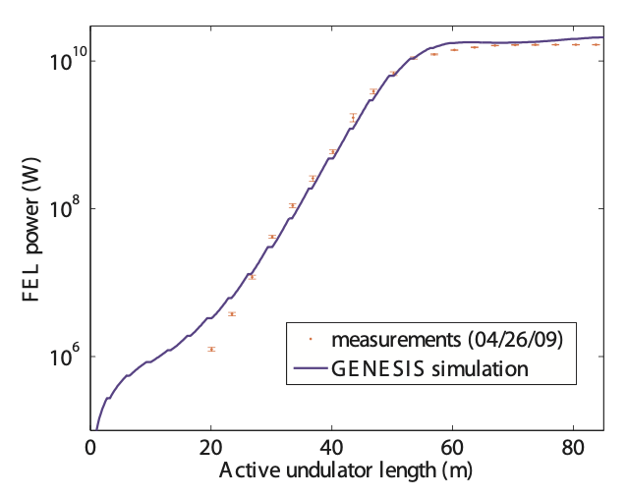
Introduction to X-ray Free-Electron Lasers (XFELs)
X-ray free-electron lasers: Accelerator driven x-ray sources to study ultrafast, ultrasmall scale phenomena
X-ray FELs are instabilities, i.e. sensitive to operational conditions
➔ AI efforts target:
Tuning
Anomalies
FEL gain curve
100x drop in power
2x longer gainlength

Slide 4
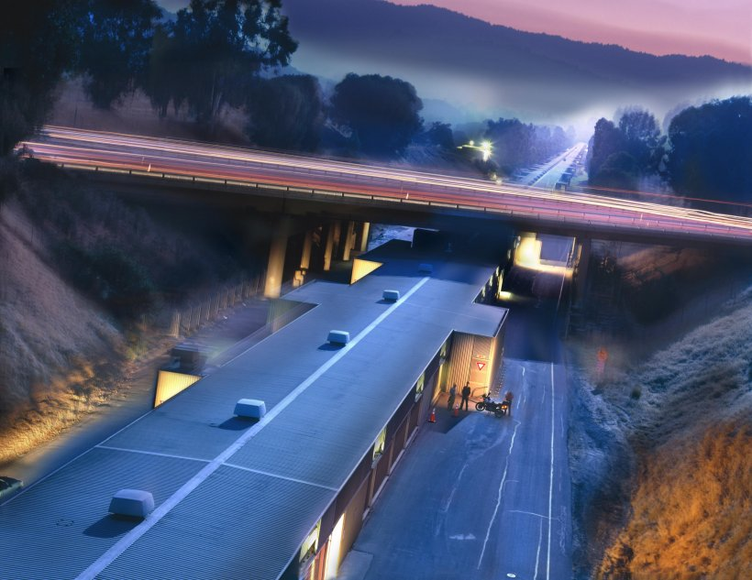
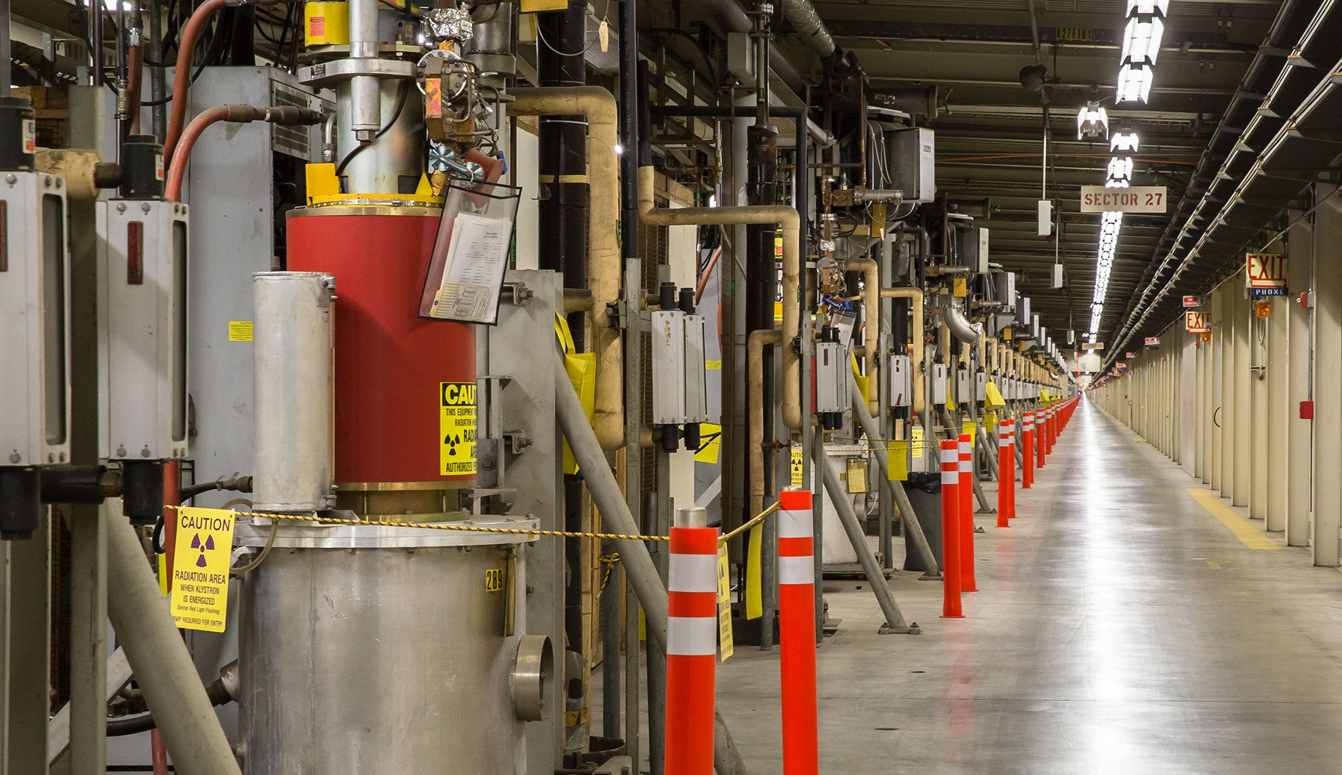
Motivation
Failure prediction at accelerators:
Failures cause downtime, degrade performance
1000s of subsystems → frequent failures
200k variables to monitor at LCLS → impossible to do manually
Big data, but nearly none of it labeled
SLAC Linear Accelerator and 280 Overpass
SLAC RF Stations

Slide 5
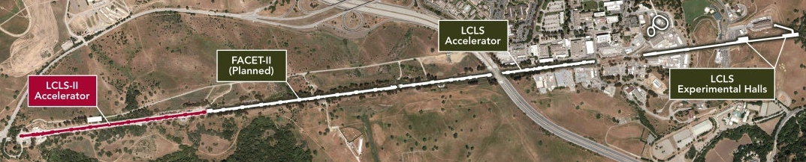
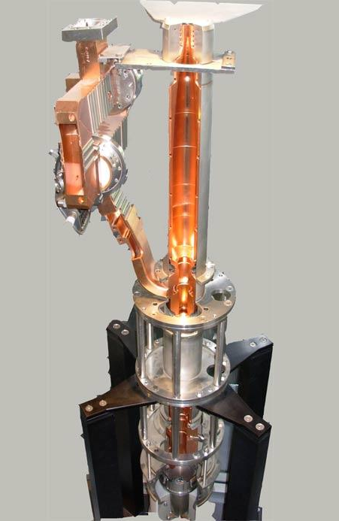
Anomaly Detection: RF Station Faults
Anomaly detection at an X-ray Free-Electron Laser
Highway 280
RF stations
Case study: RF station faults
RF stations provide power for acceleration
Most common fault at LCLS (1000s/year)
Existing algorithm has too many false positives ➔ operators ignore alarms
70% missed faults (i.e. poor recall)
70% of alarms are false (i.e. poor precision)
Recall = TP/(TP+FN) Precision = TP/(TP+FP)
TP = true positive, FP = false positive, FN = false negative

Slide 6
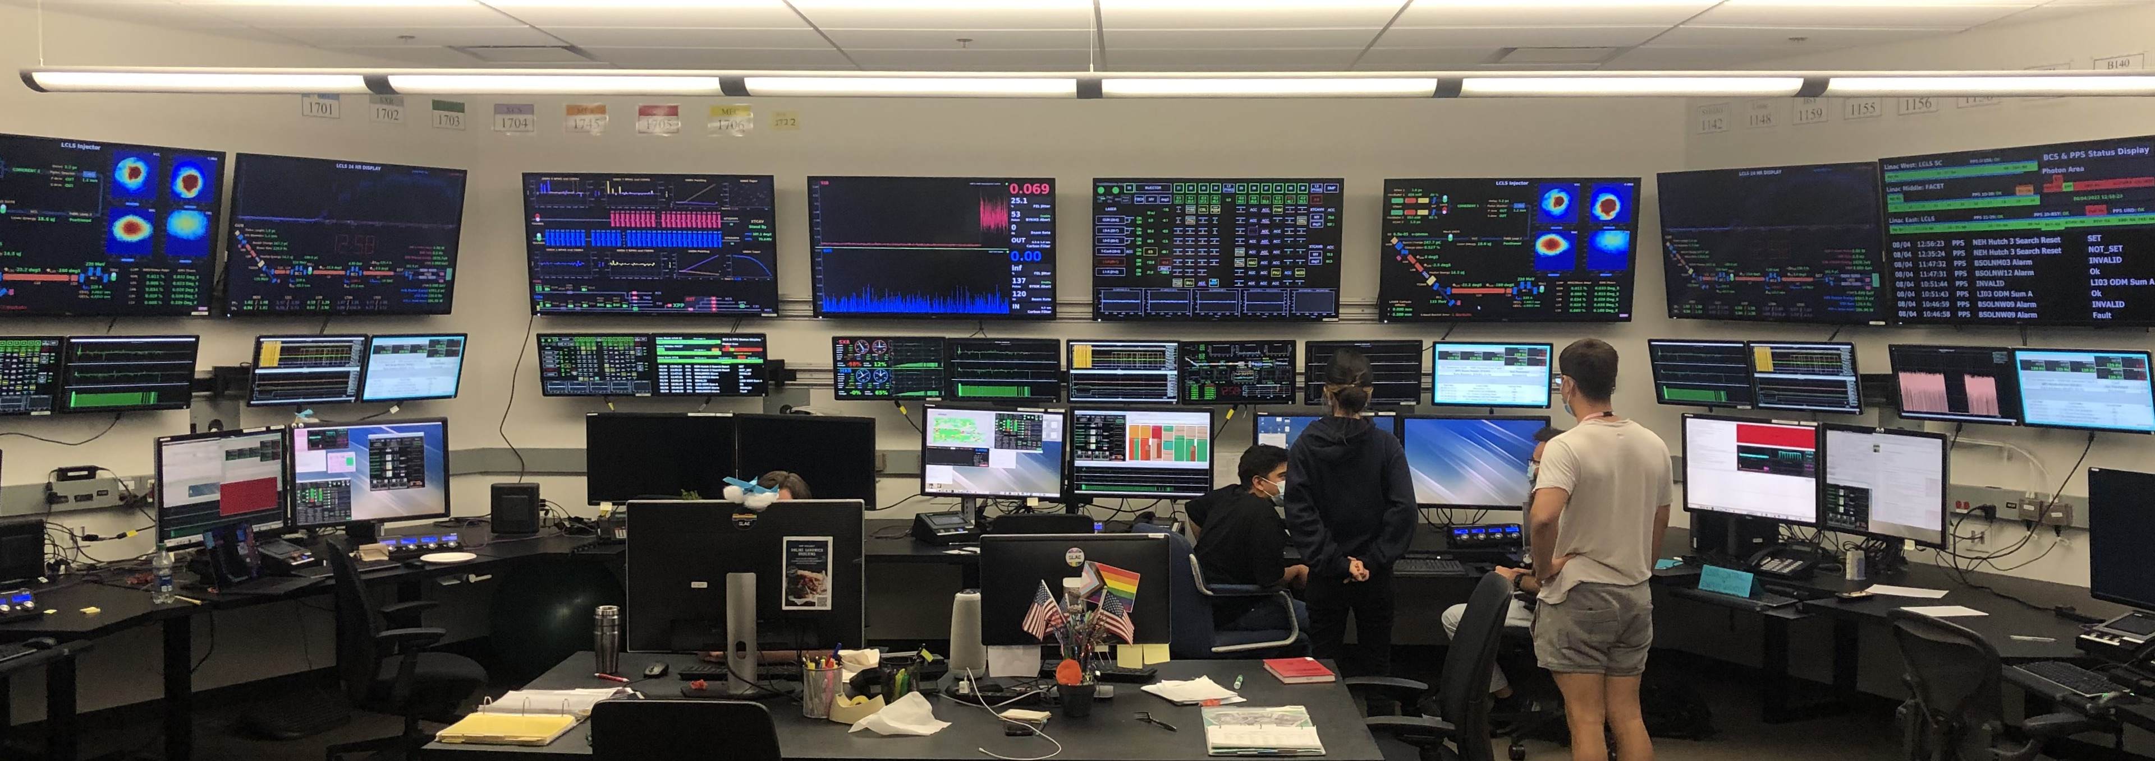
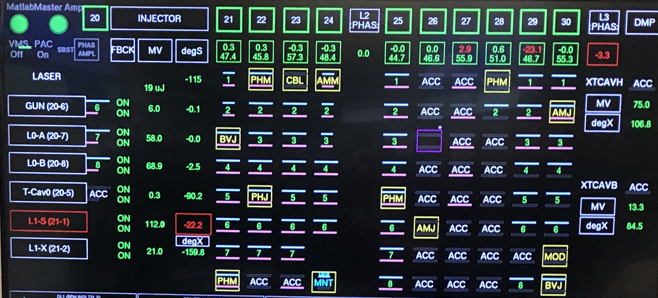
Anomaly Detection: RF Station Faults
Actual existing solution: Manual, beam-based anomaly detection
After observing a drop, search for RF stations with warning/fail status
Operators watch for a drop in X-ray power here
Many missed events
(recall ~ 1%)

Slide 7
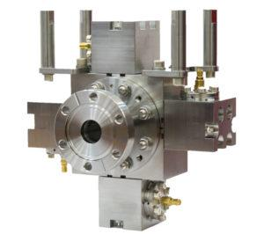
Anomaly Detection: RF Station Faults
New approach: Beam-based algorithm inspired by operators
Highway 280
RF stations
Beam position monitors
Question: How do we assess these algorithms with no labels?
Algorithm #1 looks for subsystem anomalies
Algorithm #2 looks at final beam quality
➔ self-consistency!
Simultaneous anomalies trigger alarm

Slide 8
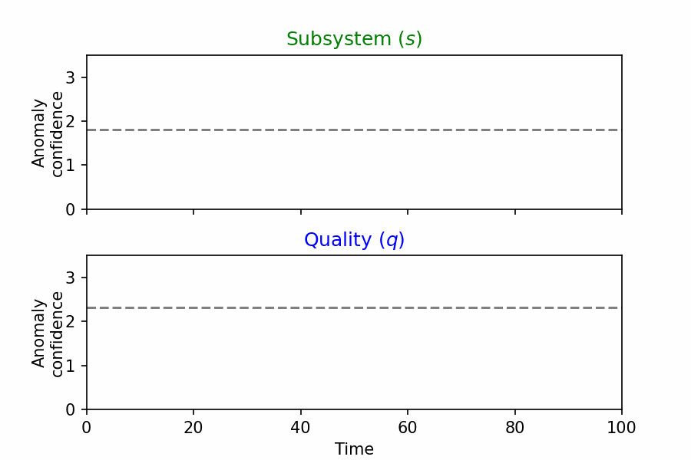
Coincident Anomaly Detection (CoAD)
Consider two algorithms making predictions on two streams of data
Subsystem
Algorithm 1
Prediction 1
Self-Consistency
metric
Unknown
machine state
Beam quality
Algorithm 2
Prediction 2
Red stars = consistent
black stars = inconsistent
More red = higher recall;
less black = higher precision
Threshold
FP rate = product of black star rates
TP rate = red star rate – FP rate
➔ Unsupervised precision/recall
R. Humble et al., MLST (2024)

Slide 9

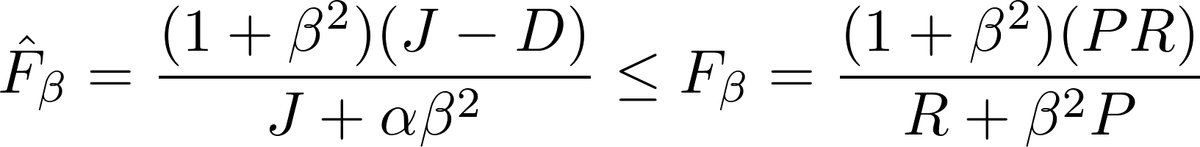
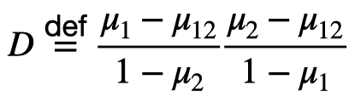




Coincident Anomaly Detection (CoAD)
Consider two algorithms making predictions on two streams of data
We estimate unlabeled version of recall/precision from coincidence
Estimates can be differentiable ➔ can train neural networks!
i.e. a loss function, not just a metric
Formally the loss function is defined for NN outputs :
: red star rate
: estimated FP rate
: Estimated anomaly rate
: Weighting factor (recall vs. precision)
R. Humble et al., MLST (2024)

Slide 10
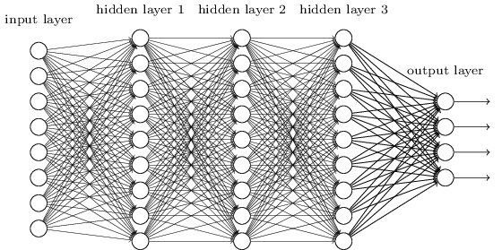
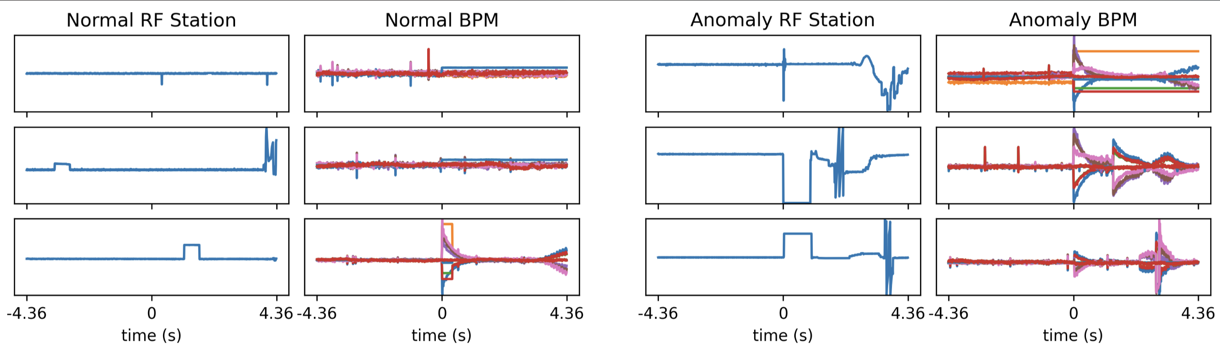
CoAD for RF Station Faults
Implementation for RF station task:
Network 1
Unsupervised loss function
RF Station data
Anomaly confidence
Estimated precision/recall
Network 2
Beam Data
Anomaly confidence
Normal examples
Anomalous examples
RF station phase
Beam energy
RF station phase
Beam energy
Jason Liang

Slide 11
CoAD for RF Station Faults
Summary of predictions on 4 months of data
 | Precision | Recall (events)
Manual recording by operator | NA | 6
Status bit | 0.31 | 385
Coincident Detection | 0.88 | 504
100x more anomalies vs. manual recording
30% more anomalies vs. status bit
With phase data,
Now 4x higher recall!
6x fewer false positives vs. status bit
R. Humble et al., PRAB (2022)
Ryan Humble, Finn O’Shea, Zhe Zhang, Jason Liang
R. Humble et al., MLST (2024)

Slide 12
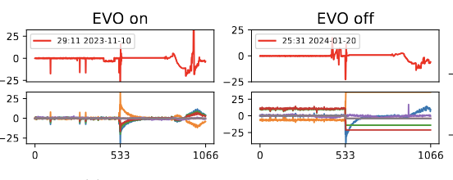
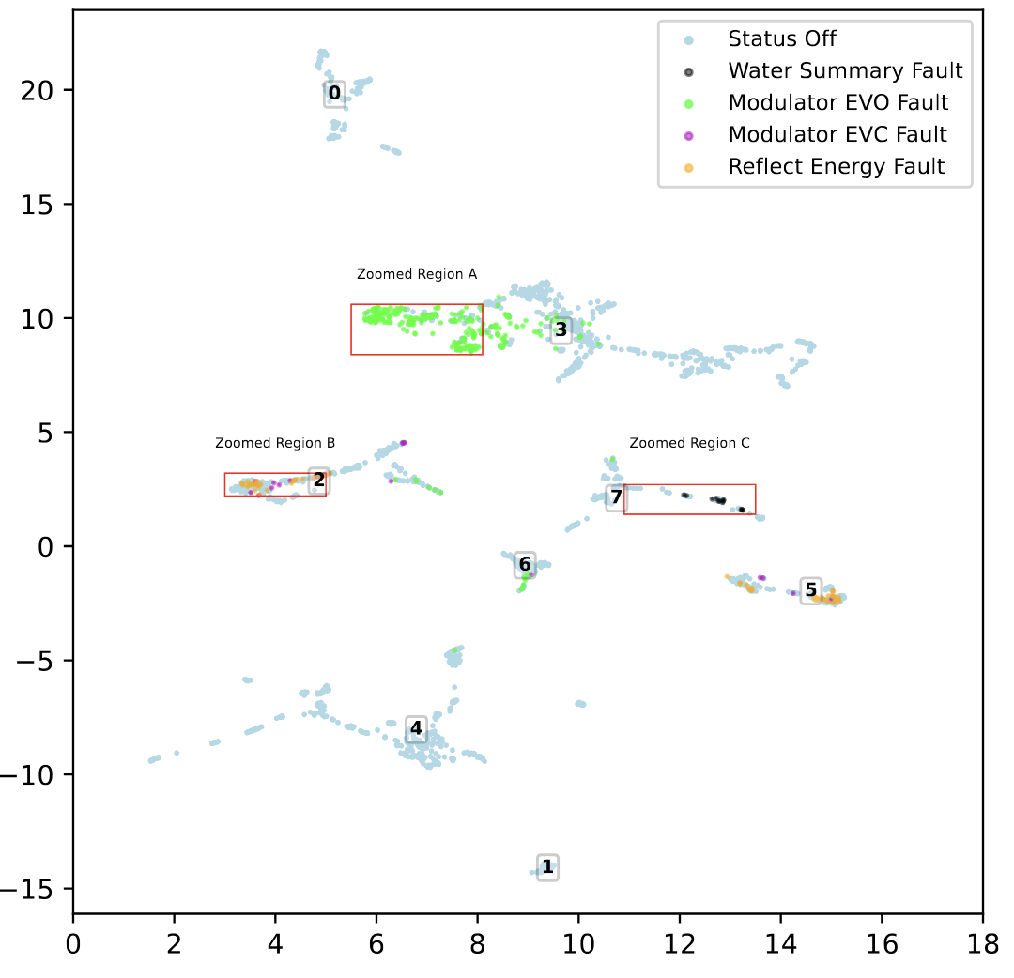
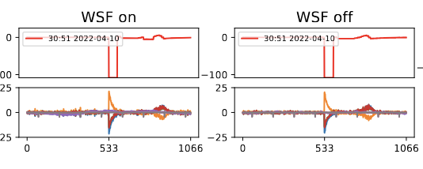
CoAD for RF Station Faults
Interpretability and root-cause analysis
Interpretability of scores ➔ can investigate failure modes of the models
Rich phase data ➔ can cluster faults and map to known problems
Modulator fault (EVO)
Water fault (WSF)
Jason Liang

Slide 13
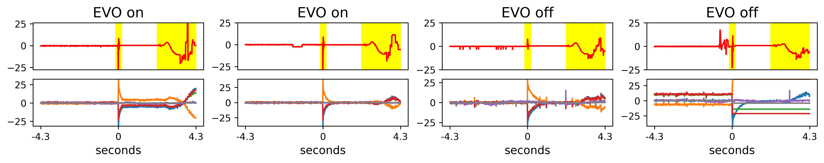
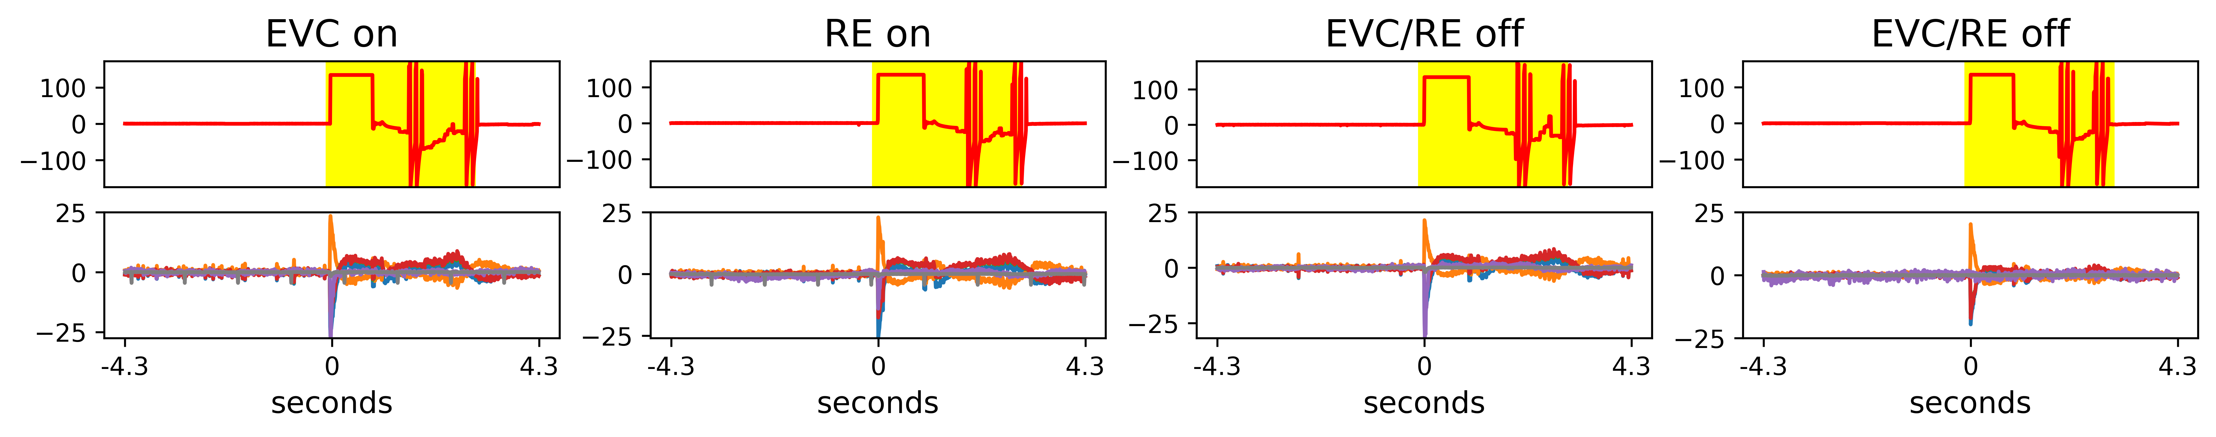
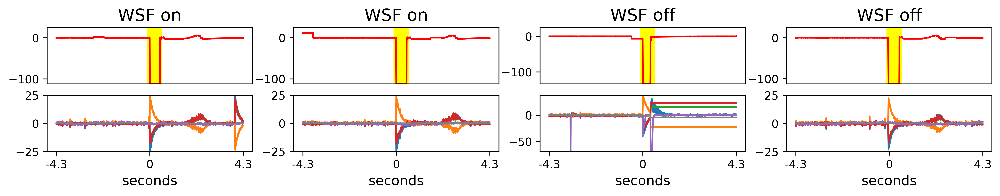
CoAD for RF Station Faults
Interpretability and root-cause analysis
Interpretability of scores ➔ can investigate failure modes of the models
Rich phase data ➔ can cluster faults and map to known problems
Jason Liang

Slide 14
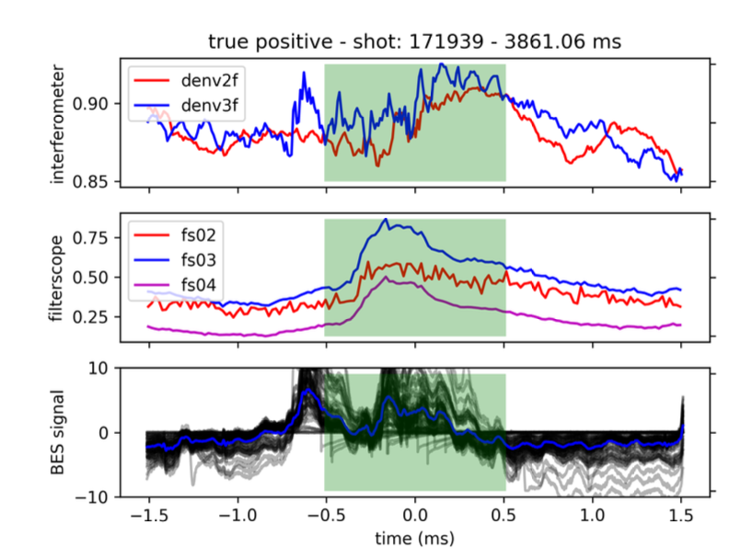
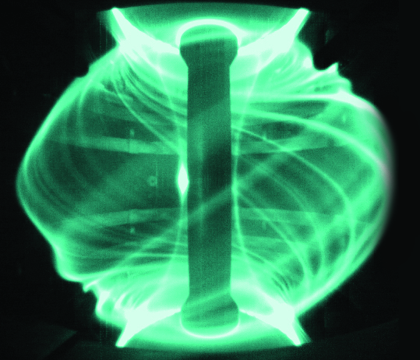
Other applications of CoAD
Exploring new applications:
Finding instabilities in Tokamaks
Failures in milling equipment
Removing backgrounds from Lux-Zeppelin
Template-free search at LIGO
Let me know if you have an idea!
Searching for edge-localized modes (ELMs) in tokamaks
”S” network sees filterscope/interferometer
“Q” network sees beam-emission spectrum (BES)
CoAD finds 50% more ELMs than SoTA!
Fusion-cdt
Finn O’Shea, Ryan Coffee, et al., MLST (2024)

Slide 15
Thanks for your attention!
And thanks to collaborators:
Eric Darve, Ryan Humble, Jason Liang, Finn O’Shea, Zhe Zhang

