Slide 1
Charged NSI in short baseline experiments
Orlando L. G. Peres
University of Campinas
2nd Short-Baseline Experiment-Theory Workshop April 2-5/24
Cherchiglia, Pasquini, OLGP, Rodrigues, Rossi arxiv:2310.18401

Slide 2
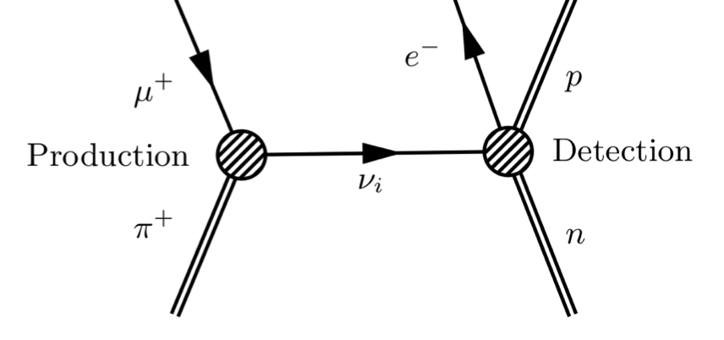
Non-Standard Neutrino Interactions
1991 Guzzo and Masiero
1991 Roulet
Charged NSI
Charged NSI
propagation NSI
(assumed here null)

Slide 3
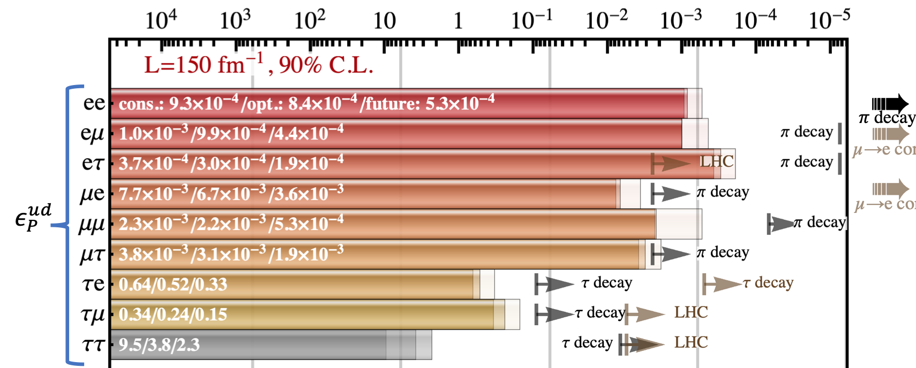
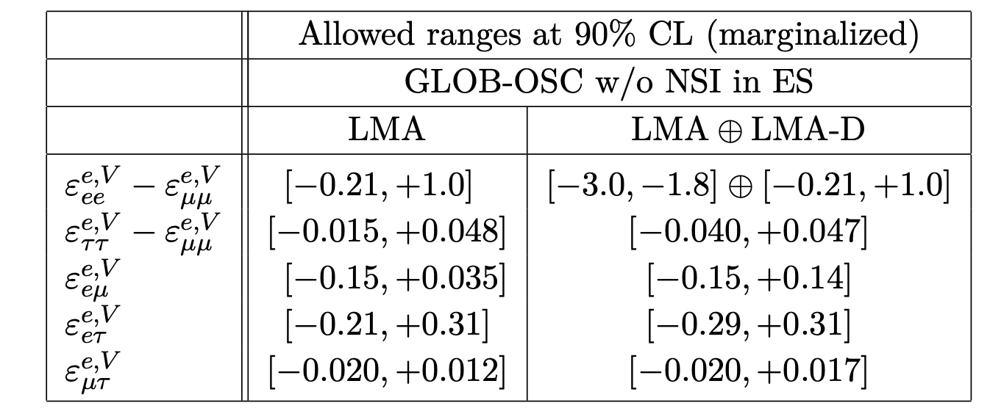
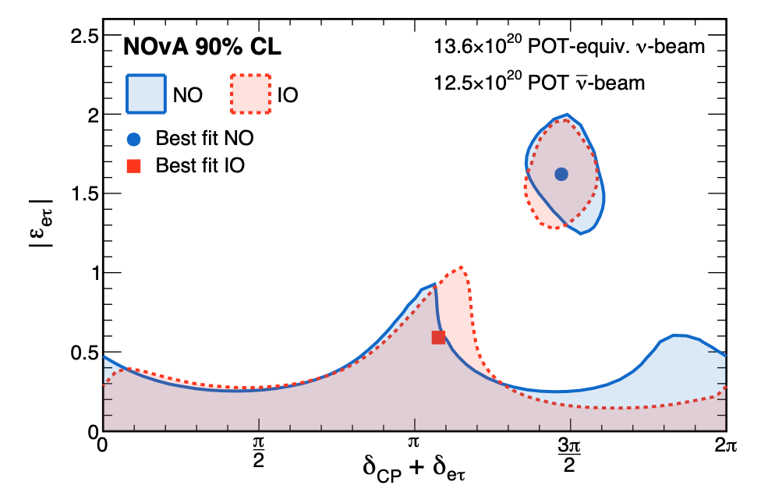
Non-Standard Neutrino Interactions
1991 Guzzo and Masiero
1991 Roulet
Charged NSI
Neutral NSI
Falkowski, Gonzalez-Alonso, Kopp, Soreq and Tabrizi, arxiv:2105.12136
Coloma, Gonzalez-Garcia, Maltoni, Pinheiro and Urrea arxiv:2305.07698
Kopp, Rocco and Z. Tabrizi arxiv:07902 Zahra Tabrizi Talk at this conference
Du, Li, Tang, Vihonen and Yu arxiv:2401.02901
Cherchiglia, Pasquini, OLGP, Rodrigues, Rossi arxiv:2310.18401
NOVA Acero et al. arxiv:2403.07266
Daya Bay experiment, arxiv:2401.02901

Slide 4
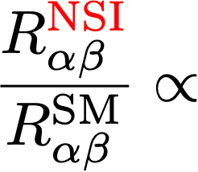
Quantum Field Theory computation of flavor transformation
Propagation include time evolution
Talk by Zahra Tabrizi on the basics of this procedure
As a proof of concept we will assume a pseudo-scalar interaction
is a complex parameter.

Slide 5
Quantum Field Theory computation of flavor transformation
As a proof of concept we will assume a pseudo-scalar interaction
Let’s assume a non-zero parameter

Slide 6
Quantum Field Theory computation of flavor transformation
How to get the full matter probability? We can solve numerically but
we will take advantage to have an analytical computation of this probability.
From Asano and Minakata, JHEP 06, 022 (2011), arXiv:1103.4387 [hep-ph]. We have analytical formulae for usual oscillations,
Series solution
The Asano-Minakata work with amplitudes, most of other
analytical formulae work with probabilities.

Slide 7
Standard oscillation
Conversion amplitude
Initial state
Final state
The full probability with matter effect for three neutrinos
Series solution

Slide 8
Charged NSI
Conversion amplitude
Survival amplitude
Initial state
Final state
Series solution

Slide 9
Charged NSI
The time evolution for Charged NSI is similar to the time evolution
in usual oscillation scenario.

Slide 10
Charged NSI
Conversion amplitude
Survival amplitude
Initial state
Final state
\
CP violation from PMNS mixing matrix
CP violation from
phase (“Wolfenstein like”)

Slide 11
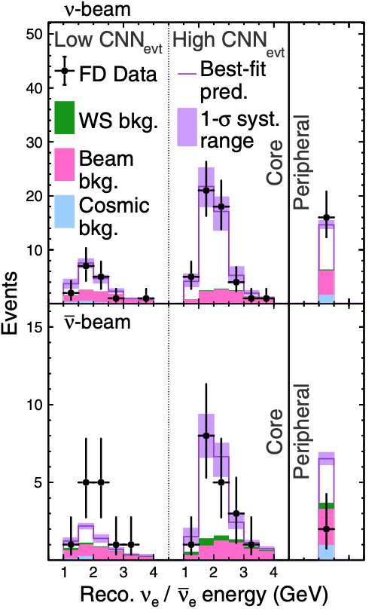
As an example of charged NSI application for real data
appearance data (NOVA and T2K)

Slide 12
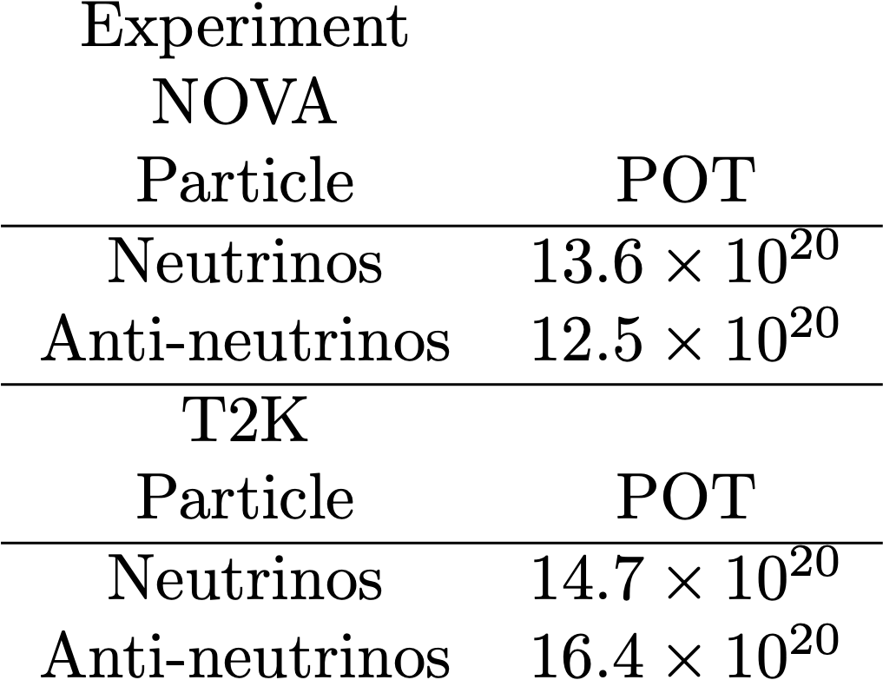
As an example of charged NSI application for real data
appearance data
GLOBES to simulate the electron/muon neutrino (anti-neutrino).
Priors:

Slide 13
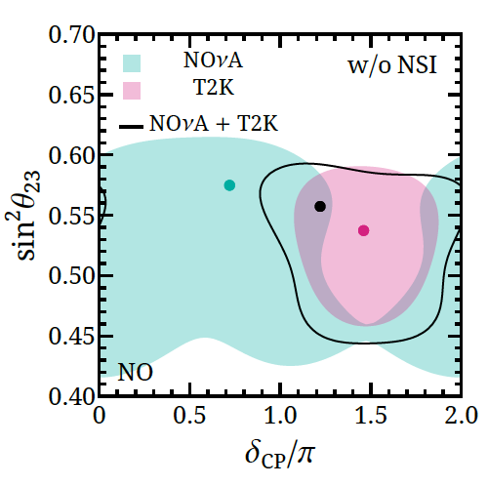
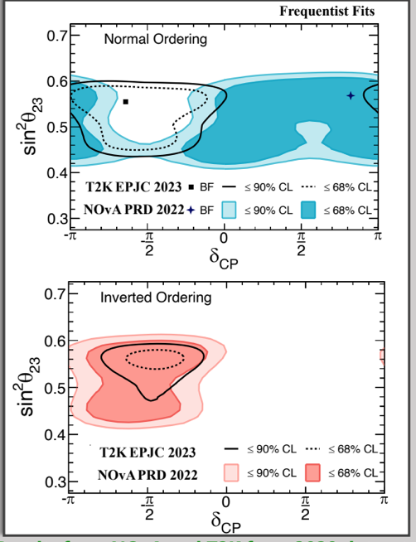
Tension between T2K and NOVA (?!)
T2K and NOVA results
Our results for T2K and NOVA data
What happen when we switch on the charged NSI?

Slide 14
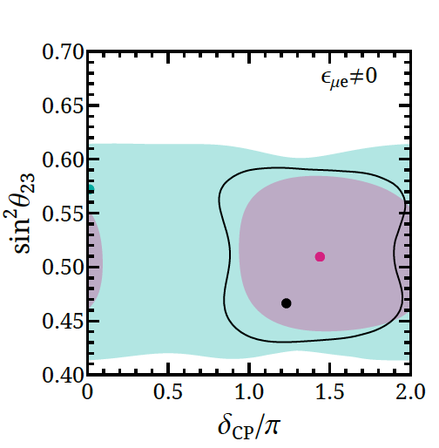
Charged NSI X Standard oscillation
Standard Oscillation
Charged NSI
First terms of the probability,
Standard oscillation CP violating factor
Charged NSI oscillation CP violating factor

Slide 15
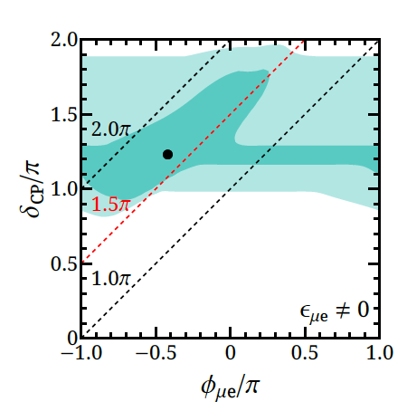
Charged NSI CP violation
What happened to the CP phases?
Charged NSI case
Standard oscillation limit
Standard Oscillation
Charged NSI
First terms of the probability,
Standard oscillation CP violating factor
Charged NSI oscillation CP violating factor

Slide 16
appearance
There are different scenarios where
appearance can be a signal for BSM
Standard Oscillation
appearance
far detector
yes
near detector
no
BSM scenario
3+1 sterile scenario
non-unitarity
neutral NSI scenario (propagation)
light boson
appearance
far detector
yes
near detector
yes

Slide 17
Can we see unusual effects in this scenario?
Conversion probability
Survival probability
Initial state
Final state
appearance

Slide 18
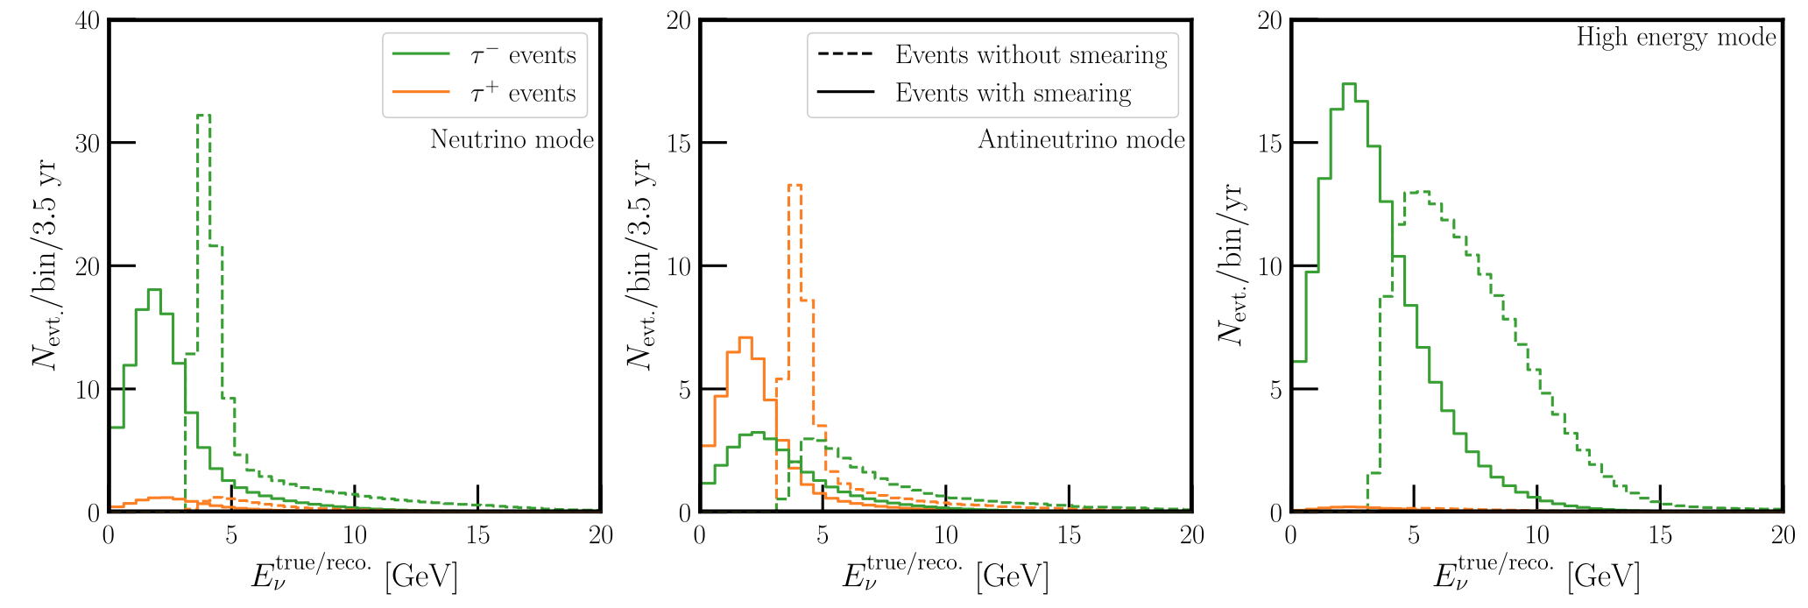
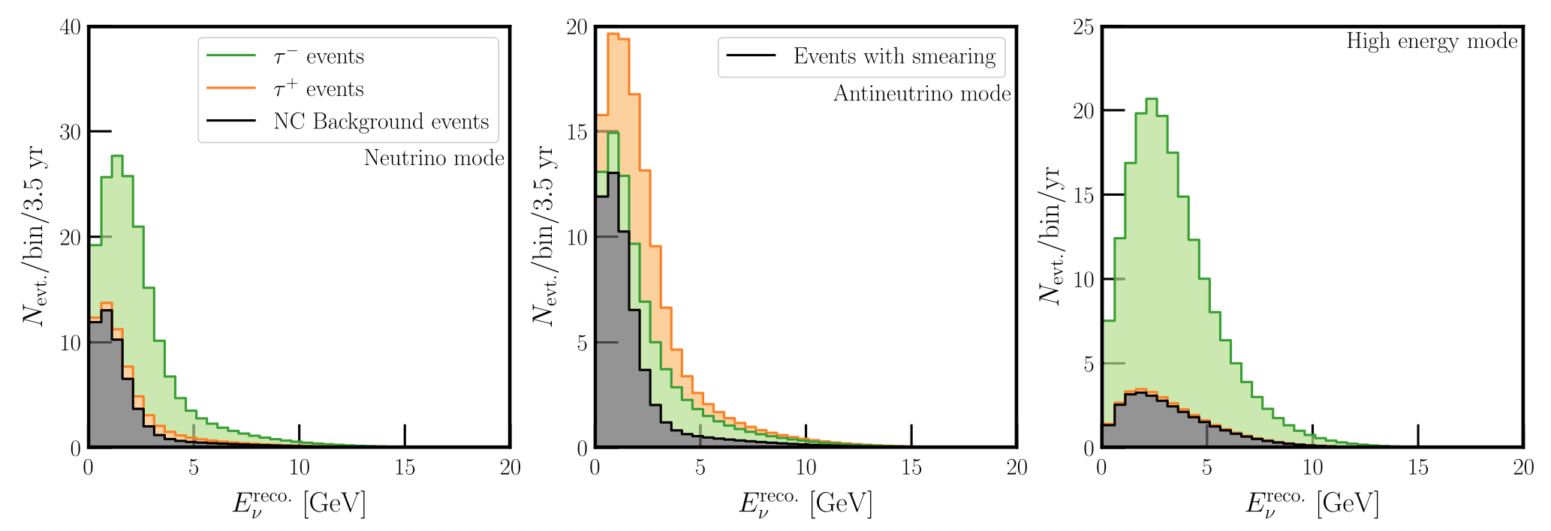
appearance , we follow
A. De Gouvea, K. Kelly, G. V. Stenico and P. Pasquini, Phys.Rev.D 100 (2019) 1, 016004 • e-Print: 1904.07265 [hep-ph]
Tau neutrino appearance in DUNE (from de Gouvea)
Normalization uncertainty, NC background included

Slide 19
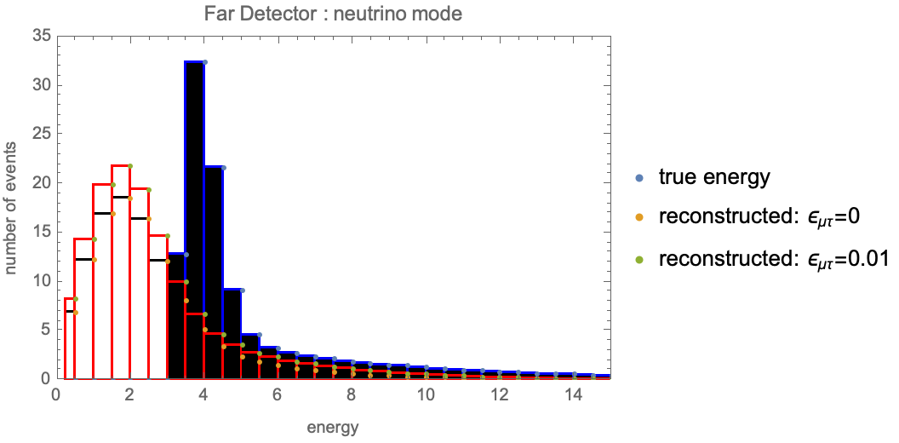
Tau neutrino appearance in far neutrino detector at DUNE with charged NSI
(work in progress, far detector)
\
With the same assumptions we can reach
The projected sensitivity from FASER is
Still working in progress, effects of charged NSI in
muon disappearance not included

Slide 20
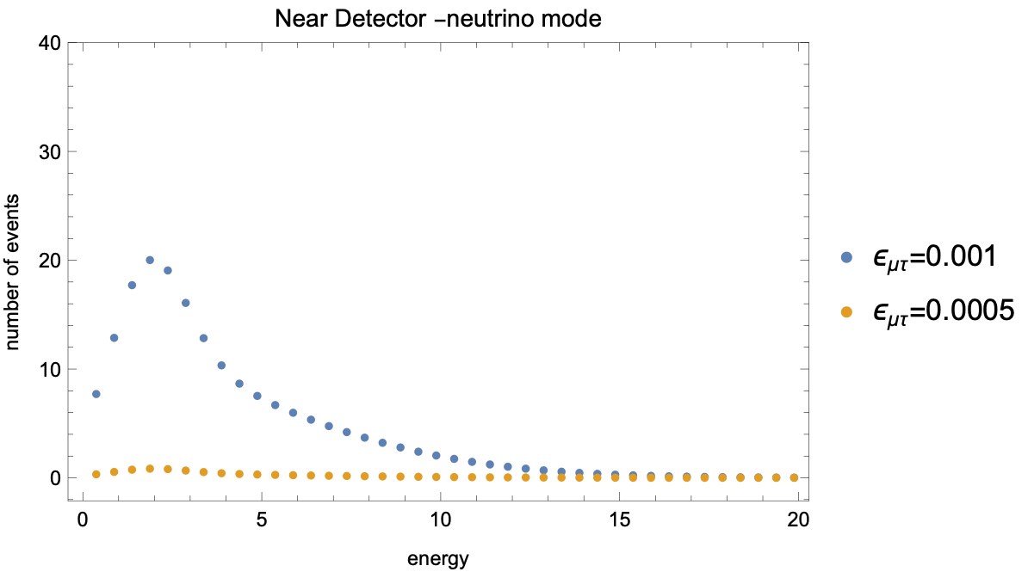
Similar for Tau neutrino appearance in near neutrino detector
(work in initial state, near detector)
Not yet fully polished, different assumptions
from far detector
the NC estimation still ongoing.
We can get a conservative value of

Slide 21
Conclusions
NSI for neutrinos is a interesting topic of interest in neutrino phenomenology
Charged NSI can have different behavior of propagation NSI
New source of CP violation from charged NSI, can change the results of
appearance experiments
Charged NSI with taus can induce tau neutrino appearance in far and near detector
My question: Usually in LBL, electron neutrino came from three-body decay.
In the charged NSI ( NSI at source ) electron neutrino can came from two-body decay.
this can help discriminate ?

