Slide 1
Discussion session: Alternative PeVatrons
Kaya and Matthew

Slide 2

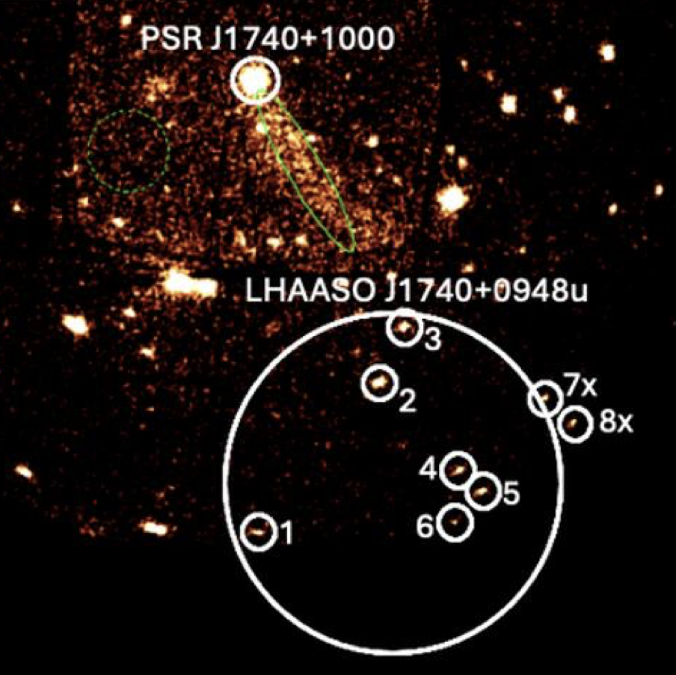
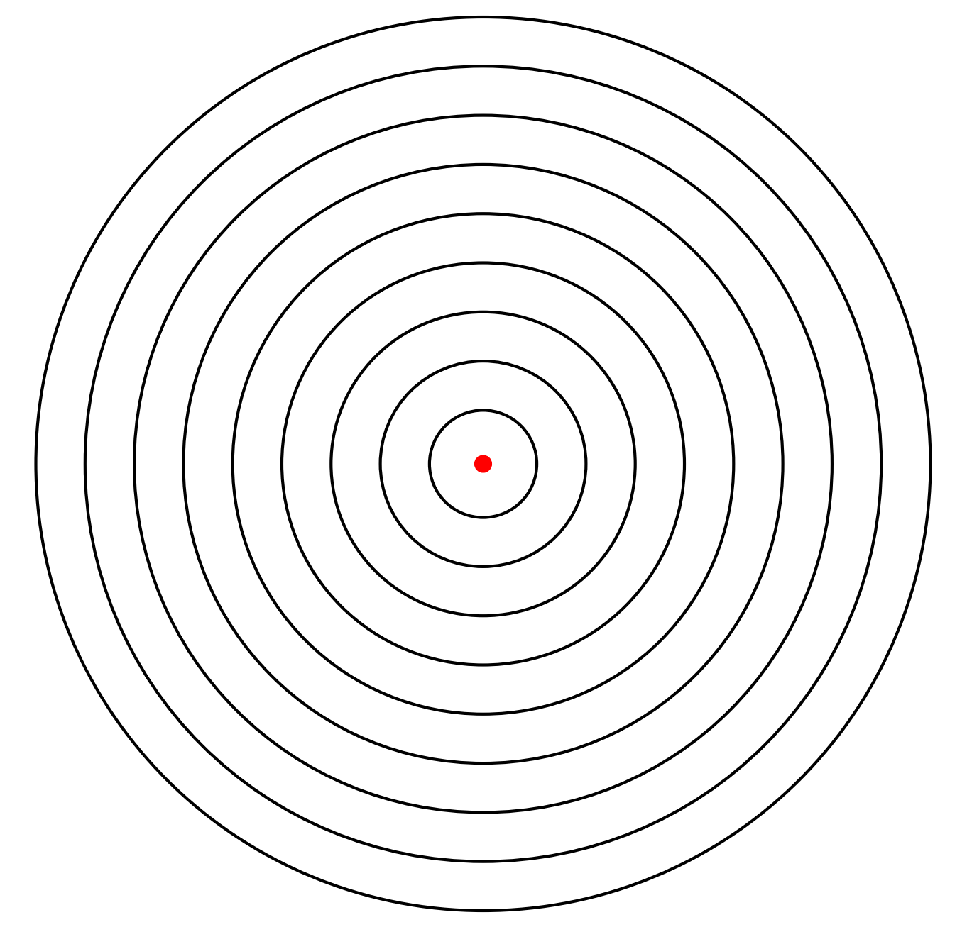

Pulsar wind nebulae
One source and one acceleration/injection site
Energy injection rate is known = spin-down power
MW SED and morphology data can be modeled and fitted
$$R_{PWN}$$

Slide 3
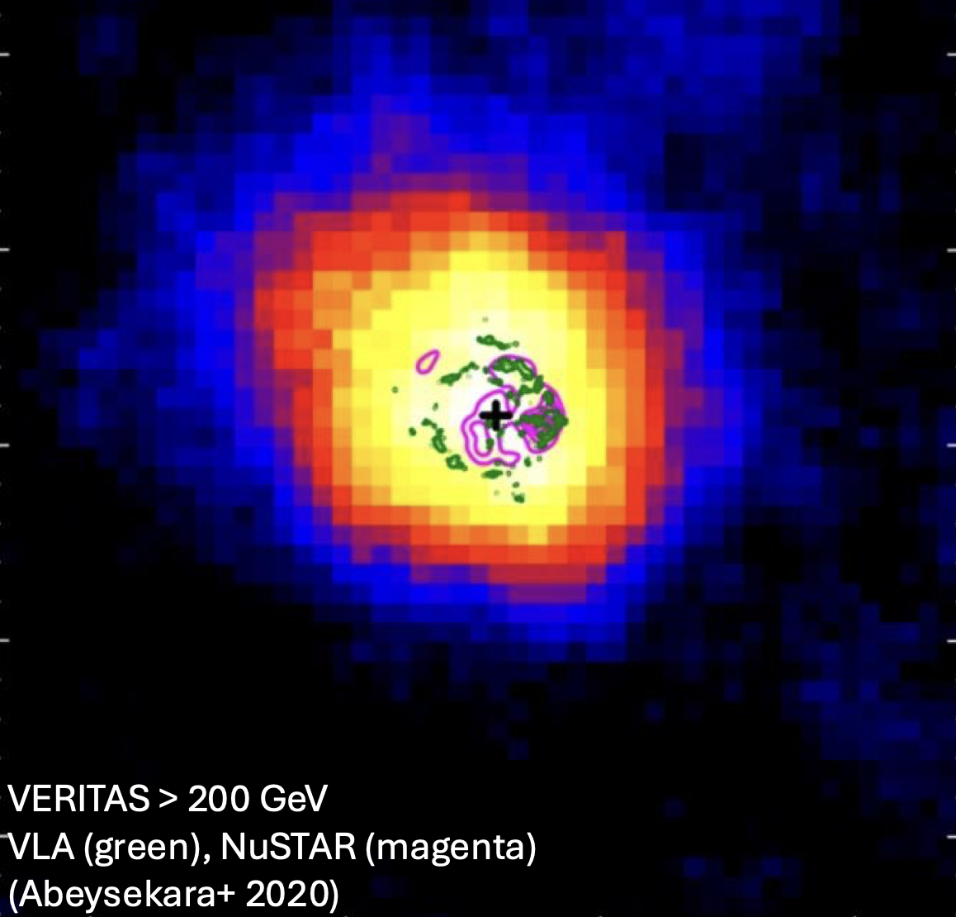
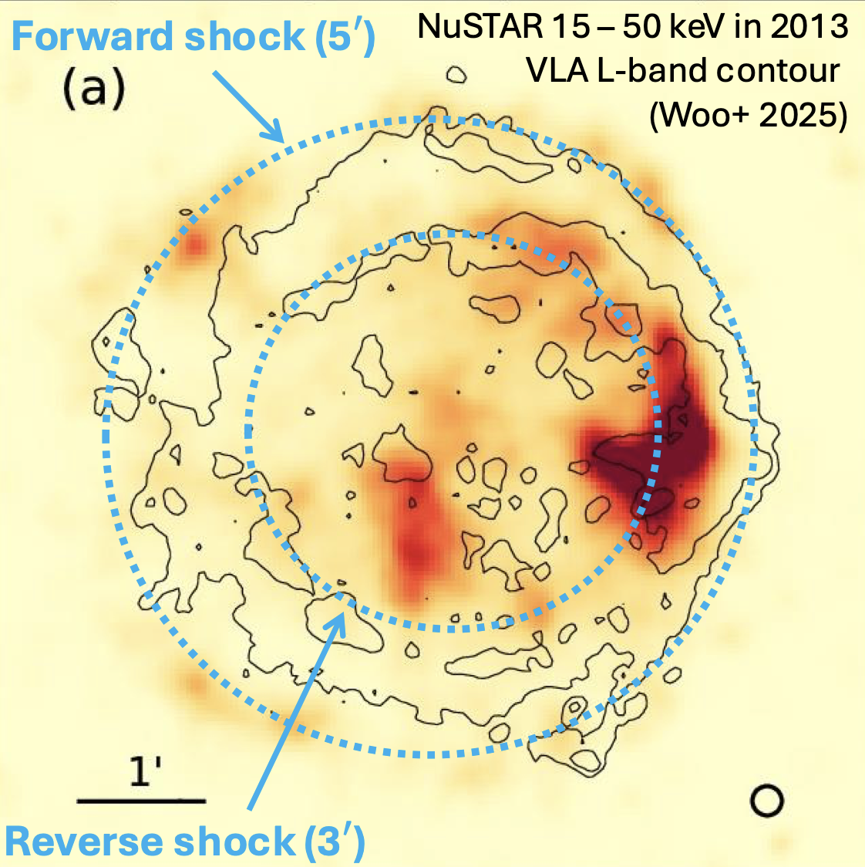
Supernova remnants
One source and multiple acceleration sites
Identify acceleration sites => Hard X-ray (NuSTAR)
Energy injection rate/spectrum => radio + hard X-ray SED variability
Robust comparison with DSA simulation (Rebecca, Martin, Emily)

Slide 4
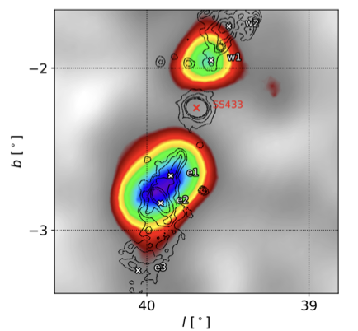
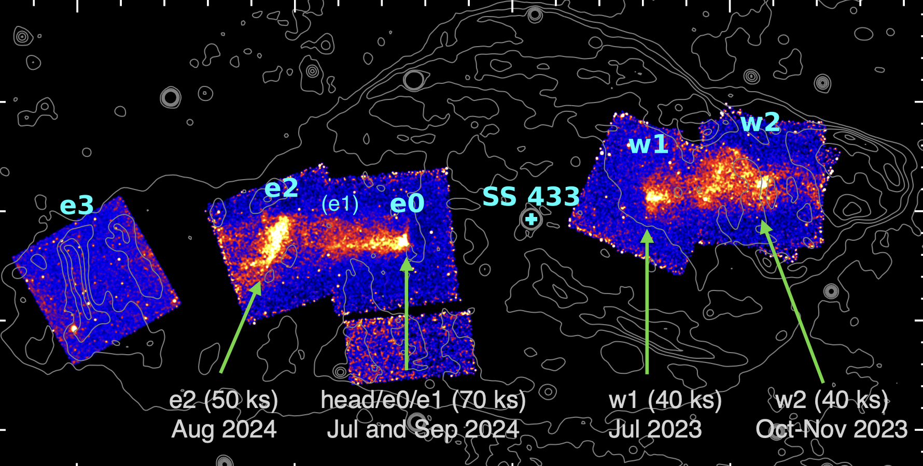
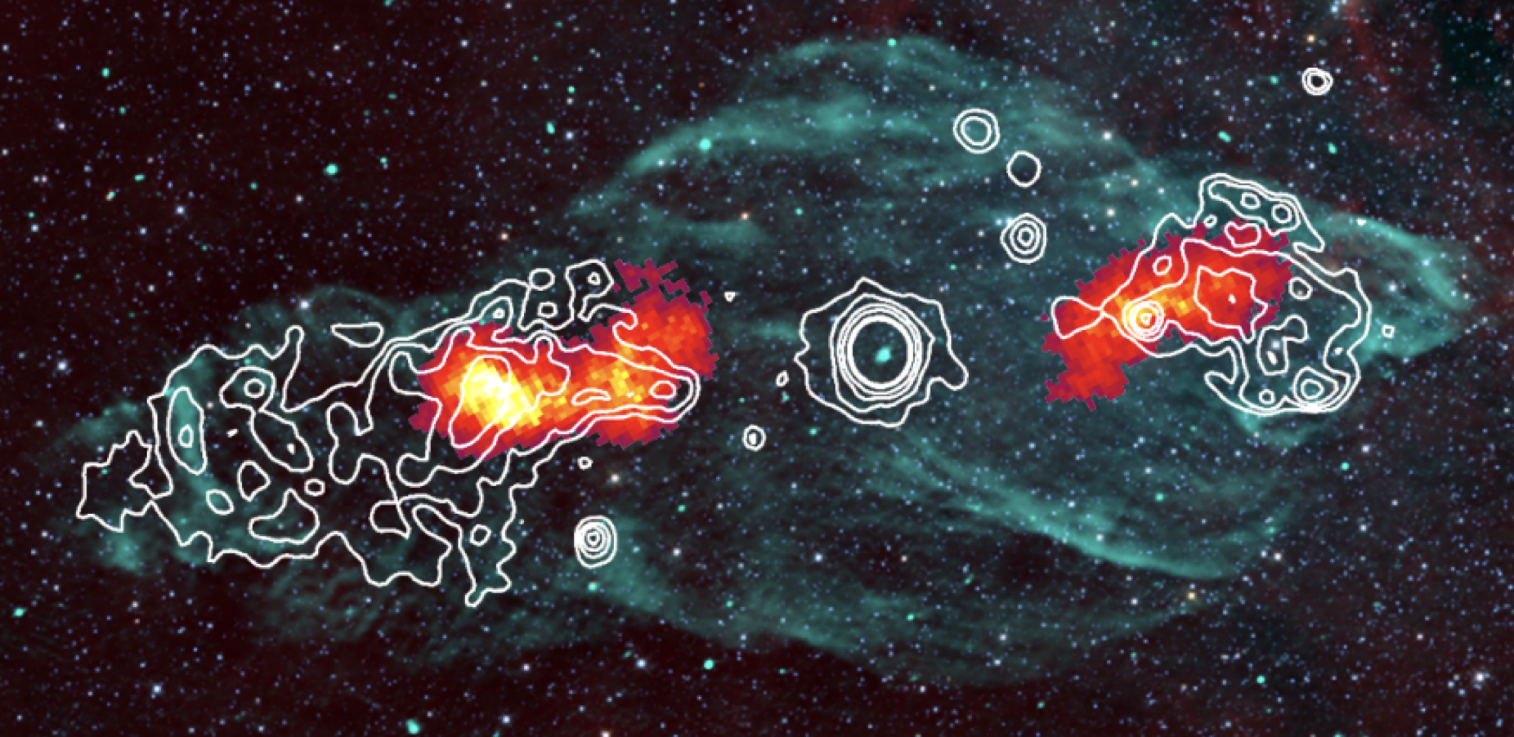
Microquasars
One source and multiple acceleration sites
Identify acceleration sites: HAWC/LHAASO => IACTs => X-rays
Comparison with MHD/PIC simulations (e.g., Haocheng)
HAWC (Xiaojie)
H.E.S.S (Laura)
Chandra (X-ray; Naomi)

Slide 5
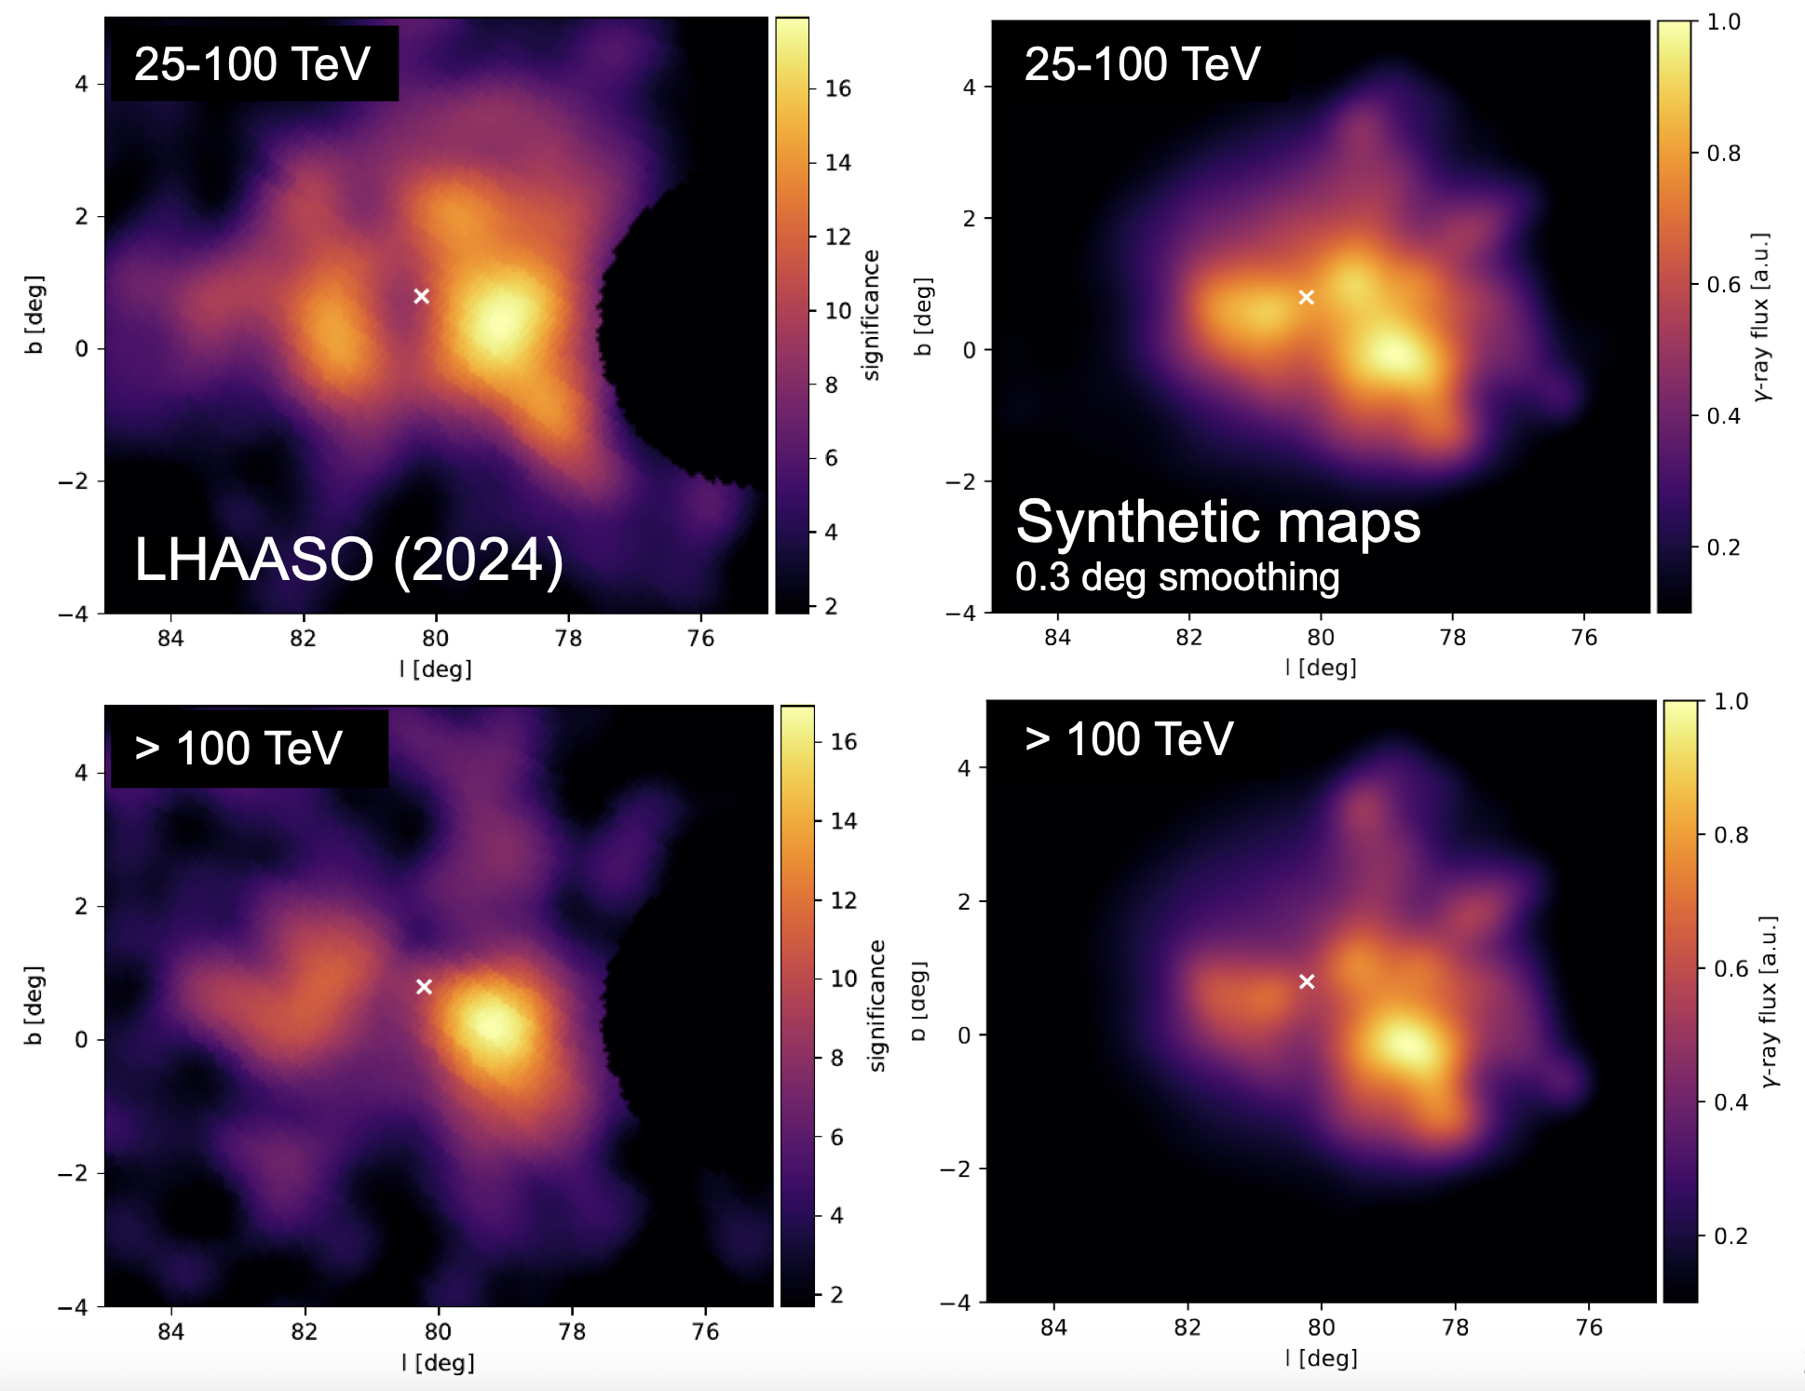
Star clusters (Silvia, Lucia)
Many energy injection sources: colliding winds and SN explosions
Need to consider target molecular clouds
Integrate your particle injection/propagation over millions of years.
Can X-ray and radio data help? Or is this a gamma-ray-only story?

Slide 6
Dark/passive/transient PeVatrons and target molecular clouds
Ruizhi: 5 nearby molecular clouds => stacking analysis => significant TeV detection by LHAASO => CR spectrum consistent with the knee
Dark/Passive PeVatrons: PeVatron accelerators are NOT located near target molecular clouds.
Transient PeVatrons: outbursting microquasars
How do we tackle and understand dark PeVatrons and transient PeVatrons

