Slide 1
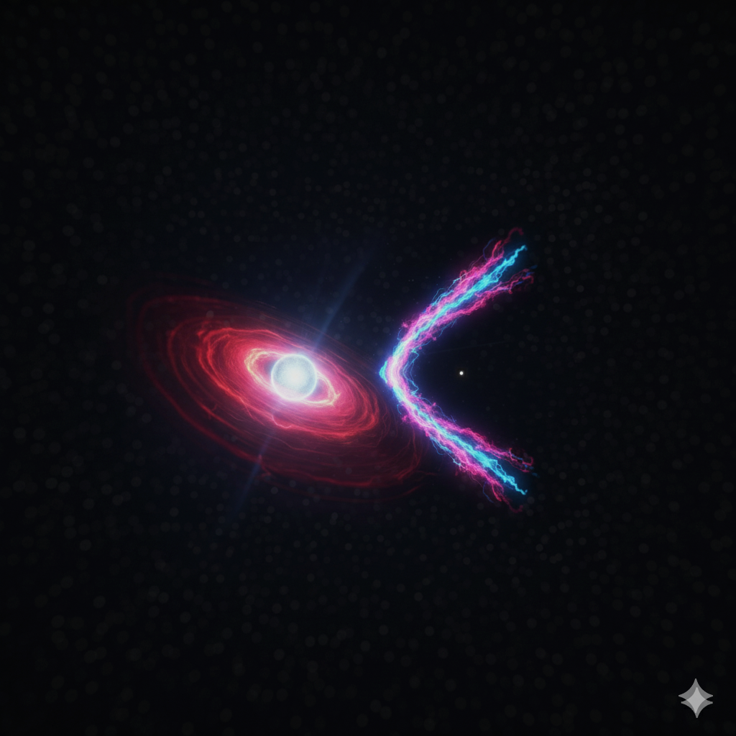

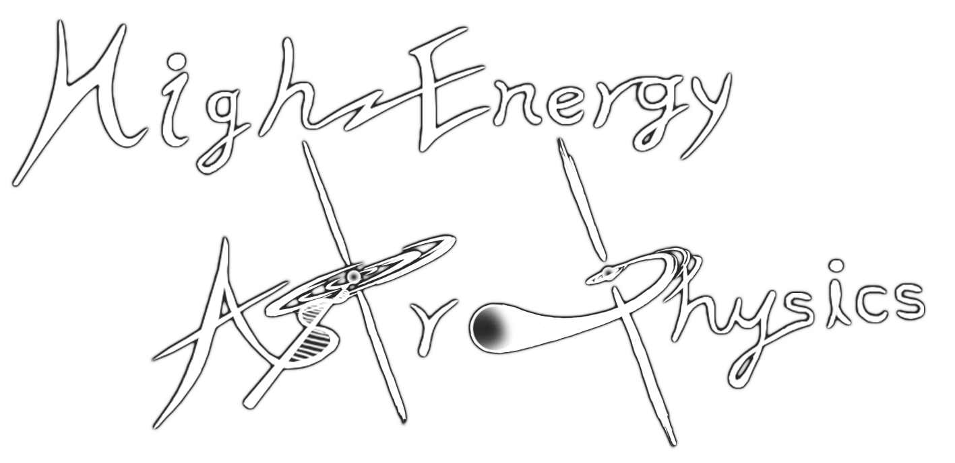

TeV $γ$-ray Binary HESS J0632+057: Multi-Wavelength Insights into Pulsar–Disk Interactions
Jaegeun Park
Chungbuk National University
CDHY PeVatron Workshop | October 10, 2025

Slide 2
Outline
Introduction to HESS J0632+057
Multi-Wavelength Observation Campaign
Key Findings
Interpretations
Summary & Future Work

Slide 3
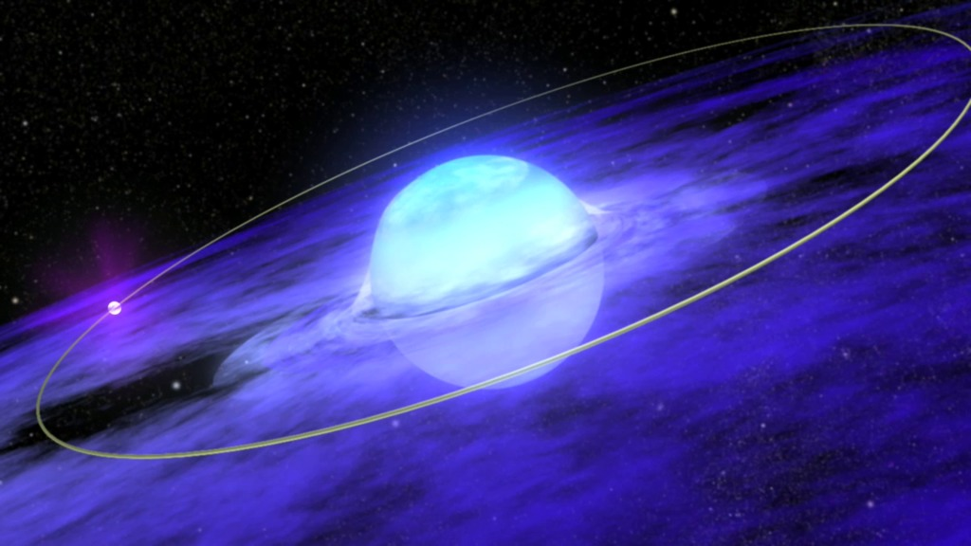
What are TeV Gamma-ray Binaries?
TeV Gamma-ray binary system
Compact object (NS or BH)
Early-type star (O, B or Be)
Credit: Walt Feimer, NASA/Goddard Space Flight Center
TGBs are rare, high-mass stellar systems composed of a compact object (a neutron star or black hole) and a massive star
They are potential PeVatrons, capable of accelerating particles to emit photons with energies > 100 TeV (Alfaro+2025)
Sometimes TGB has a Be-type companion star with a decretion disk, further complicating and enriching the observed high-energy phenomena

Slide 4
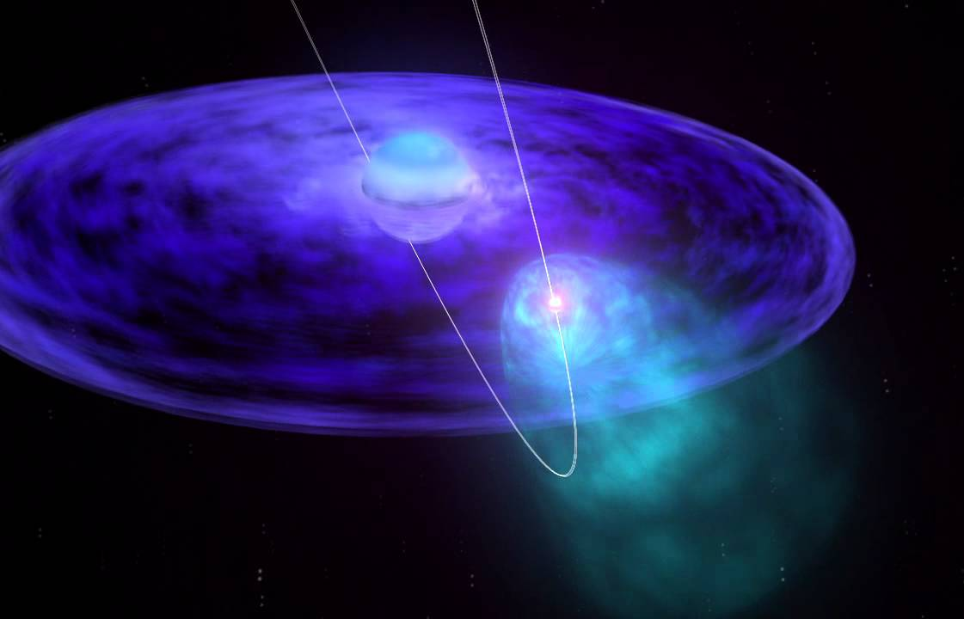
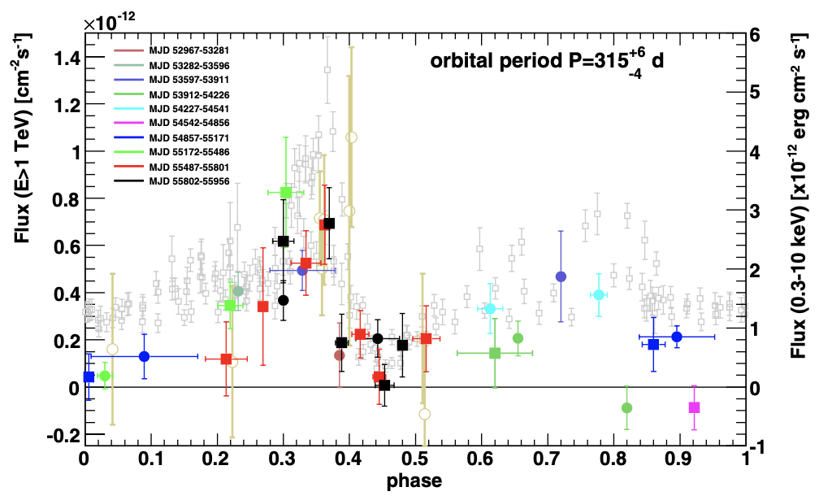
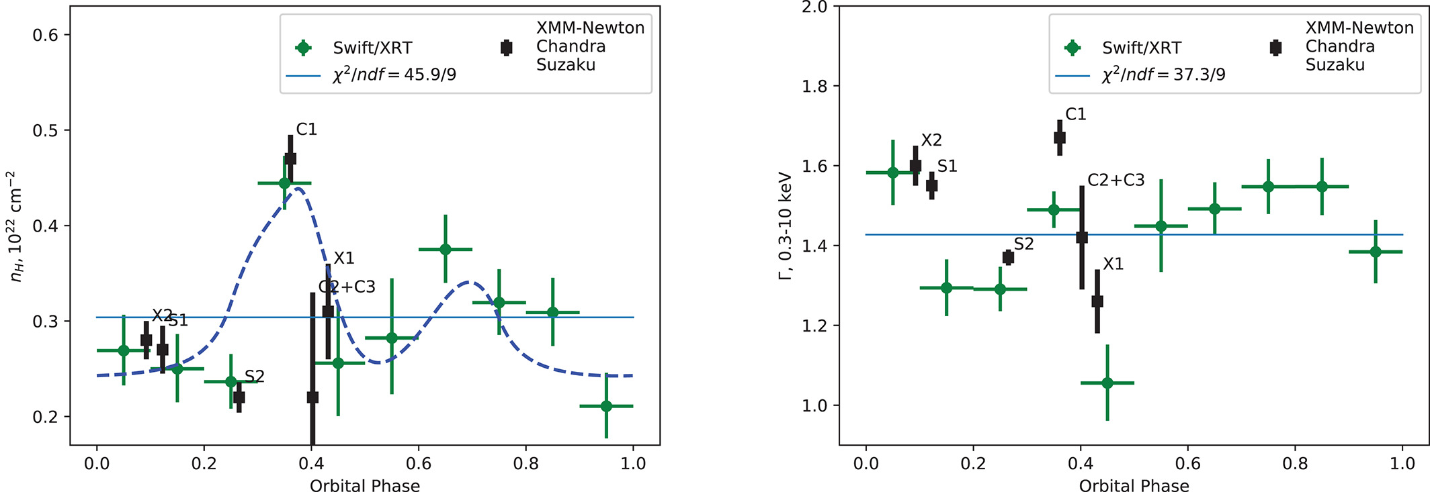
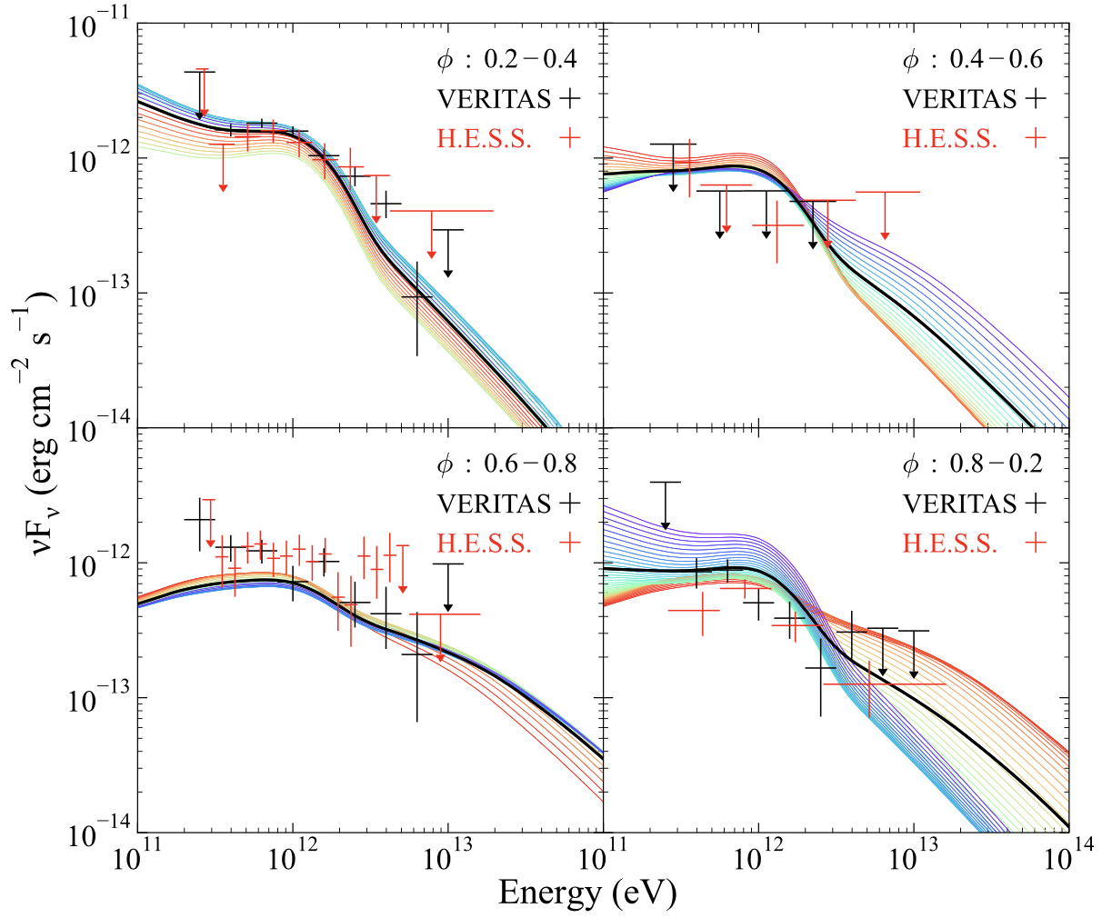

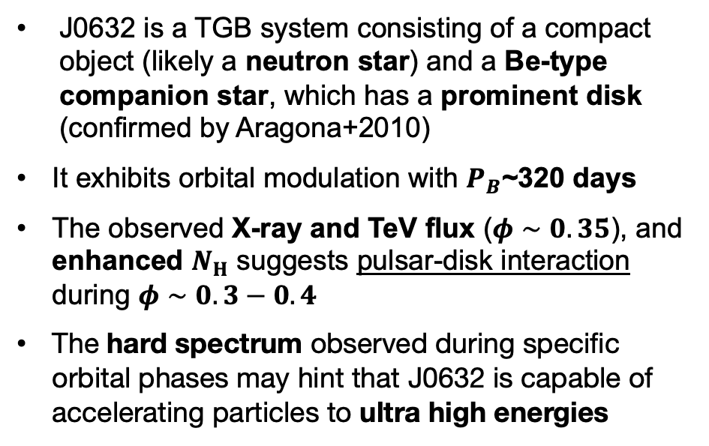
HESS J0632+057: A Unique Laboratory
Companion
(Aliu+ 2014)
(Malyshev+ 2019)
Neutron star
X-ray/TeV lcs
$N_{H}$ modulation
Disk
Intrabinary Shock
J0632 is a TGB system consisting of a compact object (likely a neutron star) and a Be-type companion star, which has a prominent disk (confirmed by Aragona+2010)
It exhibits orbital modulation with $P_{B}$~320 days
The observed X-ray and TeV flux ($φ∼0.35$), and enhanced $N_{H}$ suggests pulsar-disk interaction during $φ∼0.3−0.4$
The hard spectrum observed during specific orbital phases may hint that J0632 is capable of accelerating particles to ultra high energies
(Kim+ 2022)
Hard spectrum

Slide 5
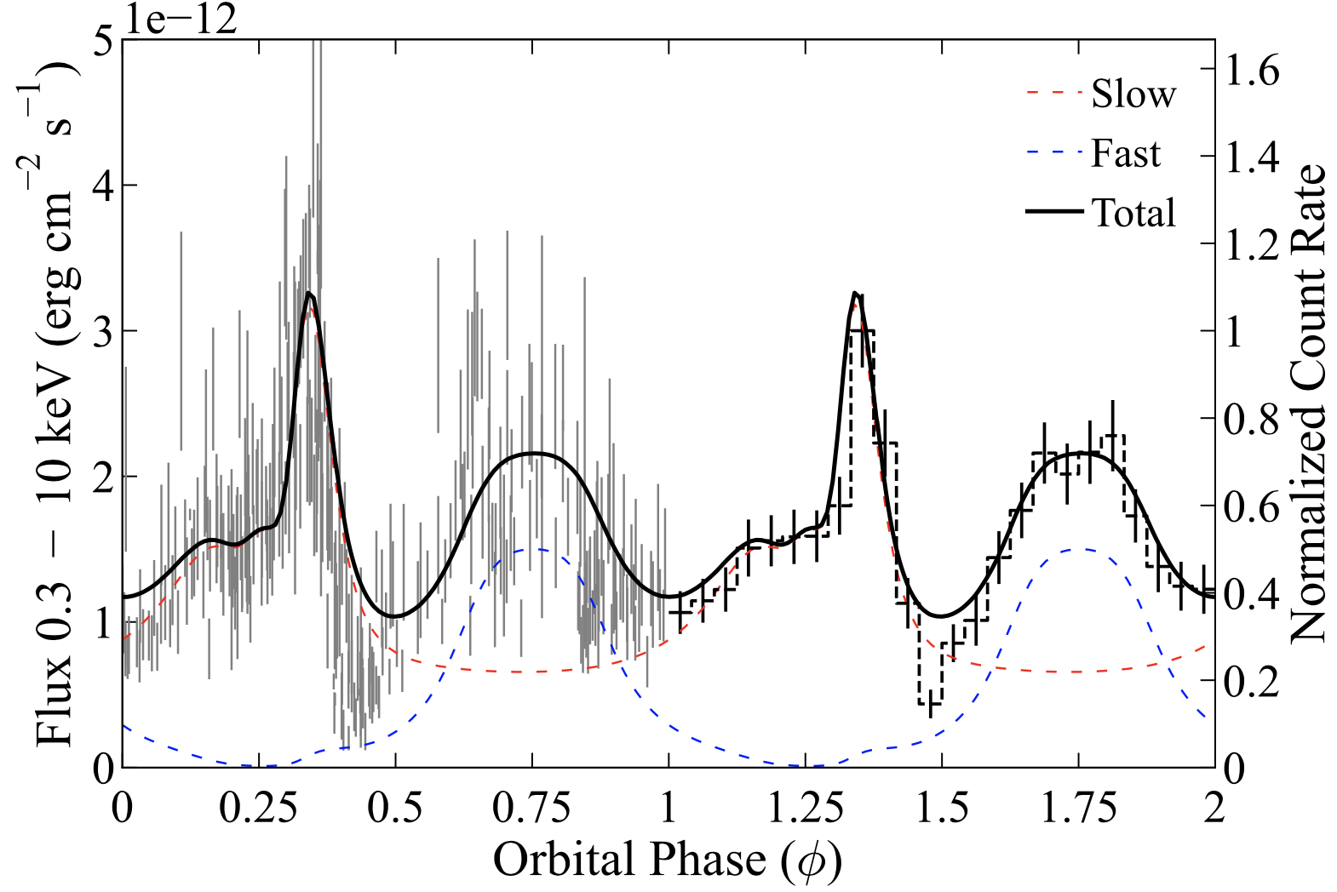
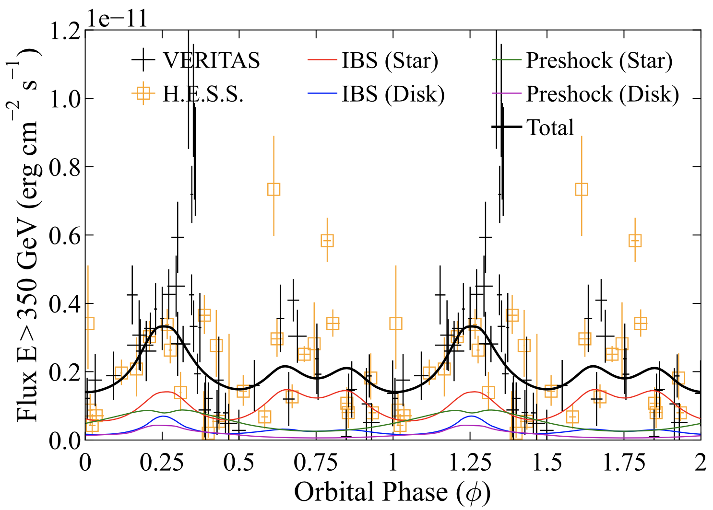
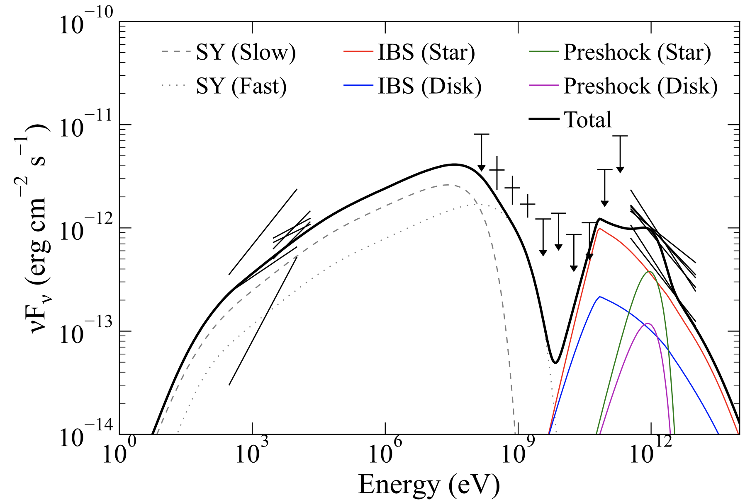
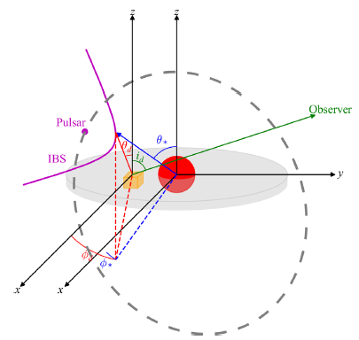
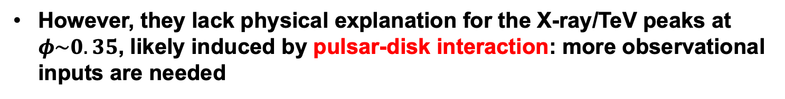
An intrabinary shock scenario for J0632
X-ray
TeV
(Kim+ 2022)
An IBS is formed by interaction between the pulsar’s and companion’s winds (magenta)
This model have been successful in explaining general features of the light curves and phase-averaged SED
However, they lack physical explanation for the X-ray/TeV peaks at $φ\sim 0.35$, likely induced by pulsar-disk interaction: more observational inputs are needed

Slide 6




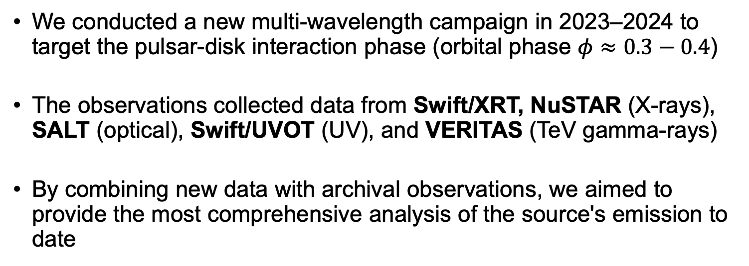
Our Multi-Wavelength Observation Campaign
We conducted a new multi-wavelength campaign in 2023–2024 to target the pulsar-disk interaction phase (orbital phase $φ≈0.3−0.4$)
The observations collected data from Swift/XRT, NuSTAR (X-rays), SALT (optical), Swift/UVOT (UV), and VERITAS (TeV gamma-rays)
By combining new data with archival observations, we aimed to provide the most comprehensive analysis of the source's emission to date

Slide 7
Key Findings

Slide 8
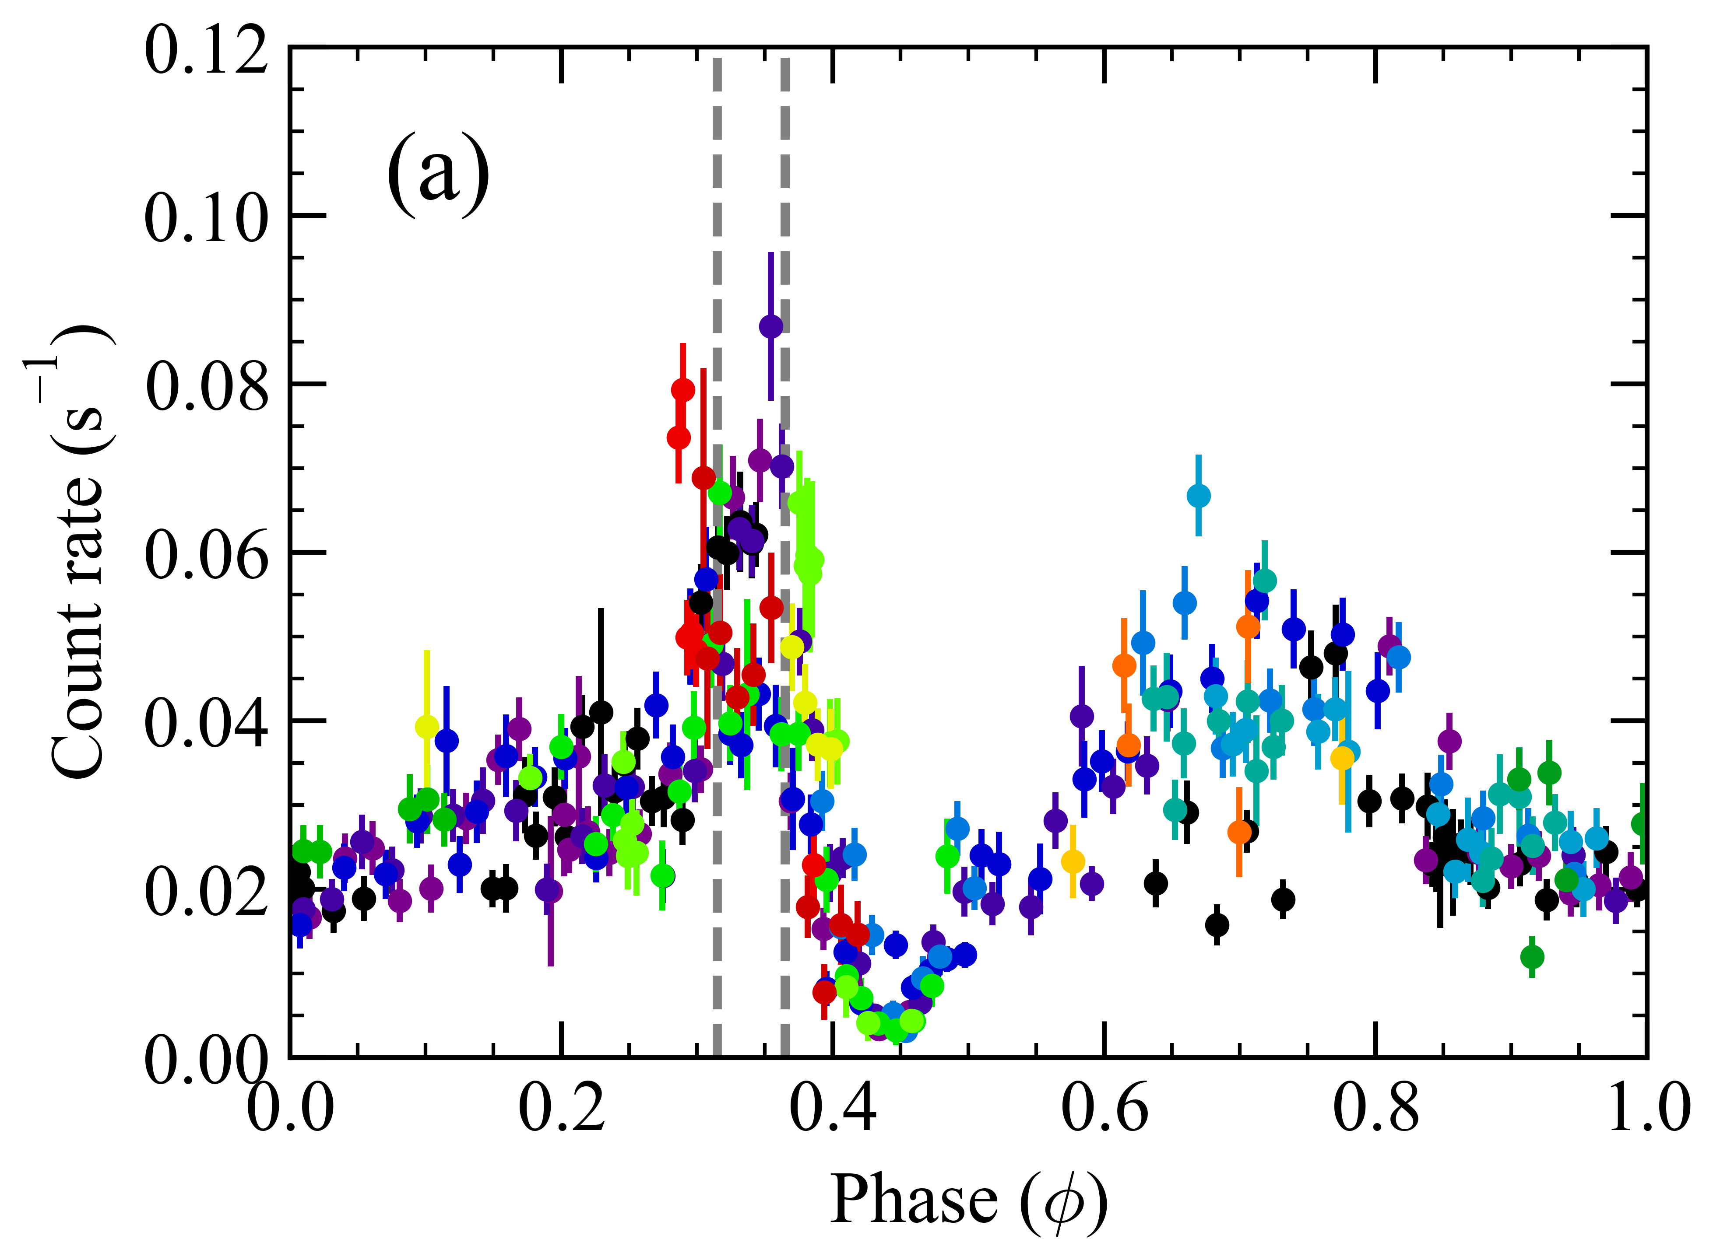
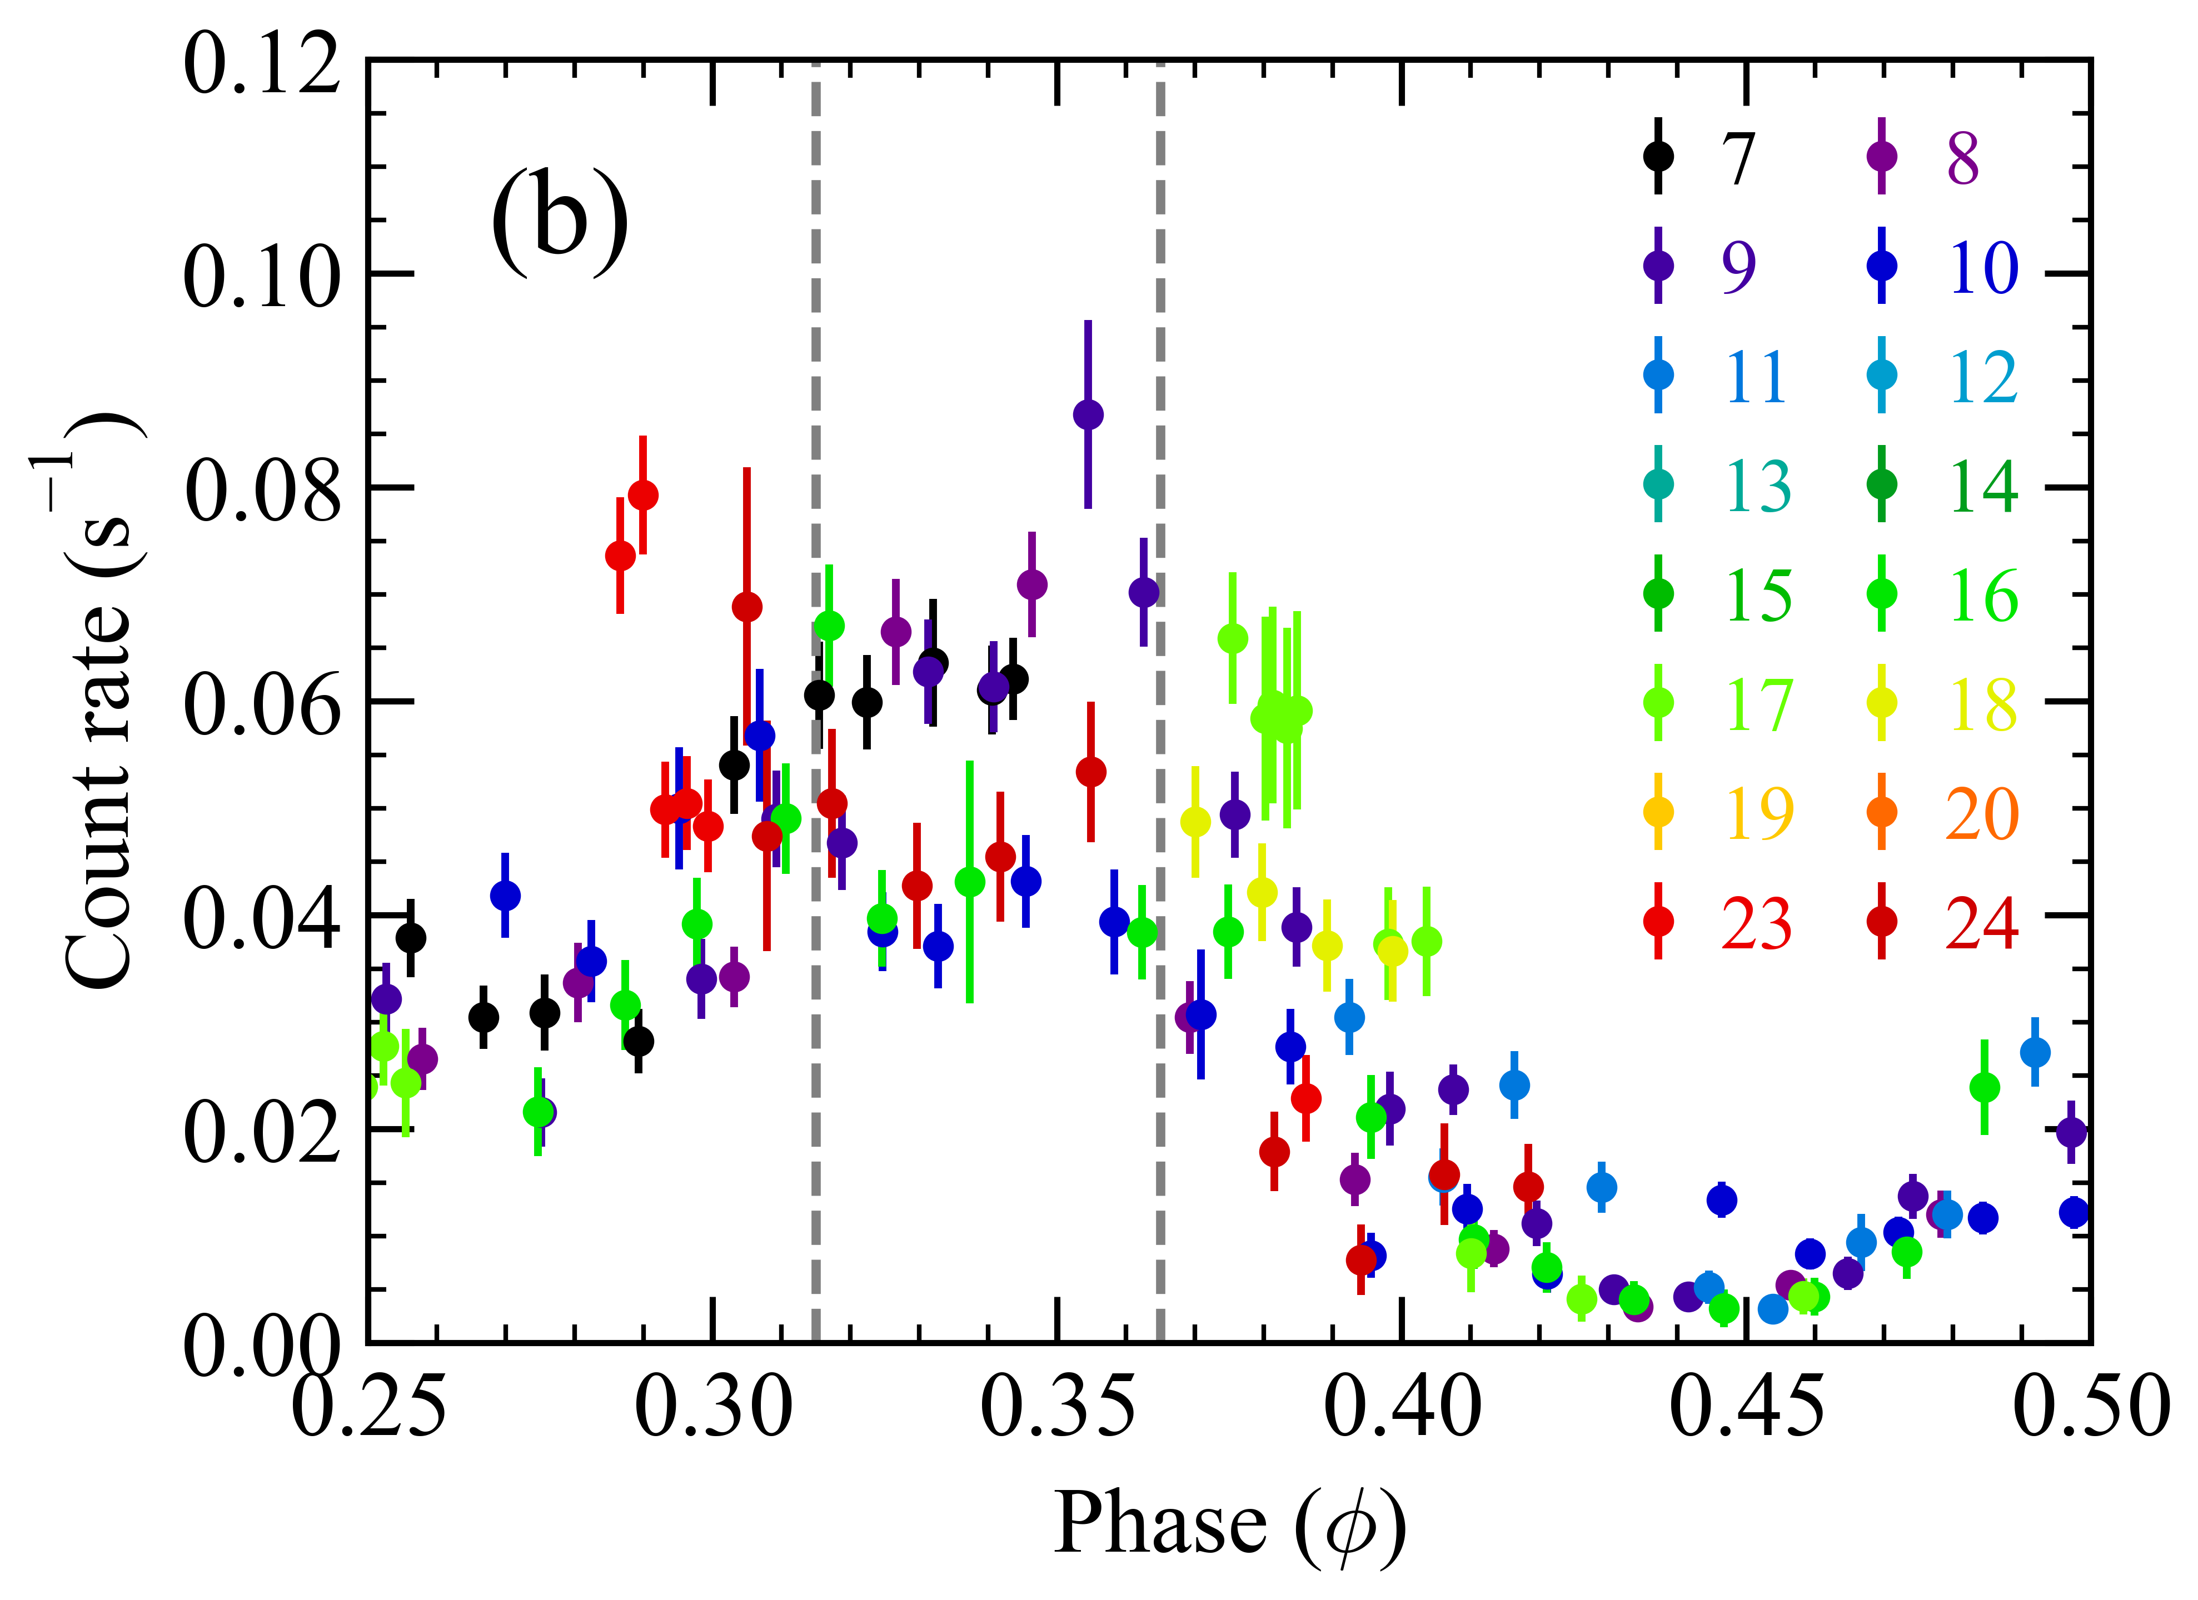
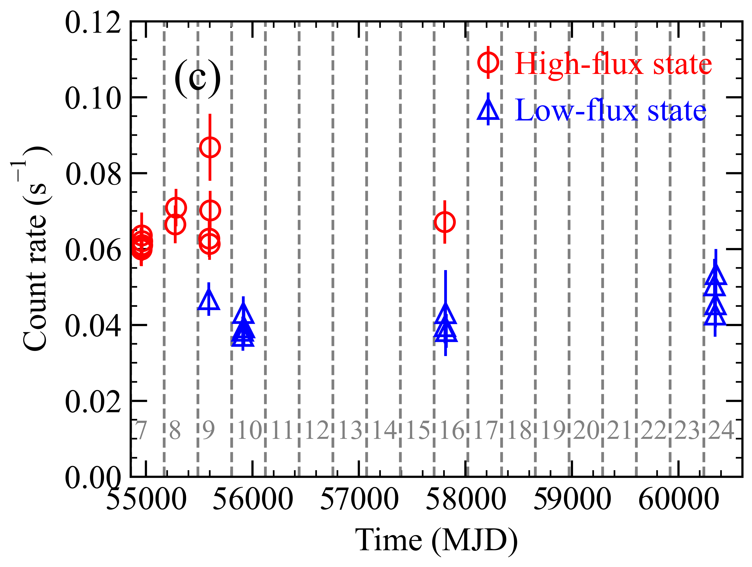
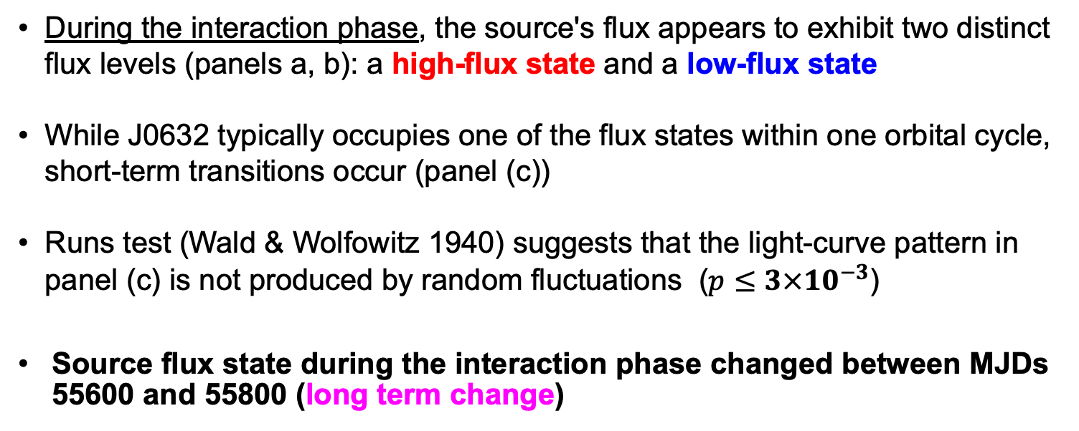
Hint for two X-ray flux states during the interaction phase
Zoomed-in
High-flux state
Low-flux state
During the interaction phase, the source's flux appears to exhibit two distinct flux levels (panels a, b): a high-flux state and a low-flux state
While J0632 typically occupies one of the flux states within one orbital cycle, short-term transitions occur (panel (c))
Runs test (Wald & Wolfowitz 1940) suggests that the light-curve pattern in panel (c) is not produced by random fluctuations ($p{≤3×10}^{−3}$)
Source flux state during the interaction phase changed between MJDs 55600 and 55800 (long term change)

Slide 9
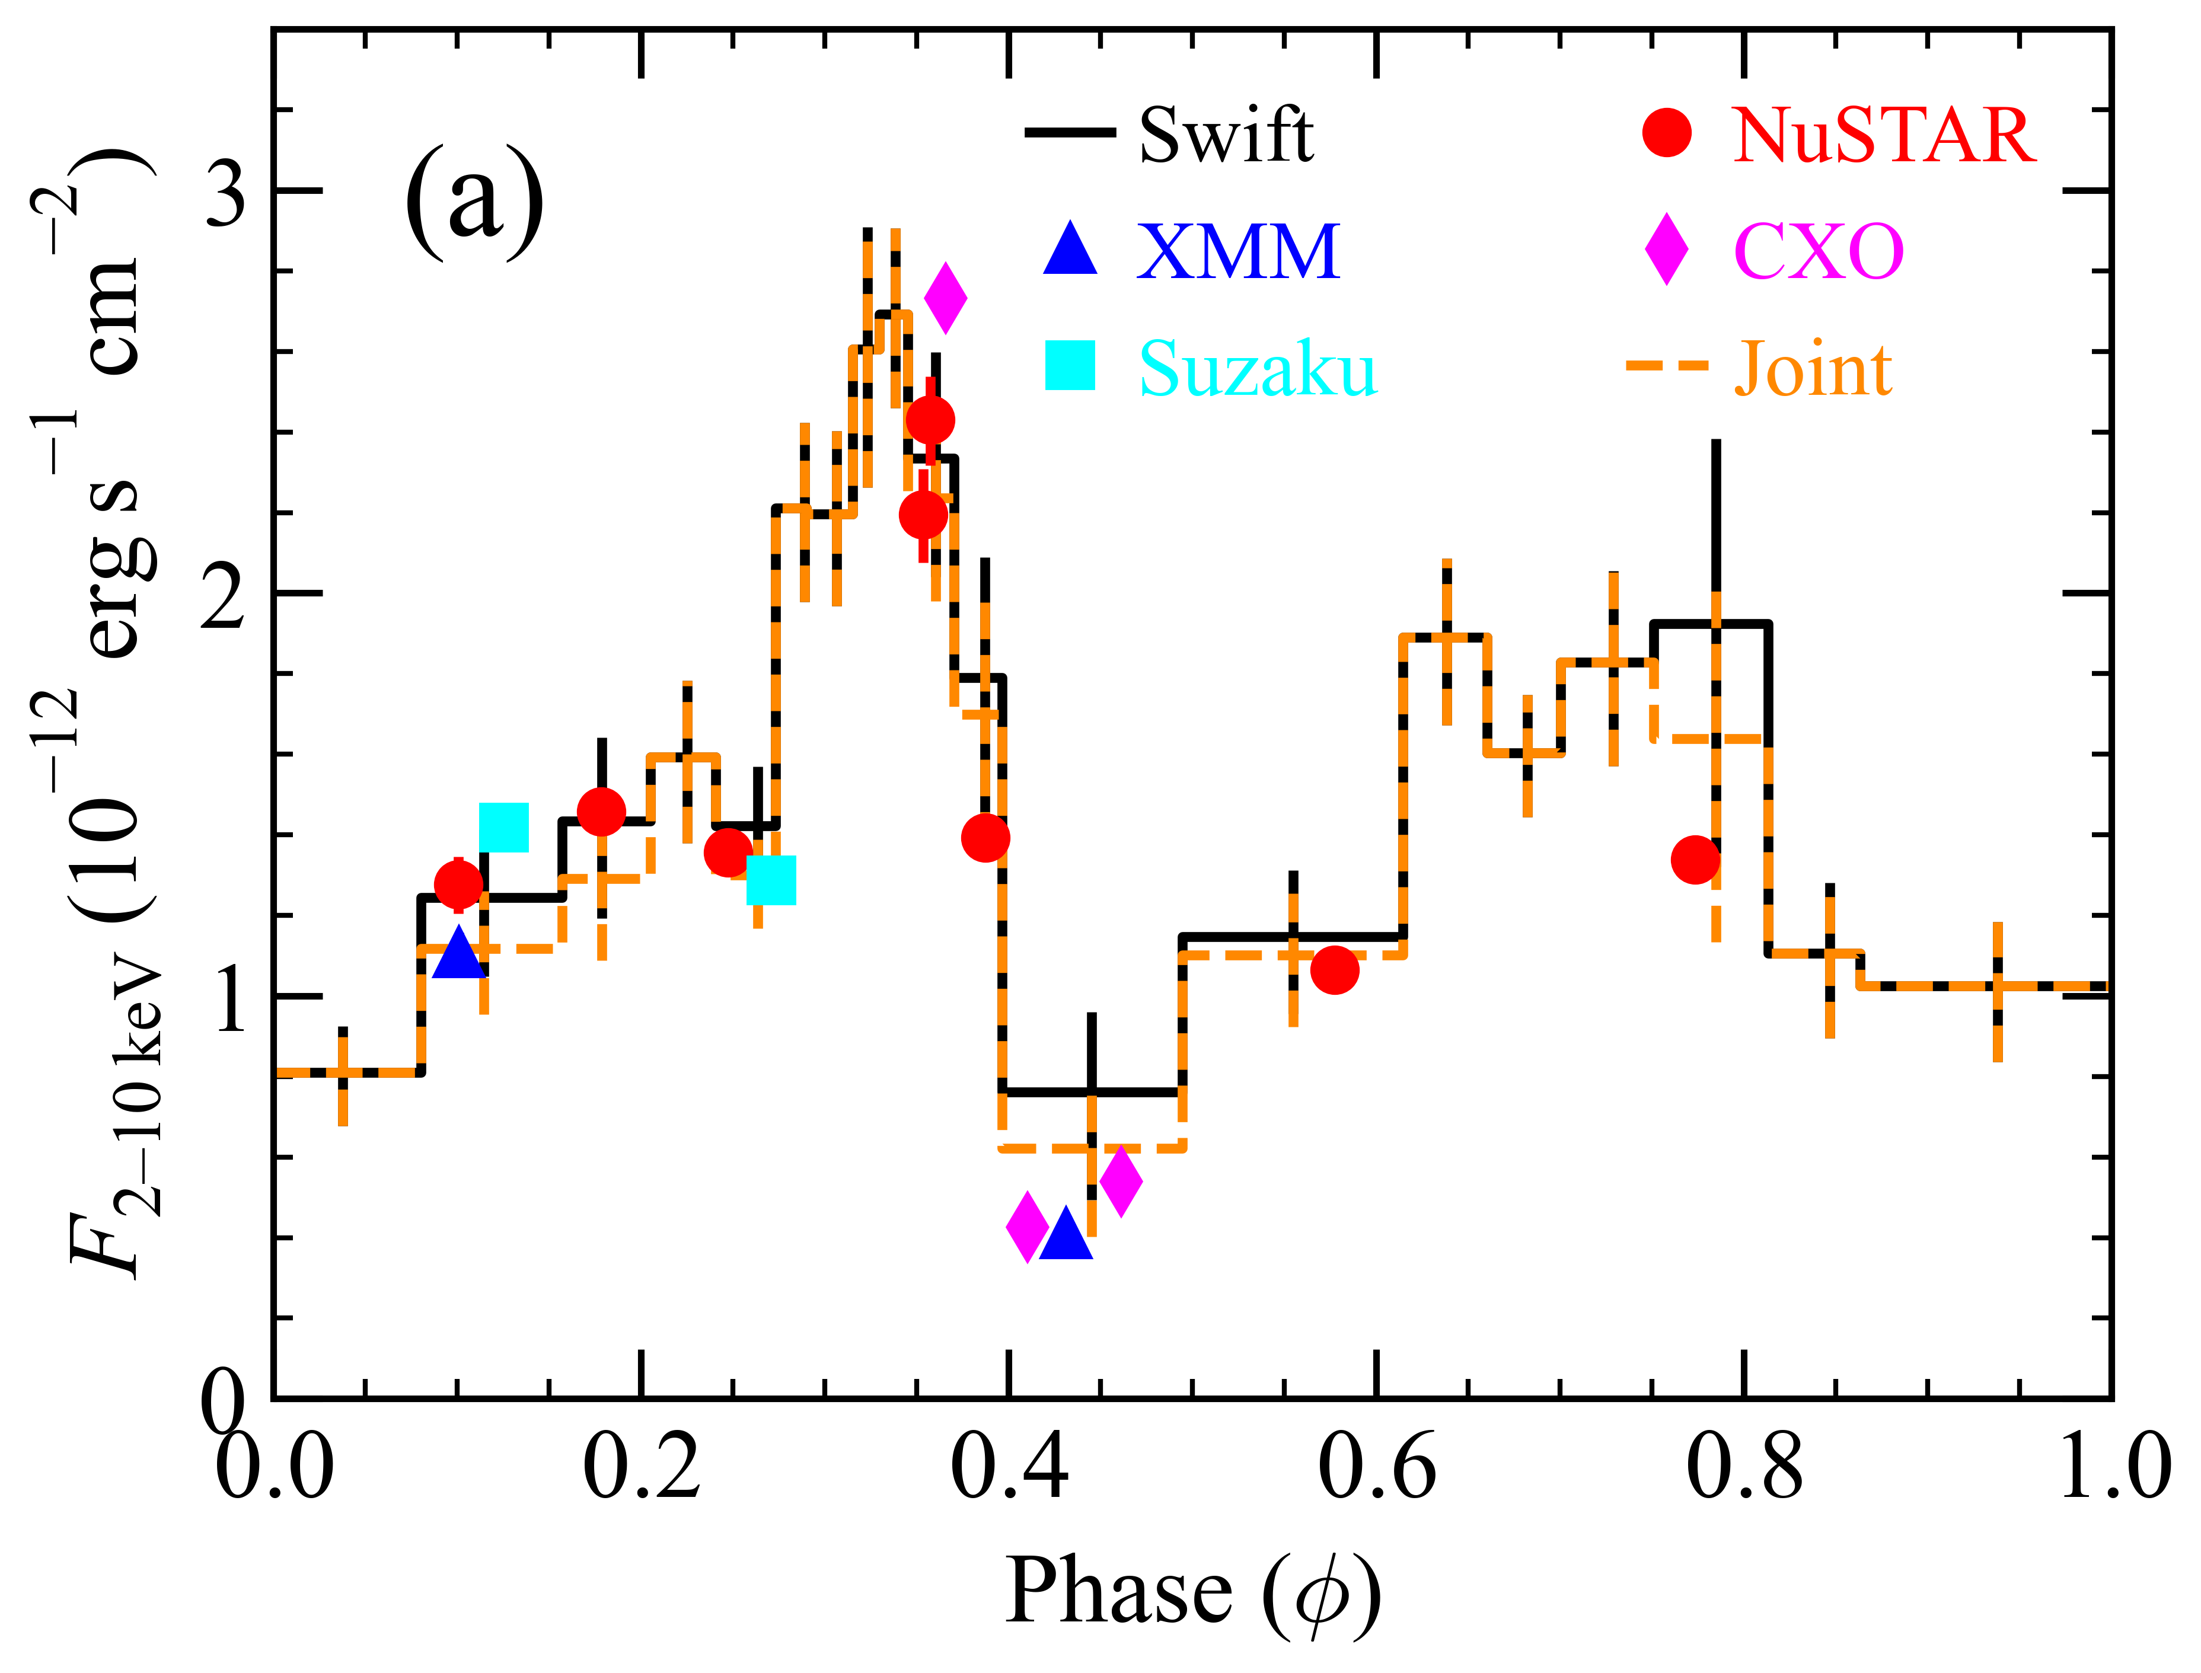
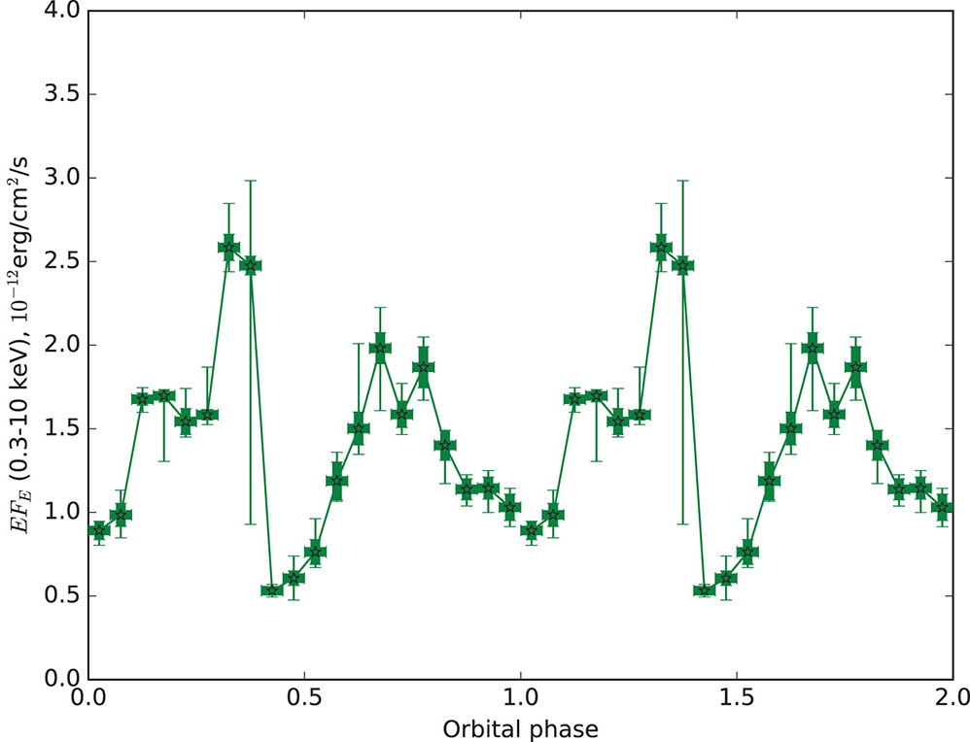
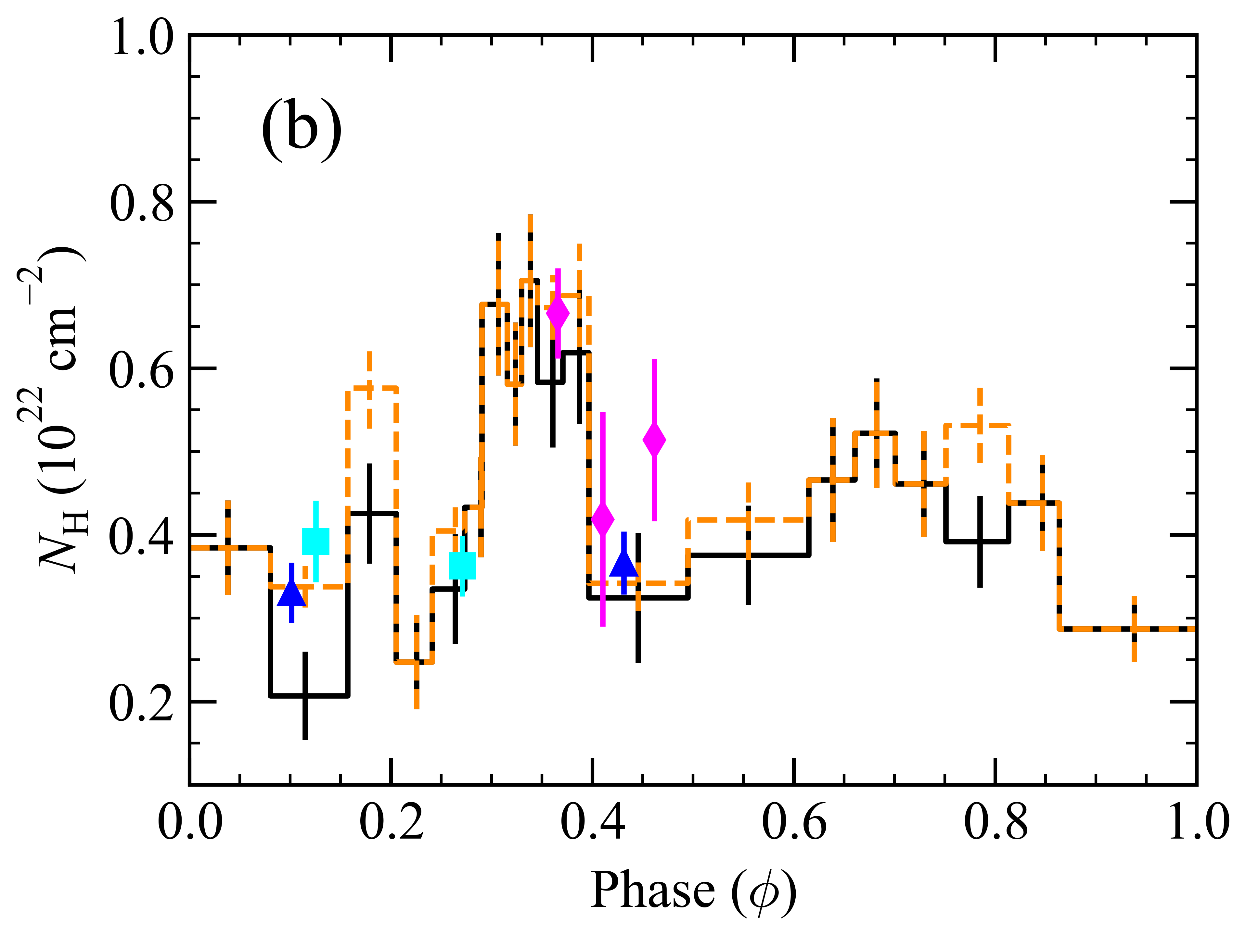
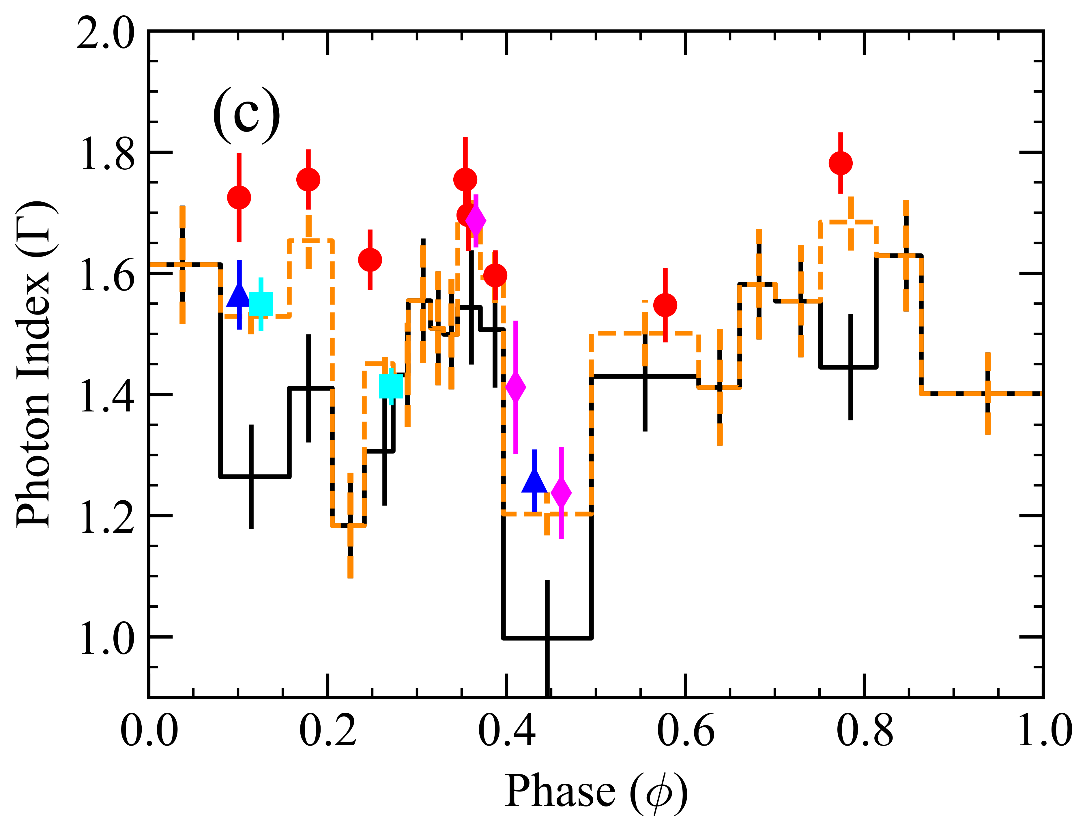
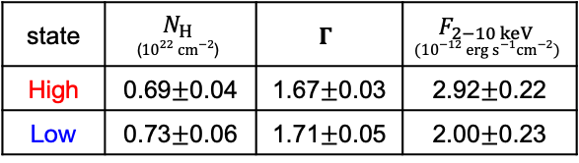
Improved measurement of the orbital modulation
(Malyshev+2019)
We improved measurement of the orbital modulation in the X-ray emission from J0632
This allowed an estimation for the duration of the pulsar-disk interaction
Although discrepancies between instruments are observed, these are statistically insignificant
We also found that spectra from the two “states” within the interaction phase are consistent with each other
High-flux state
Low-flux state
state | $$N_{H}$$ $$\text{(}{10}^{22} cm^{−2}\text{)}$$ | $$Γ$$ | $$F_{2−10 keV} \\ ({10}^{−12} erg s^{−1}cm^{−2})$$
High | 0.69$±$0.04 | 1.67$±$0.03 | 2.92$±$0.22
Low | 0.73$±$0.06 | 1.71$±$0.05 | 2.00$±$0.23

Slide 10
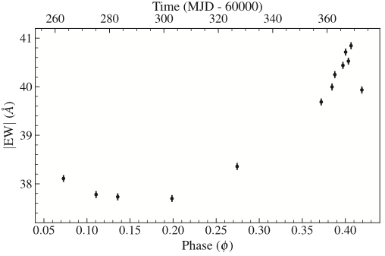
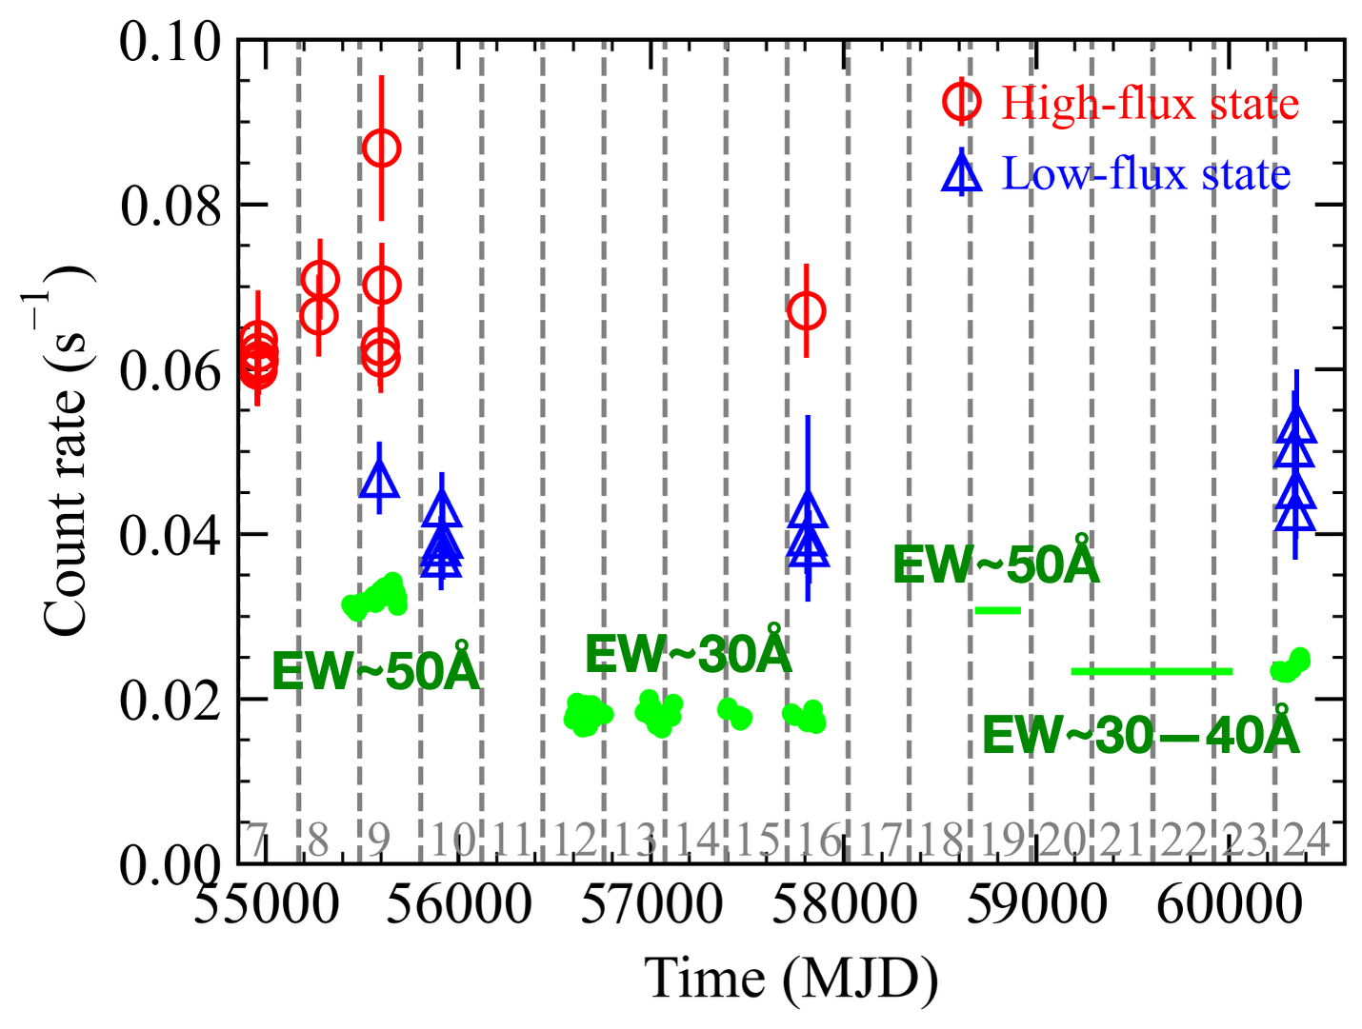
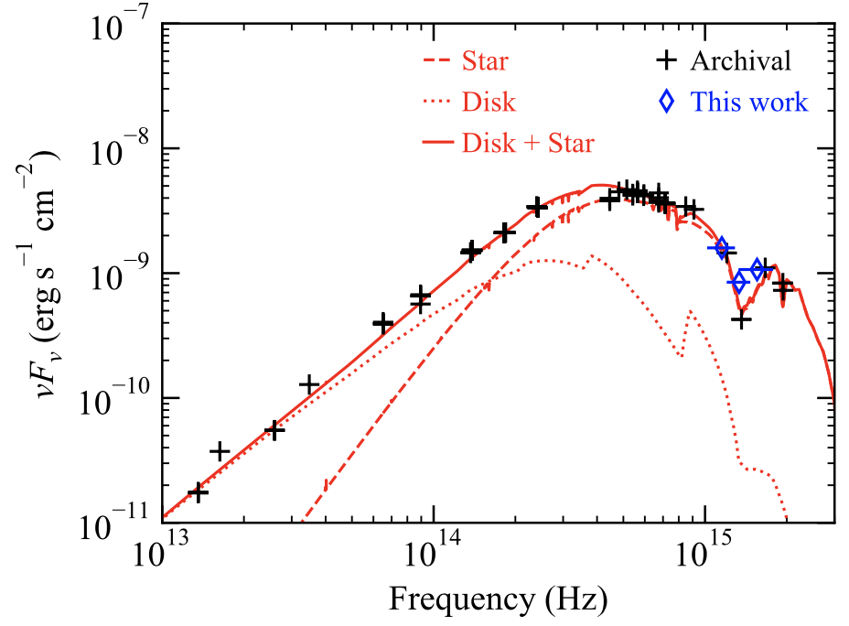
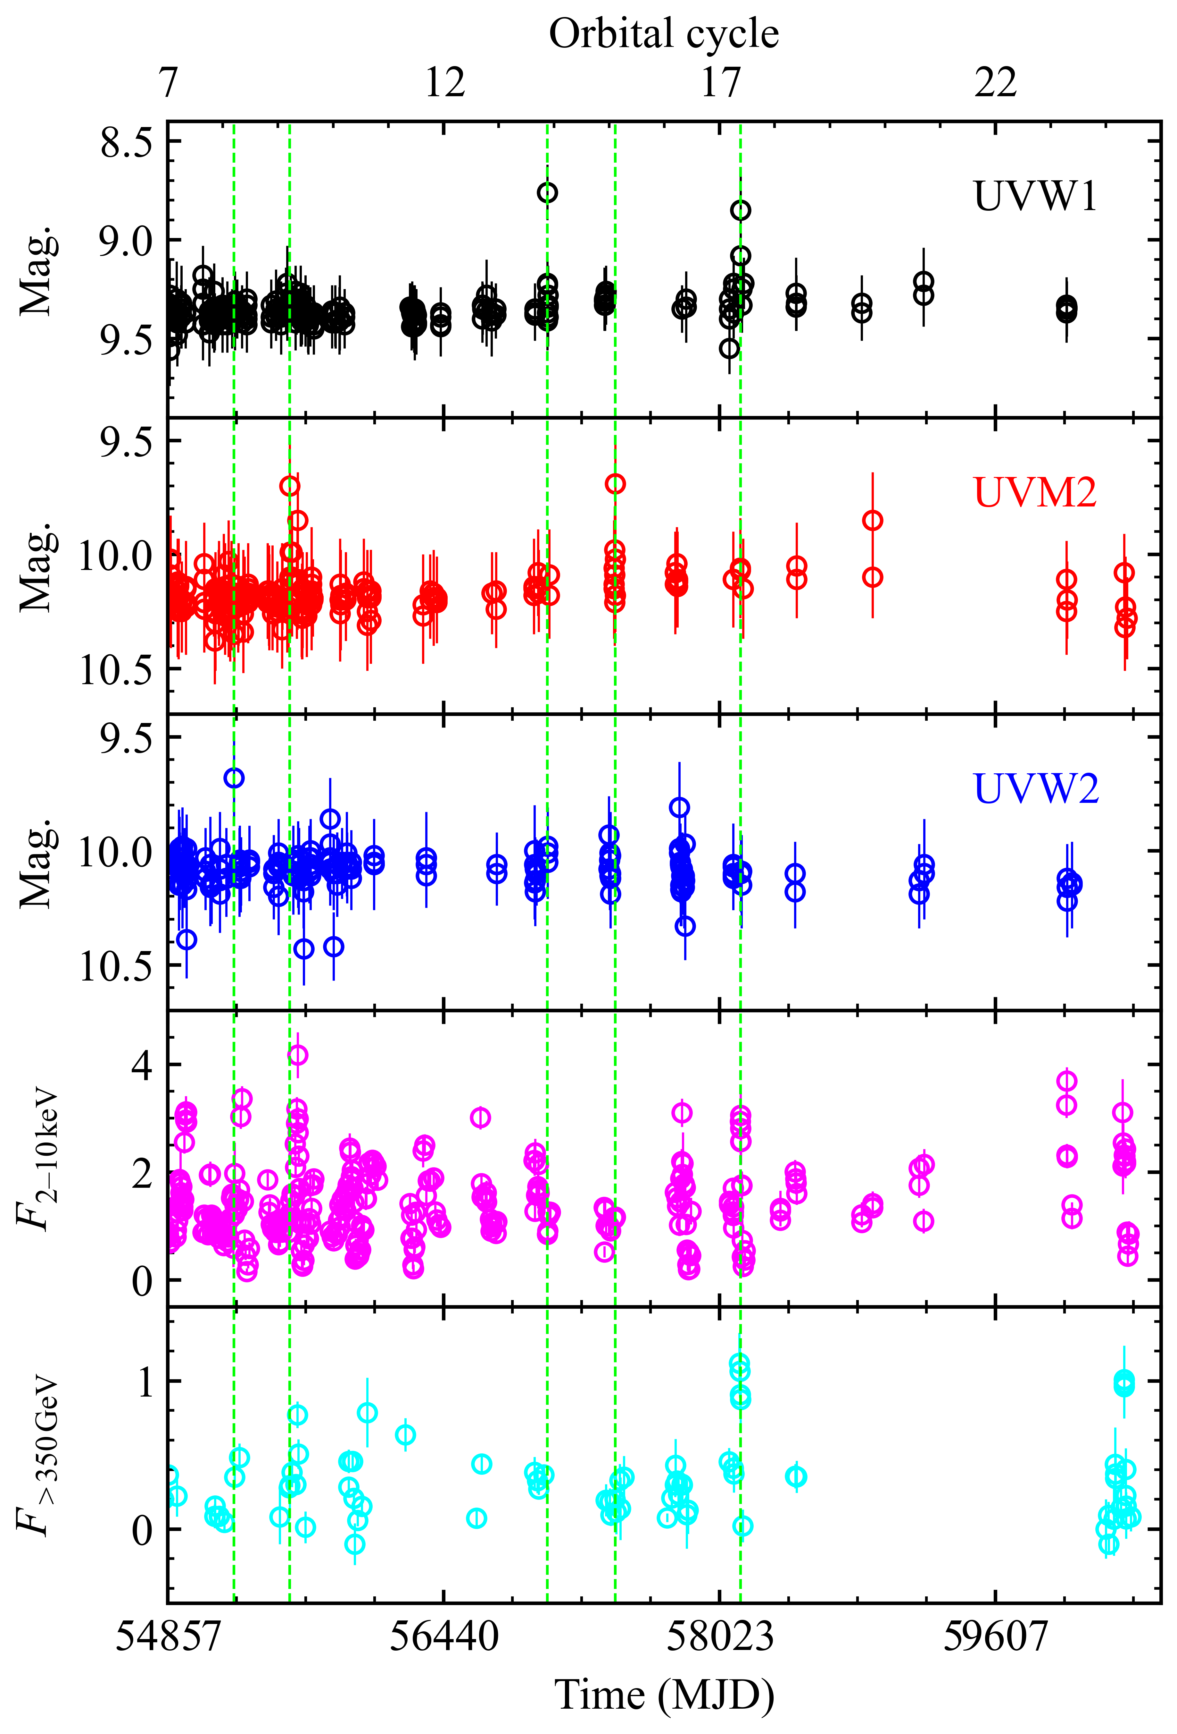
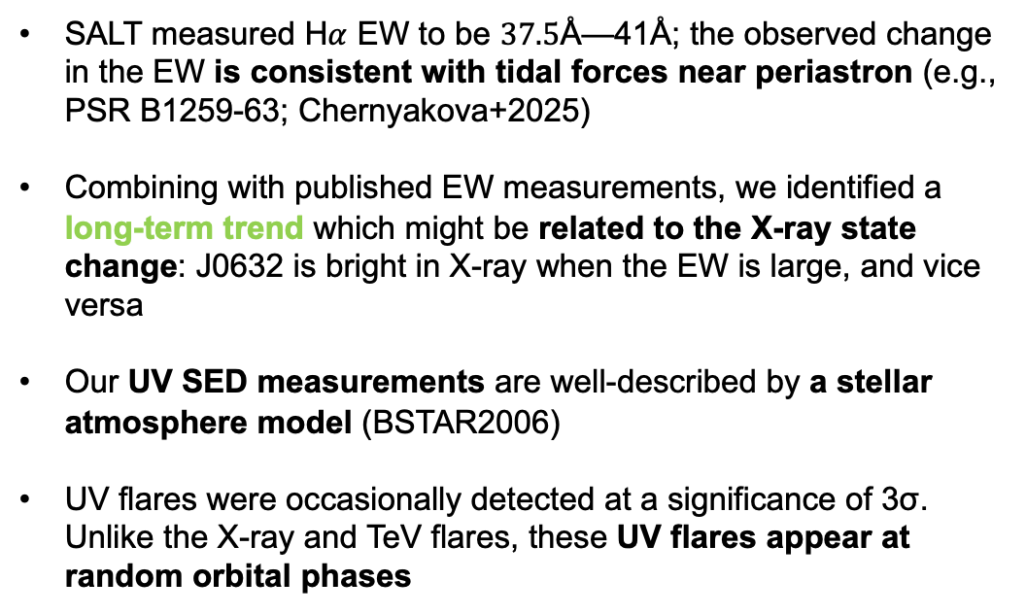


An intriguing long-term H$α$ equivalent width trend and Swift/UVOT Data Analysis: Companion Flares
SALT H$α$
UV: the companion star
SALT measured H$α$ EW to be $37.5$Å—41Å; the observed change in the EW is consistent with tidal forces near periastron (e.g., PSR B1259-63; Chernyakova+2025)
Combining with published EW measurements, we identified a long-term trend which might be related to the X-ray state change: J0632 is bright in X-ray when the EW is large, and vice versa
Our UV SED measurements are well-described by a stellar atmosphere model (BSTAR2006)
UV flares were occasionally detected at a significance of 3σ. Unlike the X-ray and TeV flares, these UV flares appear at random orbital phases
X-ray
TeV

Slide 11
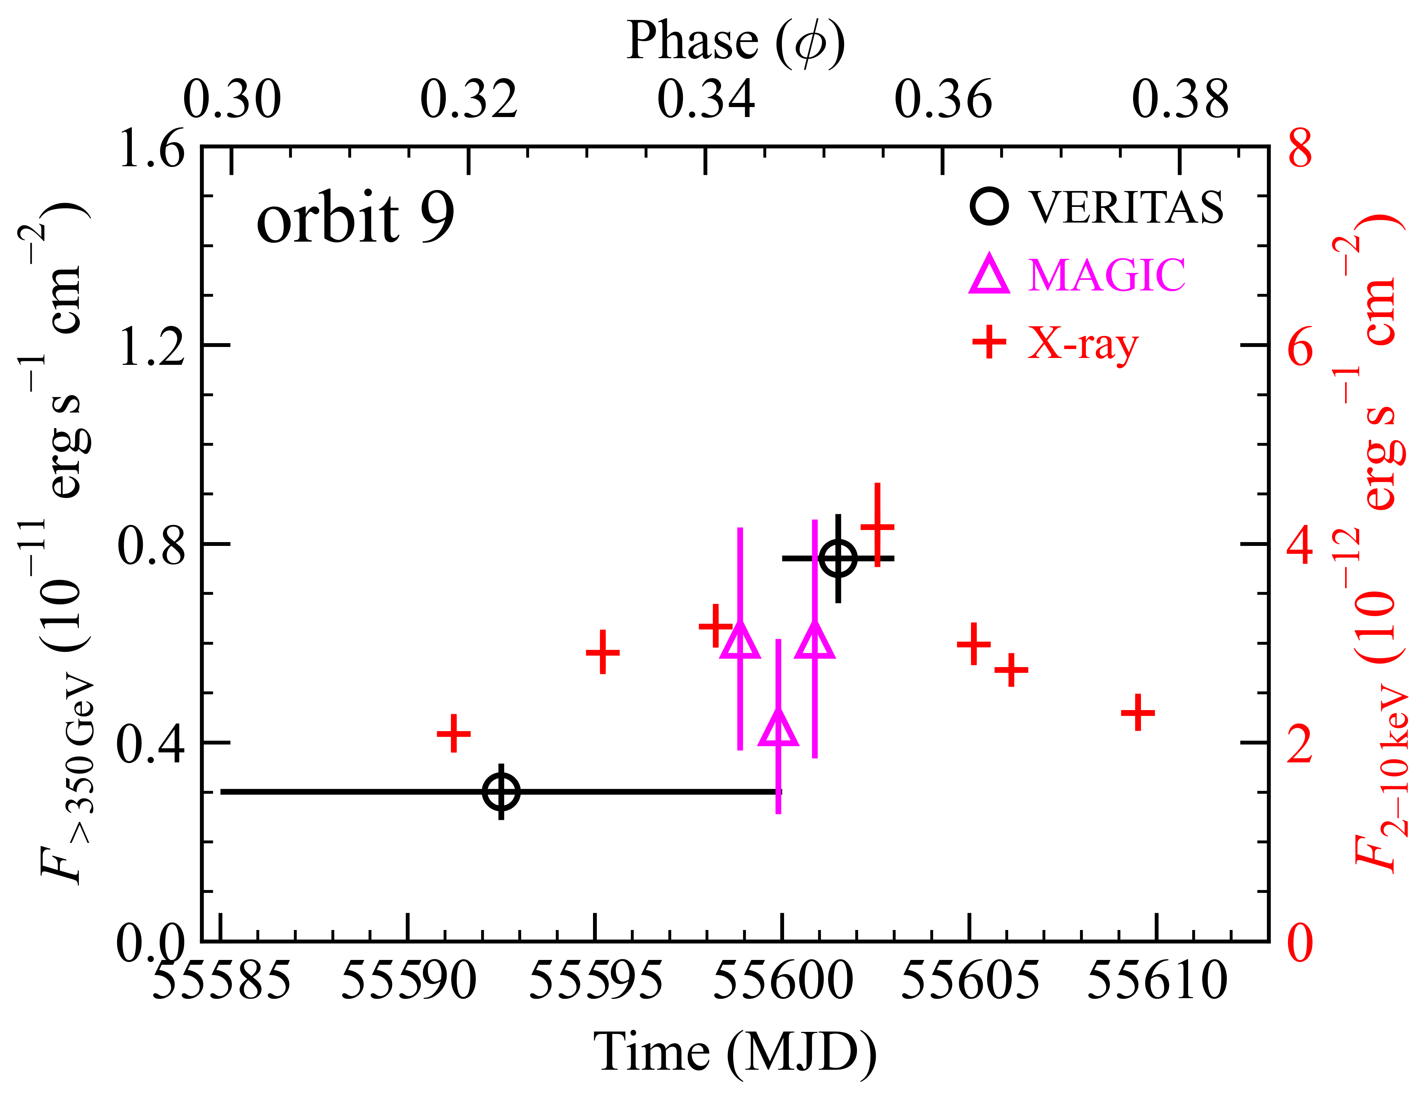
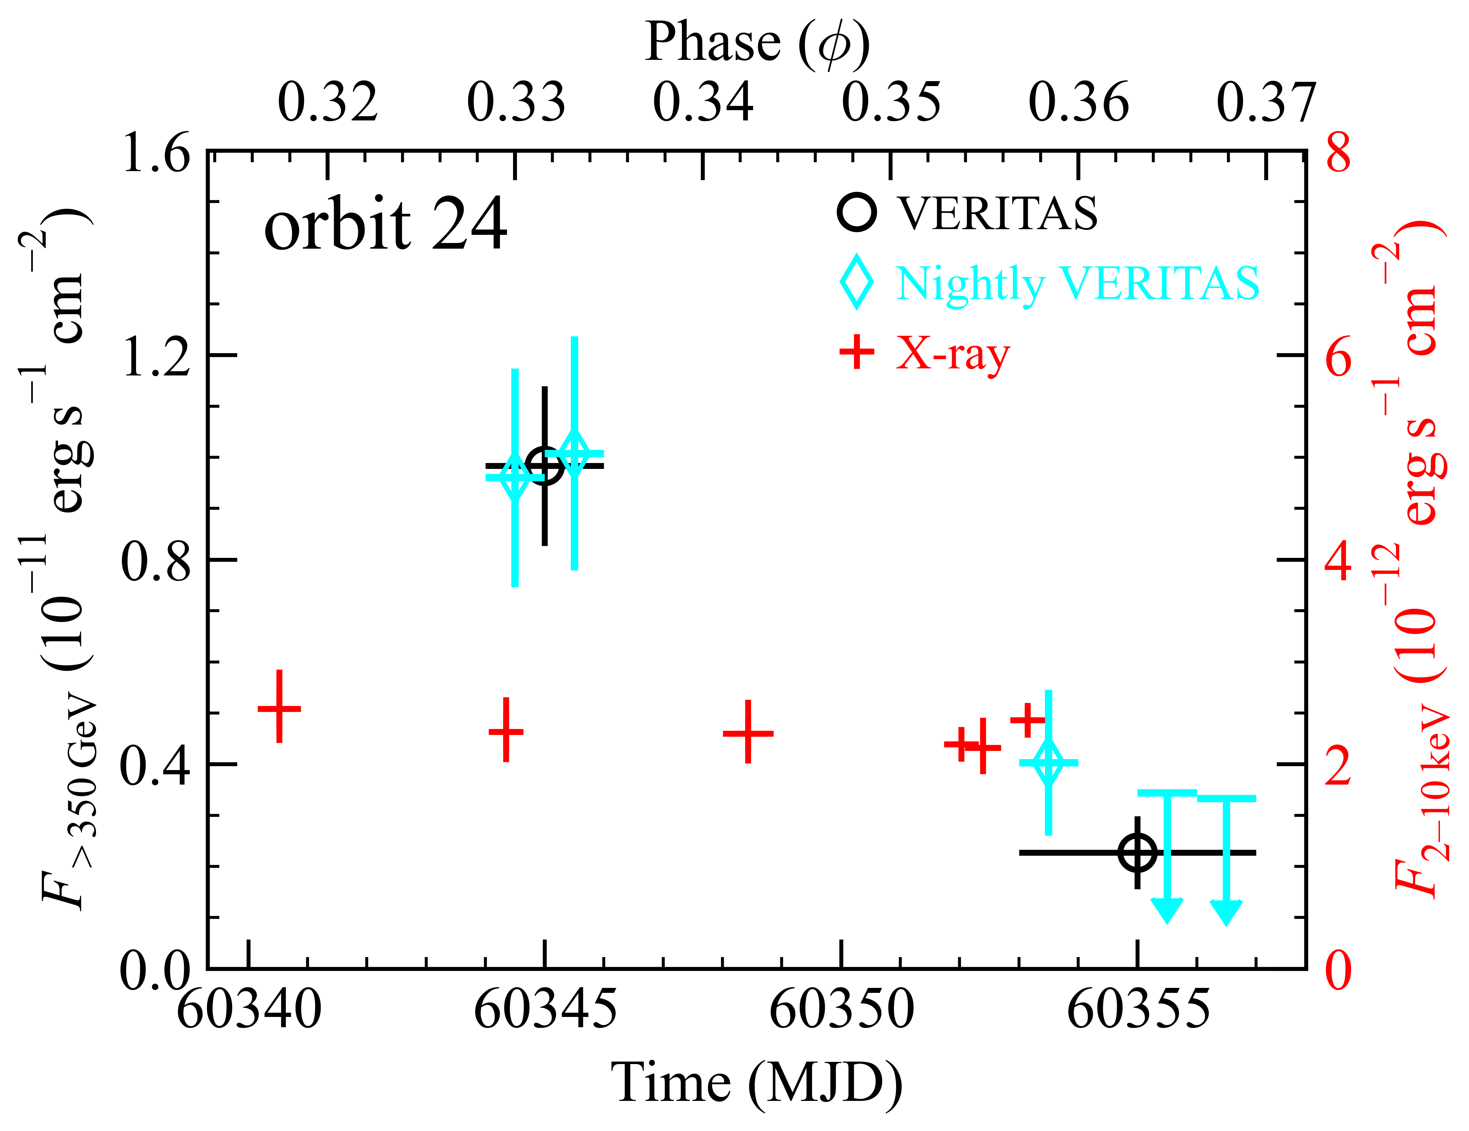
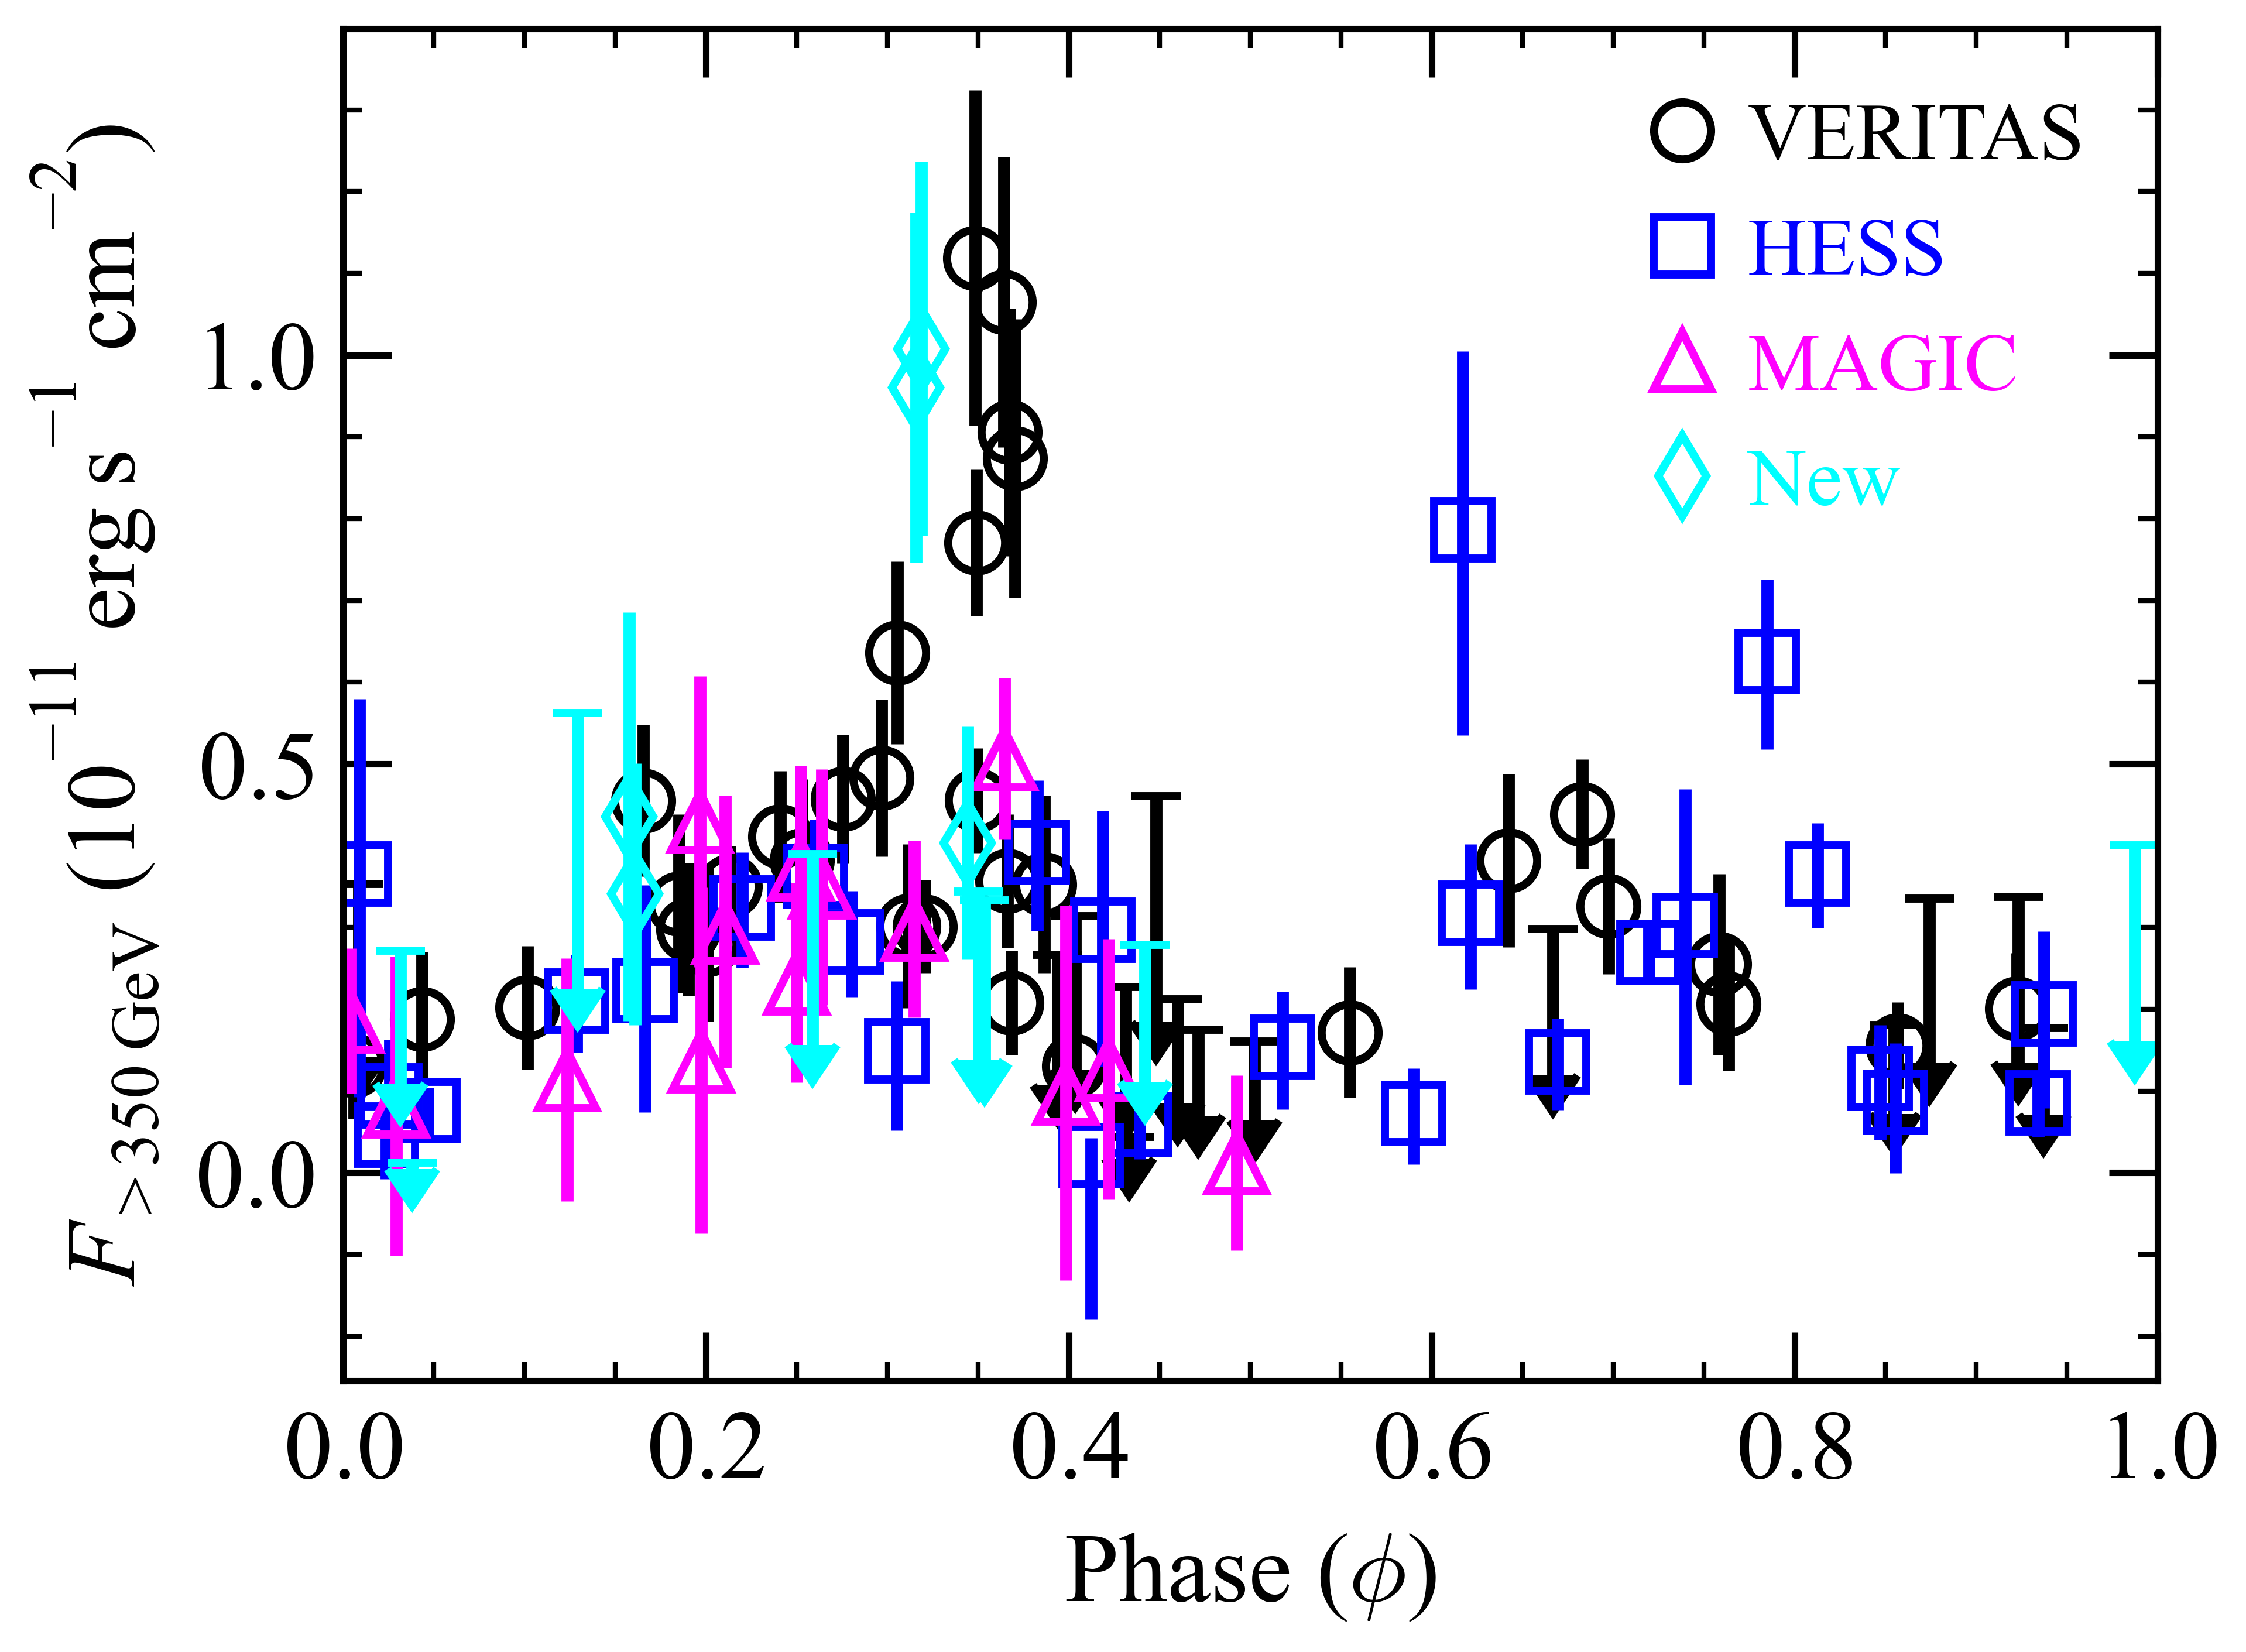
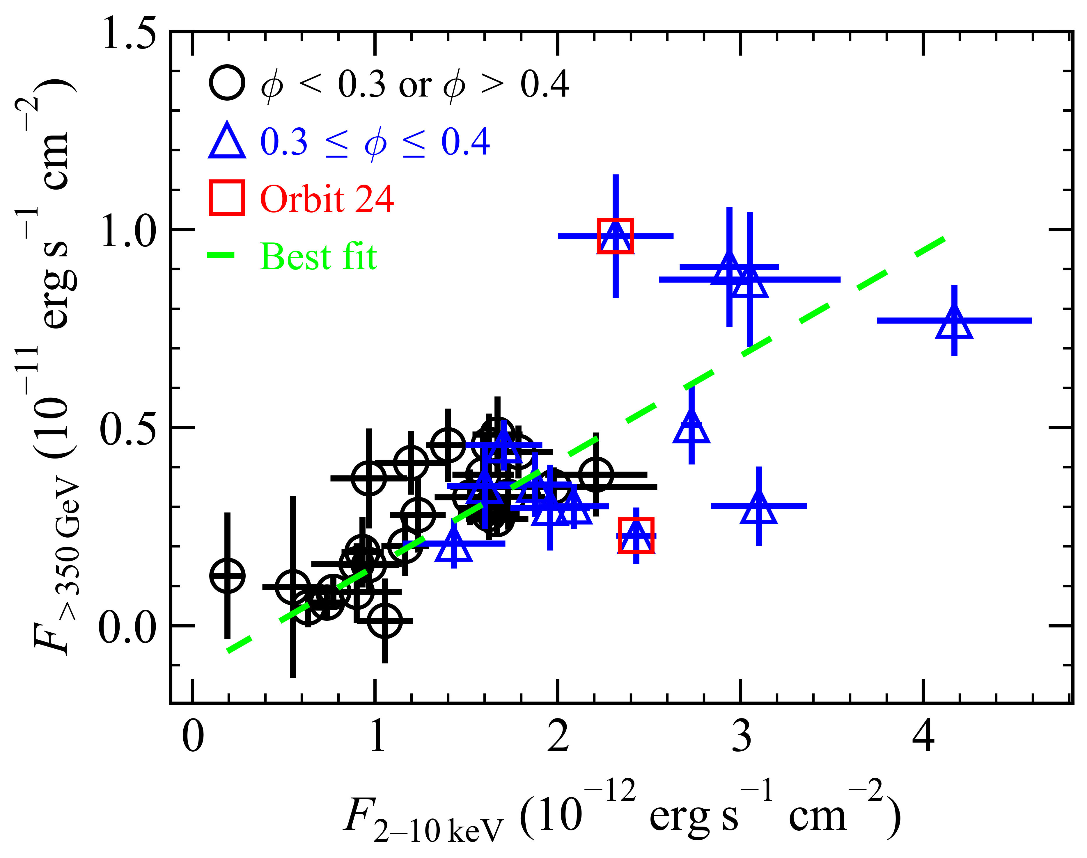
We found independent X-ray and TeV variabilities
High-flux TeV
Low-flux TeV
The new VERITAS observation (cyan) captured TeV flares of J0632 within the interaction phase
Although X-ray and TeV points generally are correlated, high-flux TeV points exhibit significant scatter
A simultaneous increase in X-ray and TeV flux was seen in orbit 9, but in orbit 24, these bands varied independently

Slide 12
Interpretations

Slide 13
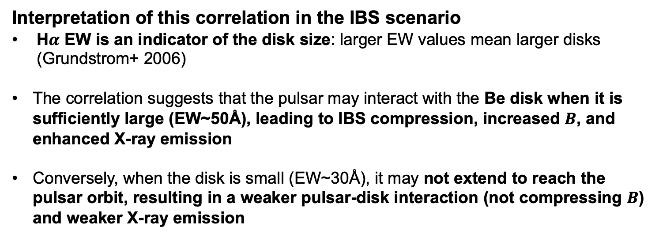
Correleration between X-ray flux and H$α$ EW
Orbit 9
disk
IBS
Orbits 16, 24
EW~50Å
EW~50Å
EW~30Å
disk
EW~30—40Å
IBS
Interpretation of this correlation in the IBS scenario
H$α$ EW is an indicator of the disk size: larger EW values mean larger disks (Grundstrom+ 2006)
The correlation suggests that the pulsar may interact with the Be disk when it is sufficiently large (EW~50Å), leading to IBS compression, increased $B$, and enhanced X-ray emission
Conversely, when the disk is small (EW~30Å), it may not extend to reach the pulsar orbit, resulting in a weaker pulsar-disk interaction (not compressing $B$) and weaker X-ray emission

Slide 14
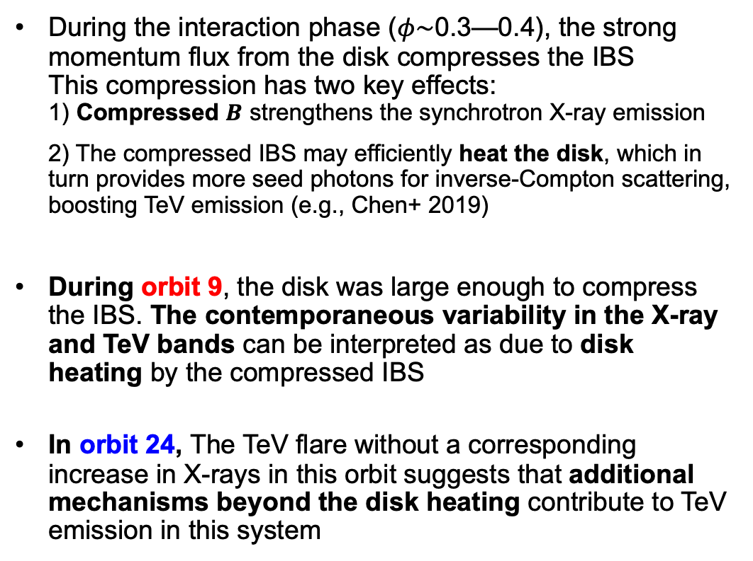
X-ray and TeV variabilities in the context of IBS models
Electrons within the IBS are responsible for both X-rays (synchrotron) and gamma rays (inverse Compton)
Heated disk
IBS
During the interaction phase ($φ\sim$0.3—0.4), the strong momentum flux from the disk compresses the IBS This compression has two key effects: 1) Compressed $B$ strengthens the synchrotron X-ray emission 2) The compressed IBS may efficiently heat the disk, which in turn provides more seed photons for inverse-Compton scattering, boosting TeV emission (e.g., Chen+ 2019)
During orbit 9, the disk was large enough to compress the IBS. The contemporaneous variability in the X-ray and TeV bands can be interpreted as due to disk heating by the compressed IBS
In orbit 24, The TeV flare without a corresponding increase in X-rays in this orbit suggests that additional mechanisms beyond the disk heating contribute to TeV emission in this system
disk
+additional mechanisms
IBS

Slide 15

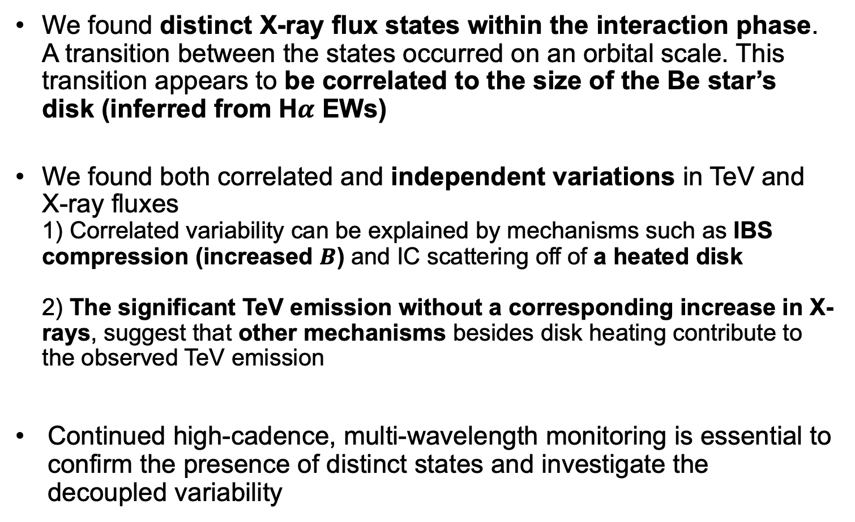
Summary and Future Work
For more details, please see our paper
We found distinct X-ray flux states within the interaction phase. A transition between the states occurred on an orbital scale. This transition appears to be correlated to the size of the Be star’s disk (inferred from H$α$ EWs)
We found both correlated and independent variations in TeV and X-ray fluxes 1) Correlated variability can be explained by mechanisms such as IBS compression (increased $B$) and IC scattering off of a heated disk 2) The significant TeV emission without a corresponding increase in X-rays, suggest that other mechanisms besides disk heating contribute to the observed TeV emission
Continued high-cadence, multi-wavelength monitoring is essential to confirm the presence of distinct states and investigate the decoupled variability

Slide 16
Thank you for your attention

Slide 17
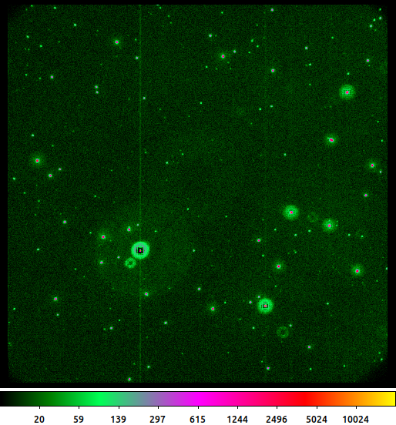
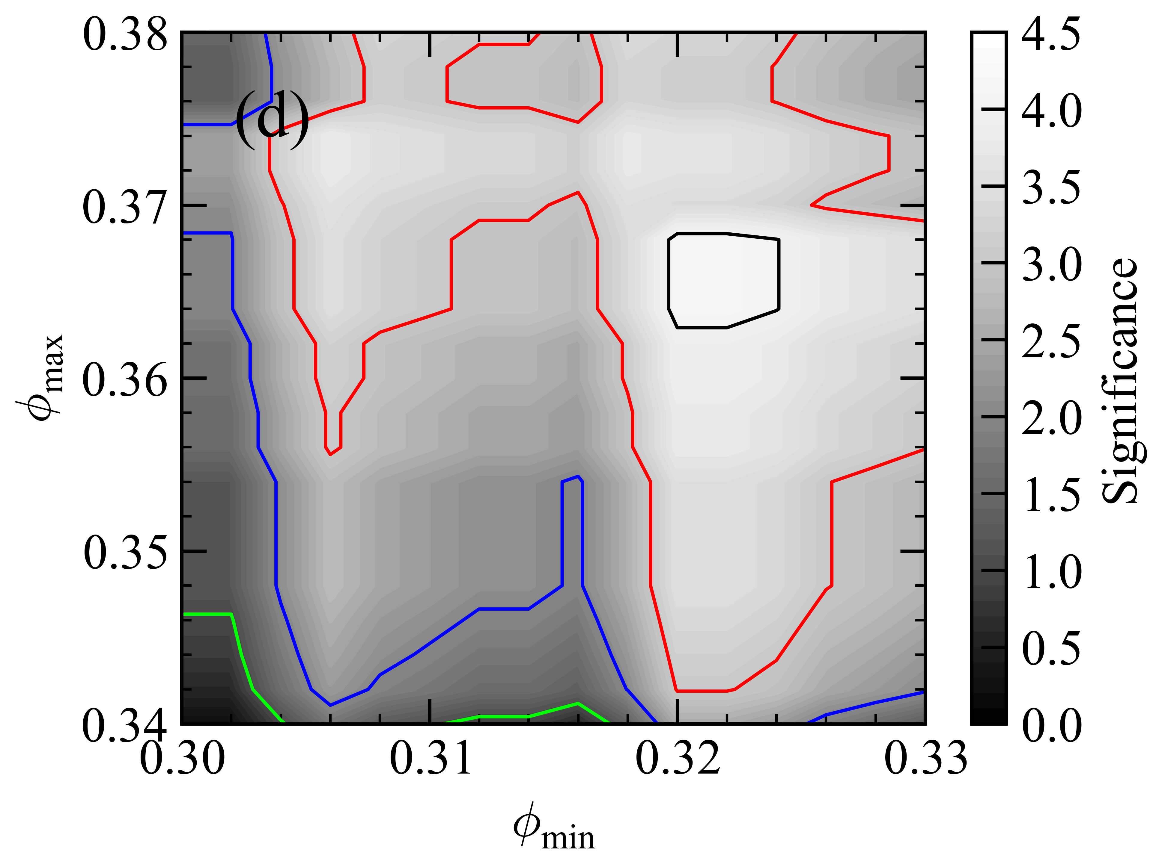
Backup
Read out streak
We utilize a read-out streak photometry (Page+ 2013)
We verified the robustness of the result across a range of phase selection intervals

Slide 18
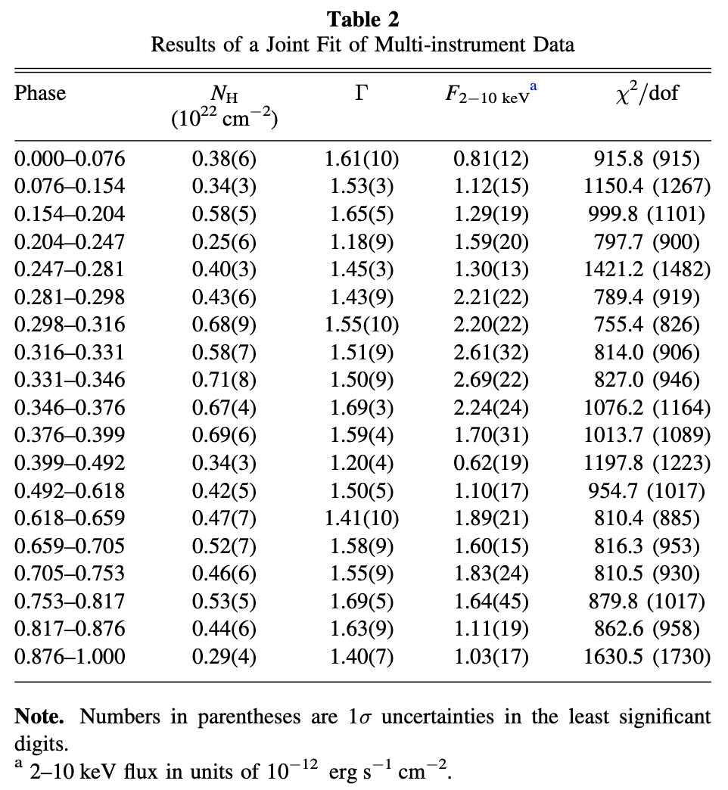
Backup
A single PL describes the data well in the multi-instrument joint analysis

