Slide 1




Studying PeVatron candidates with VERITAS and PANOSETI
Jamie Holder
University of Delaware
CDHY PeVatron Workshop
Oct 8 – 10, 2025
Nevis Labs, Columbia University

Slide 2
Motivations: Why look for PeVatrons with IACTs?
What are the sources of the Galactic cosmic rays?
What are the “PeVatrons” accelerating protons and nuclei up to 10¹⁵ eV and beyond?
Current imaging atmospheric Cherenkov telescope arrays can only study gamma-ray sources up to typically 10’s of TeV.
But 100 TeV gamma-ray emission results from PeV protons.
Hadronic PeVatron signatures can be both spectral and morphological. IACTs provide excellent spectral and angular resolution.
Notes:
Point source sensitivity for DAV
“A decisive and unambiguous indication of acceleration of PeV protons in SNRs can
be provided by observations of γ-rays at energies up to 100 TeV and beyond. Because of
the Klein-Nishina eﬀect the eﬃciency of inverse Compton scattering in this energy band is
dramatically reduced. Therefore unlike other energy intervals, the interpretation of γ-ray
observations at these energies is free of confusion and reduces to the only possible mecha-
nism - decay of secondary π0-meson. Although the potential of the current ground-based
instruments for detection of such energetic γ-rays is limited, it is expected that the next
generation arrays of imaging Cherenkov telescopes optimized in the multi–TeV energy range
will become powerful tools for this kind of studies ”

Slide 3
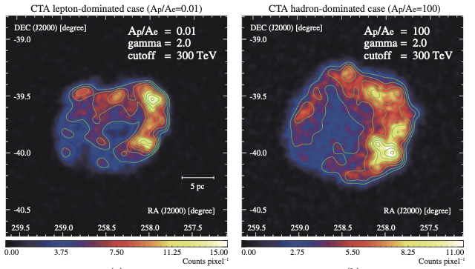
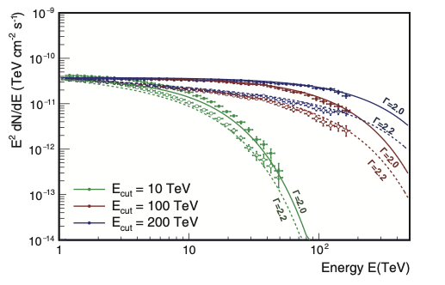
Simulated CTAO gamma-ray sky maps for RXJ 1713.7-3946
Simulated CTAO spectra for a PeVatron source, using different indices and cut-off values
From “Science with CTA”

Slide 4
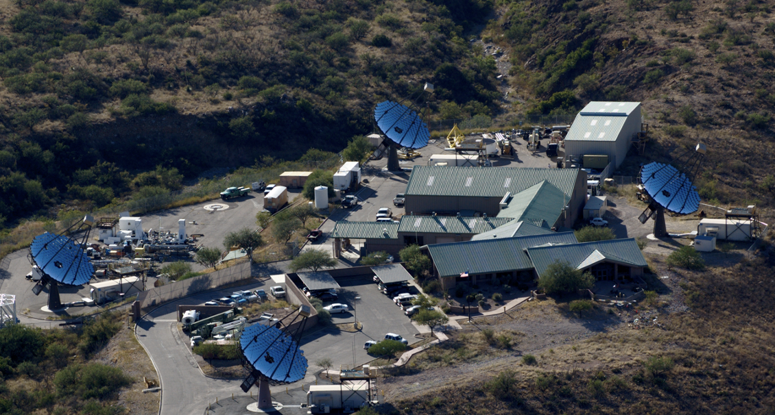
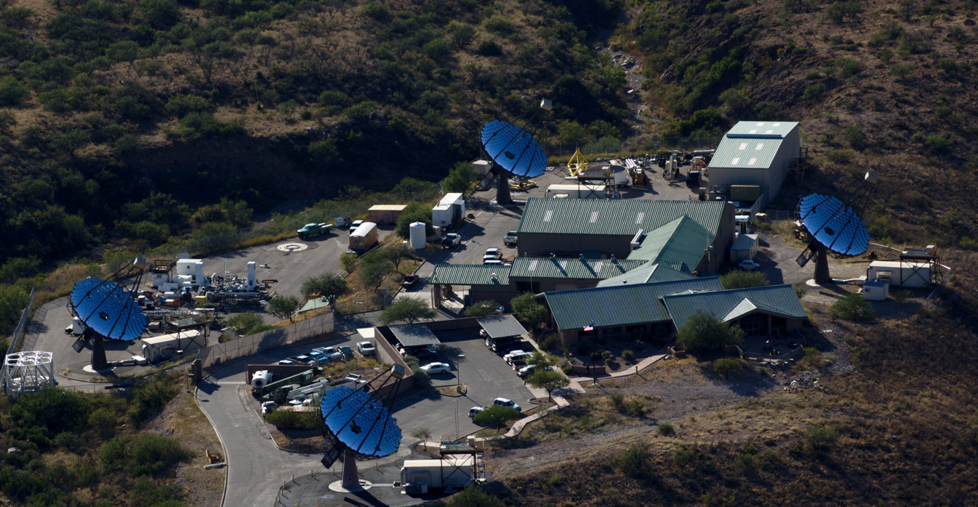
VERITAS

Slide 5
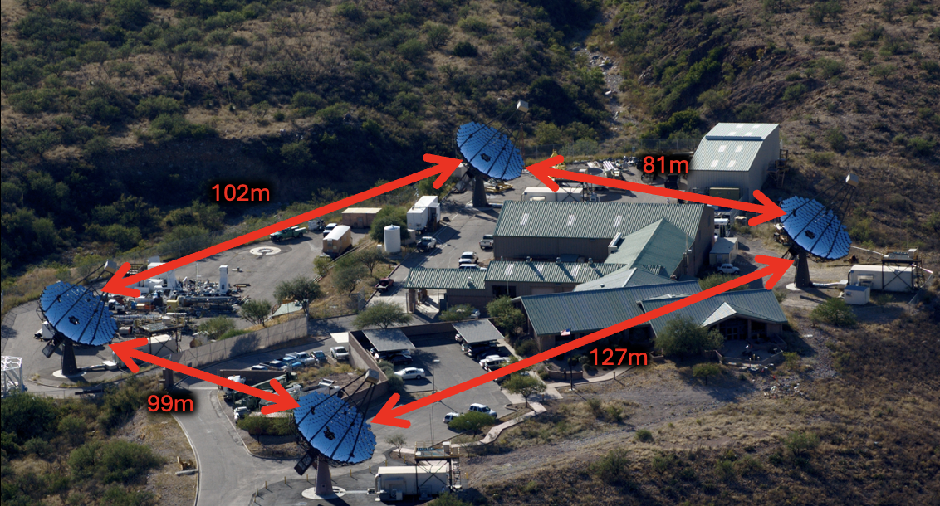
VERITAS
81m
102m
127m
99m

Slide 6
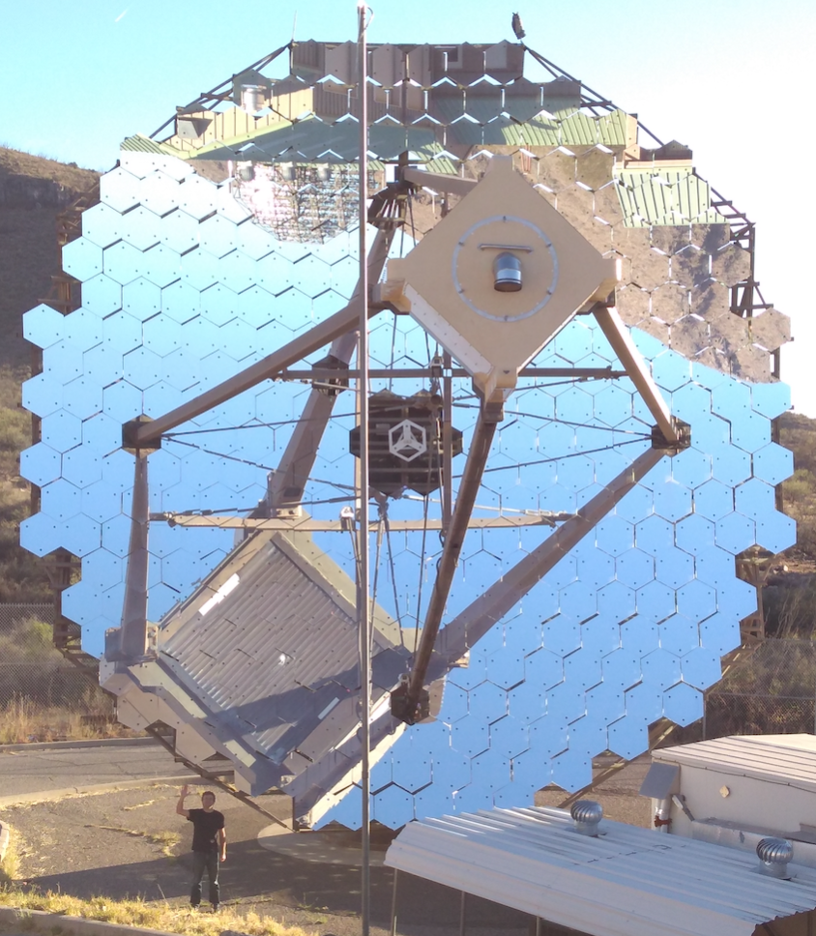
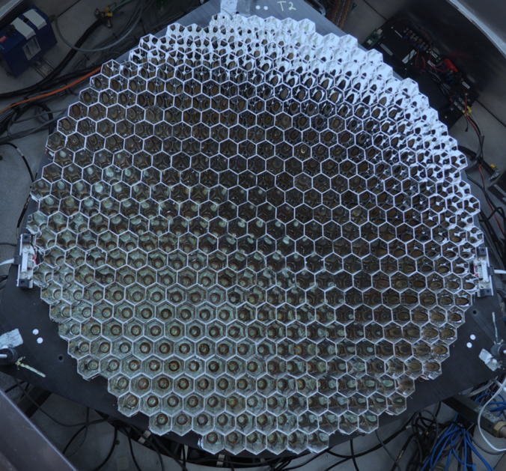
Each telescope has an aperture of 12 meters (~110 m²).
Each has a 499-pixel photomultiplier tube camera, with a 3.5 degree diameter field of view.
A trigger requires a coincidence between at least 2 of the 4 telescopes within 50 ns.
The signal from each pixel is recorded with 2ns sampling flash-ADCs

Slide 7
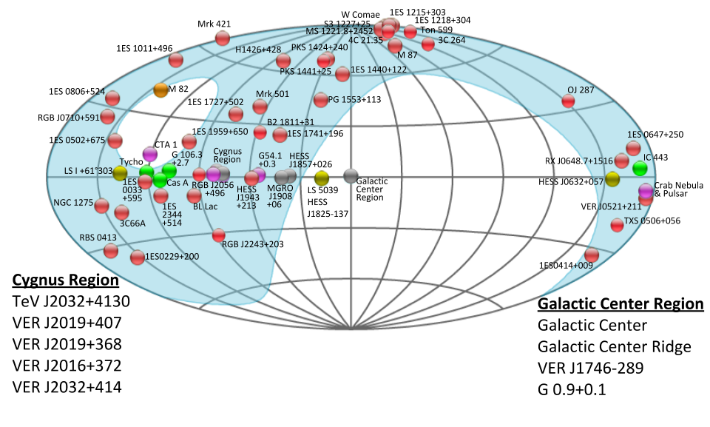
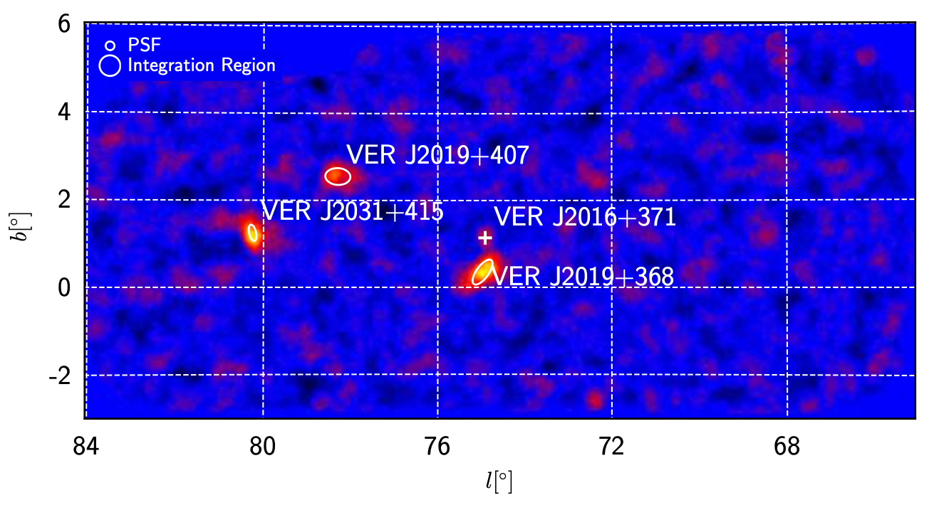
VERITAS now has a rich catalog of ~70 sources.
We have also surveyed the Cygnus region of the Galactic Plane.
A third of VERITAS sources are Galactic, including SNR, PWN, binaries and sources whose nature is not yet established.
Cygnus region survey

Slide 8
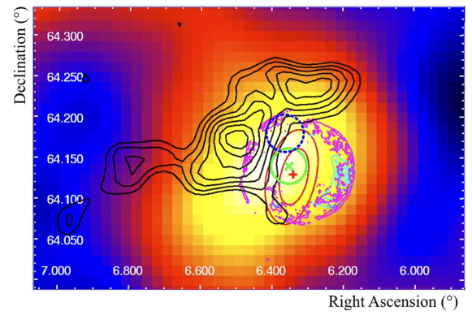
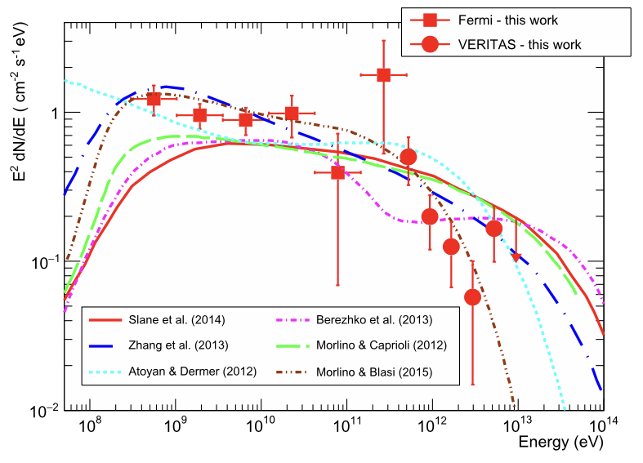
Among these, supernova remnants provide compelling PeVatron targets.
Young (i.e. historical) remnants may be the most efficient.
VERITAS discovered TeV emission from Tycho’s SNR in 2011 (<1% Crab)
150 hours of VERITAS observations, combined with Fermi-LAT results, now show spectral softening in the VHE range, suggesting a low maximum particle energy. Tycho is not a PeVatron.
Notes:
Tycho was a Type Ia. White dwarf. Clean environment

Slide 9
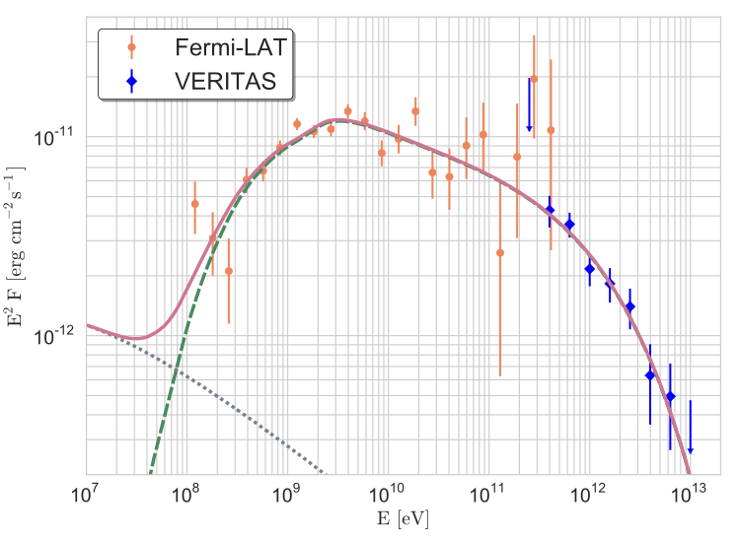
Cas A is the remnant of a Type IIb supernova
It is also much brighter at TeV (>3% Crab)
VERITAS (and MAGIC) results again show a cut-off above ~ 2 TeV.
The maximum energies obtained for protons are 21 TeV and 6 TeV for purely hadronic and lepto-hadronic models, respectively.
This shows the purely hadronic model, with TeV emission due to pion-decay.
In the lepto-hadronic model the highest-energy TeV emission is generated by the highest-energy inverse Compton contribution.
A pure leptonic model is ruled out by the broadband spectral shape (it predicts a peak at 100 GeV)
Notes:
Type IIb, meaning it resulted from the internal collapse and violent explosion of a massive star
This shows the hadronic model. Green dashed is pion decay. Dotted is non-thermal Bremsstrahlung
Pure leptonic is ruled out. It would produce an IC component peaking at 100 GeV incompatible with the measurements:
“Having established the strength of the magnetic field inside Cas A, we immediately find several
consequences. First, given the age of the remnant,∼1010 s, only electrons with Lorentz factors
γ ≫106 can be aﬀected by energy losses. The resulting IC peak, which is calculated from a
combination of CMB and FIR target-photon fields, would lie near 100 GeV in the spectrum, and its
spectral shape would be incompatible with that measured in the GeV band. The second consequence
is that the peak energy flux of the IC component must be about a factor Umag/(Ucmb + Ufir) ≃250
lower than that of the near-UV synchrotron emission radiated by the same electrons (Pohl 1996).
Consequently, the IC peak at 100 GeV is roughly a factor of 3 below the observed γ-ray flux and thus,
IC emission alone can hardly provide the bulk of the γ-ray emission at 100 GeV. It does contribute
to a significant part of it though, and the highest-energy TeV emission is fully accounted for by
the highest-energy IC contribution. Both points indicate that an additional radiation component,
such as from neutral-pion decay, is required. Therefore, we conclude that a purely leptonic model
is very unlikely.

Slide 10
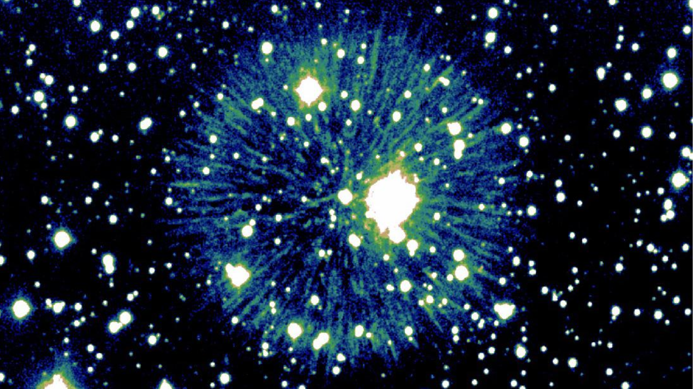
We have also recently searched for emission from the newly identified remnant of SN 1181.
This was likely a Type Iax supernova (WD-WD merger).
Low energy explosion, expanding into a low density medium.
No evidence for a signal – but unsurprising: modelling suggests any gamma-ray flux would be far below VERITAS and CTAO sensitivities
Fesen, Schaefer & Patchick. 2023

Slide 11
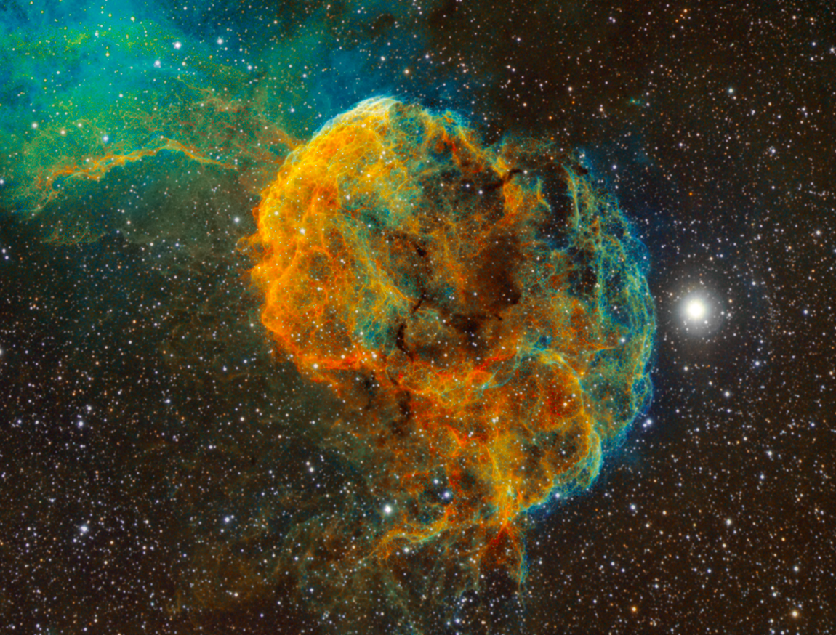
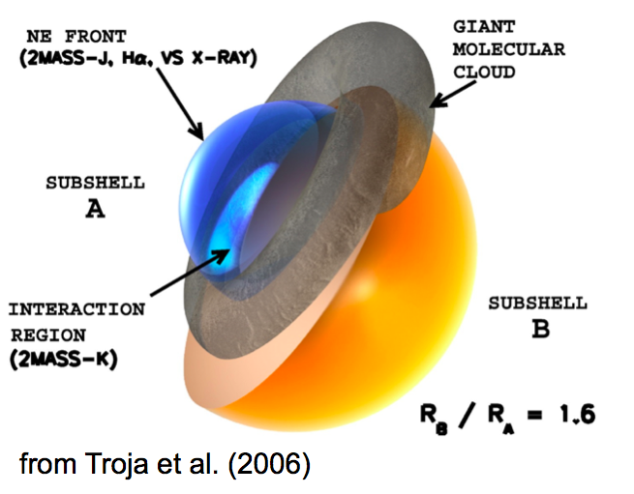
Historical SNR do not appear to be cosmic ray PeVatrons.
What about interacting, middle-aged SNR?
IC 443: A middle-aged (3-30kyr) supernova remnant in a complex environment.

Slide 12
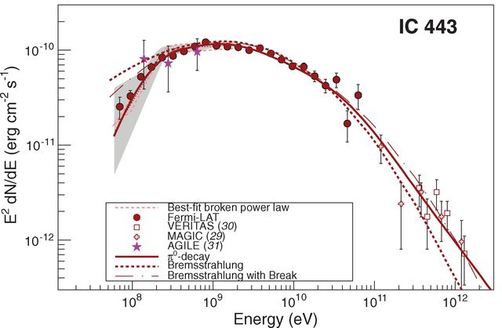
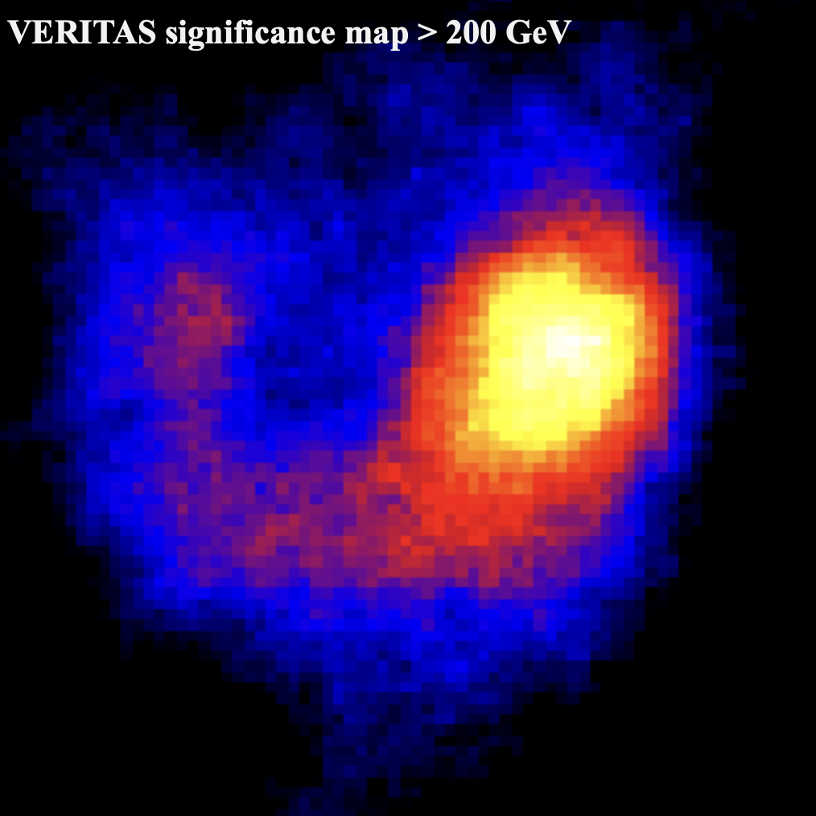
VERITAS detects bright, extended TeV emission from the remnant.
Fermi-LAT clearly measures a low energy break, consistent with the pion bump due to cosmic ray proton interactions.
Ackermann et al, Science, 339, 807 (2013)

Slide 13
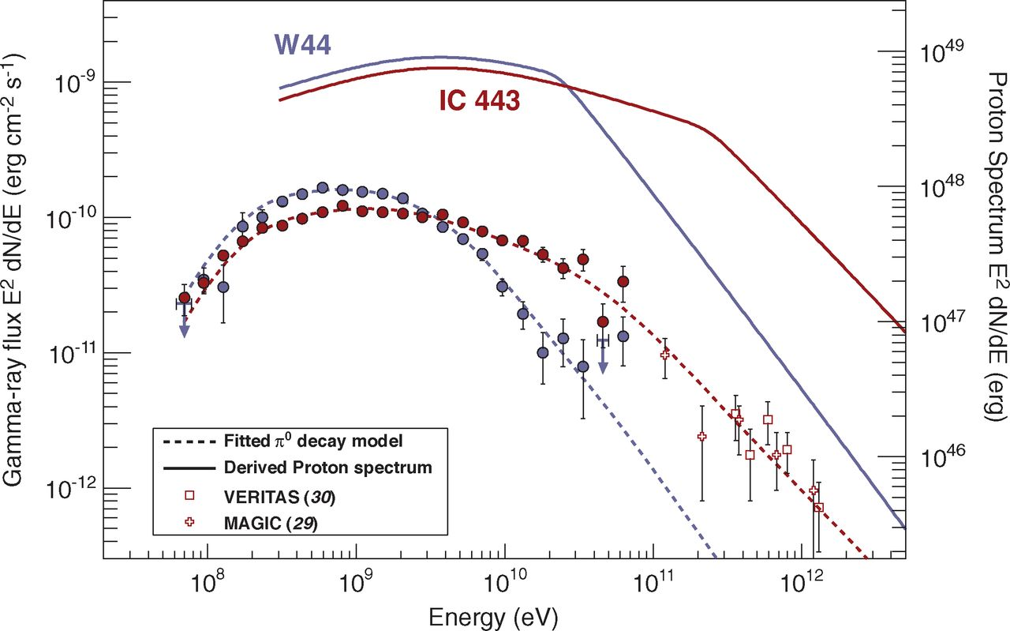
But the underlying proton spectrum does not extend to PeV energies.
Ackermann et al, Science, 339, 807 (2013)
Notes:
Gamma Cygni is more complex. From the MAGIC/Fermi study:
“In addition, we have shown that the maximum energy accel-
erated at the current SNR age is around a few TeV, while the
maximum energy reached at the beginning of the ST phase is
at most few hundreds of TeV. Hence γ-Cygni is not a PeVatron
during the ST phase, nevertheless we cannot exclude that higher
energies could have been reached during the very early stage of
its evolution. ”
“the maximum energy of accelerated particles decreases in
time like ∝t−2.55 and, at the present moment, it is around few
TeV while it reached an absolute maximum of about 100 TeV
at the end of the free-expansion phase”

Slide 14
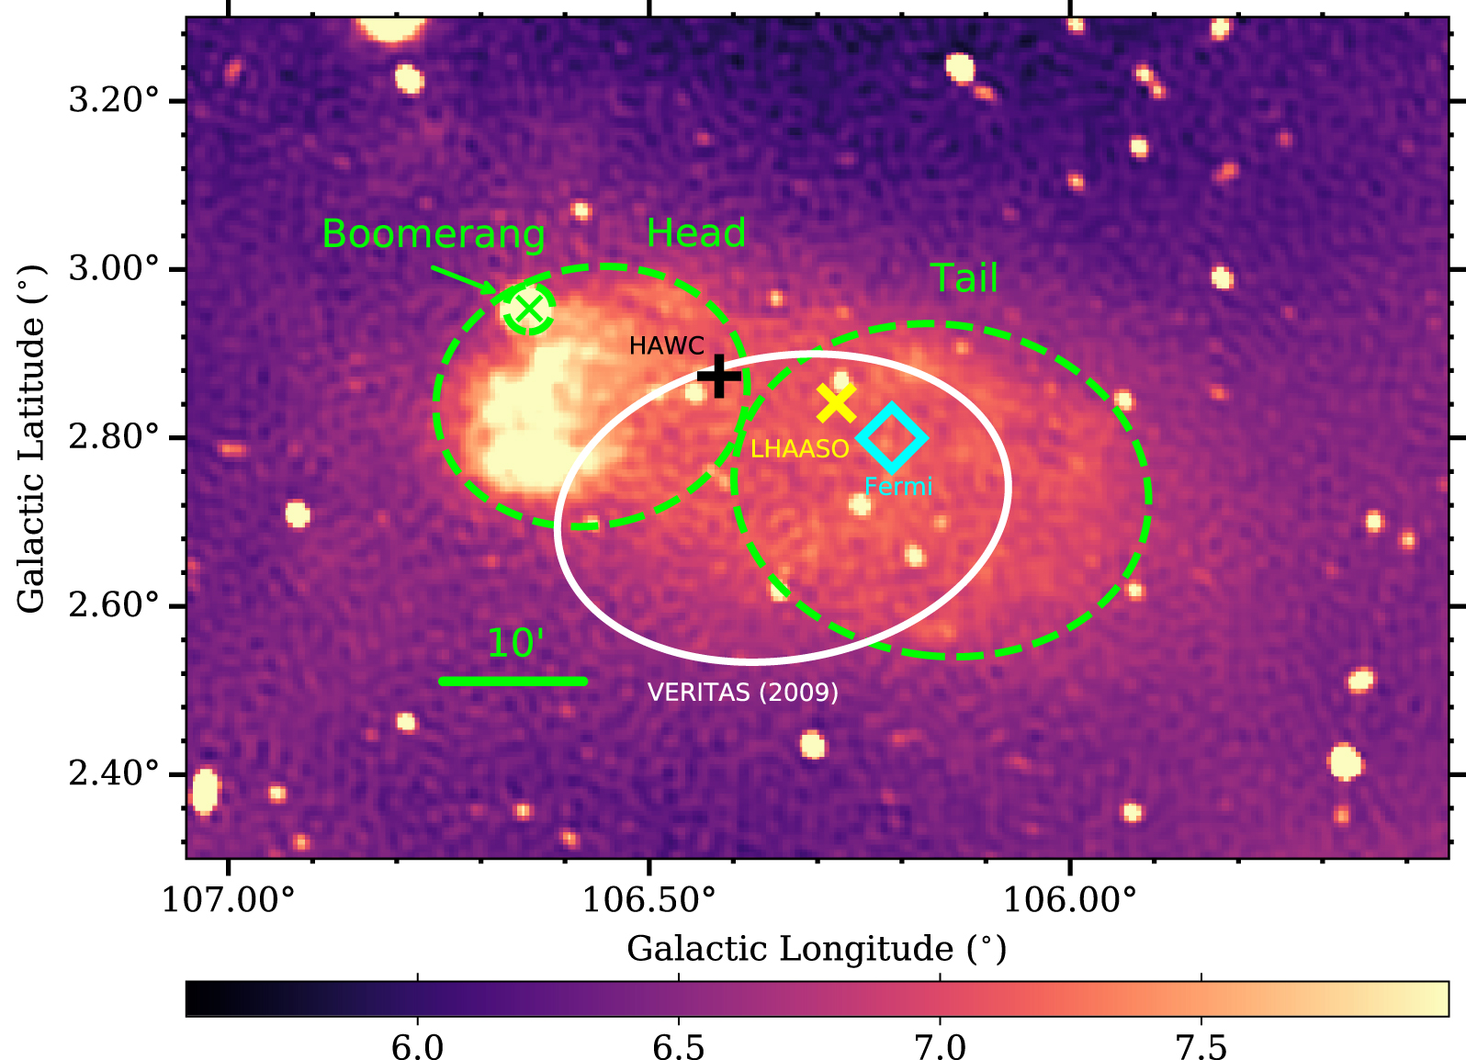
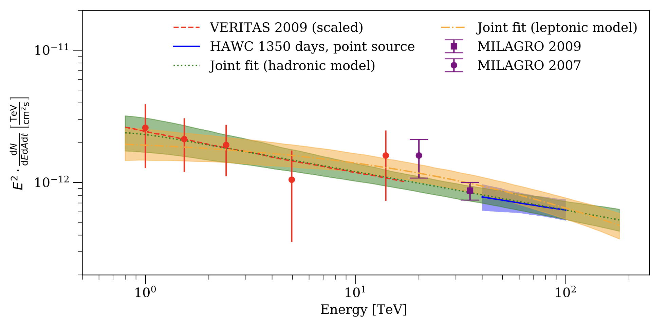
One of the best PeVatron candidates in the northern sky was first firmly identified as a gamma-ray source by VERITAS in 2009.
SNR G106.3+2.7 is a complex composite SNR, comprising a pulsar, a boomerang-shaped PWN and distinct ‘head’ and ‘tail’ regions.
HAWC see >100 TeV emission from the head region (HAWC J2227+610), implying protons above 800 TeV.
Pope et al., ApJ, 960, 75 (2024)
Albert et al., ApJL, 896, L29 (2020)
Notes:
We present the detection of very-high-energy gamma-ray emission above 100 TeV from HAWC J2227+610 with the High-Altitude Water Cherenov Gamma-Ray Observatory (HAWC) observatory. Combining our observations with previously published results by the Very Energetic Radiation Imaging Telescope Array System (VERTIAS), we interpret the gamma-ray emission from HAWC J2227+610 as emission from protons with a lower limit in their cutoff energy of 800 TeV. The most likely source of the protons is the associated supernova remnant G106.3+2.7, making it a good candidate for a Galactic PeVatron. However, a purely leptonic origin of the observed emission cannot be excluded at this time.

Slide 15
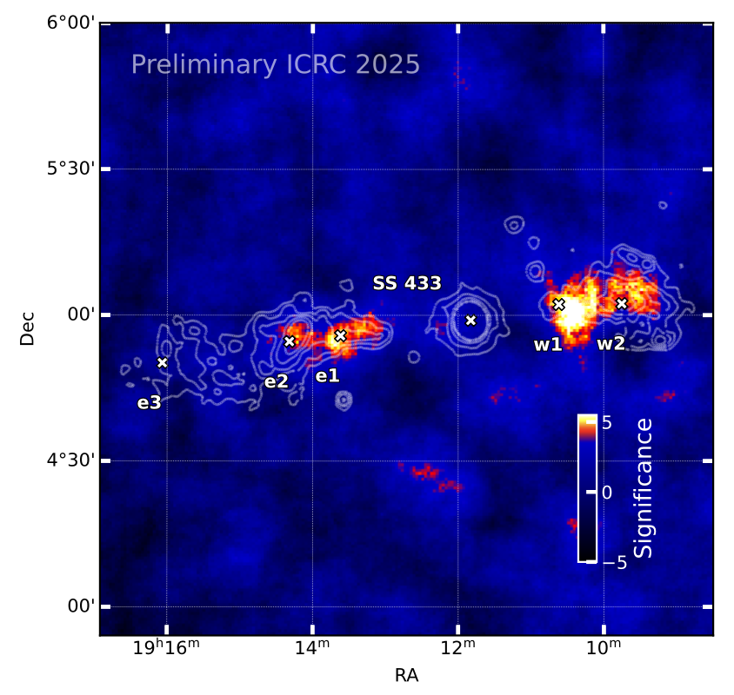
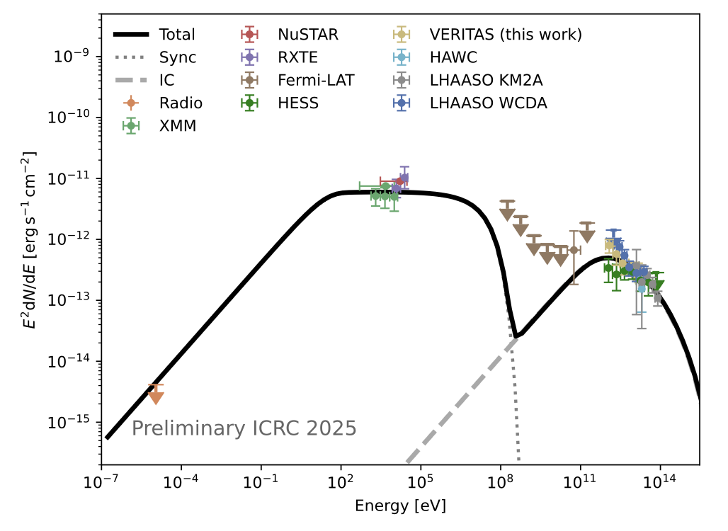
VERITAS is also contributing to the exciting new topic of gamma-ray emitting microquasar outflows.
Results on SS 433 from this year’s ICRC.
Leptonic emission model
https://arxiv.org/abs/2509.21063

Slide 16
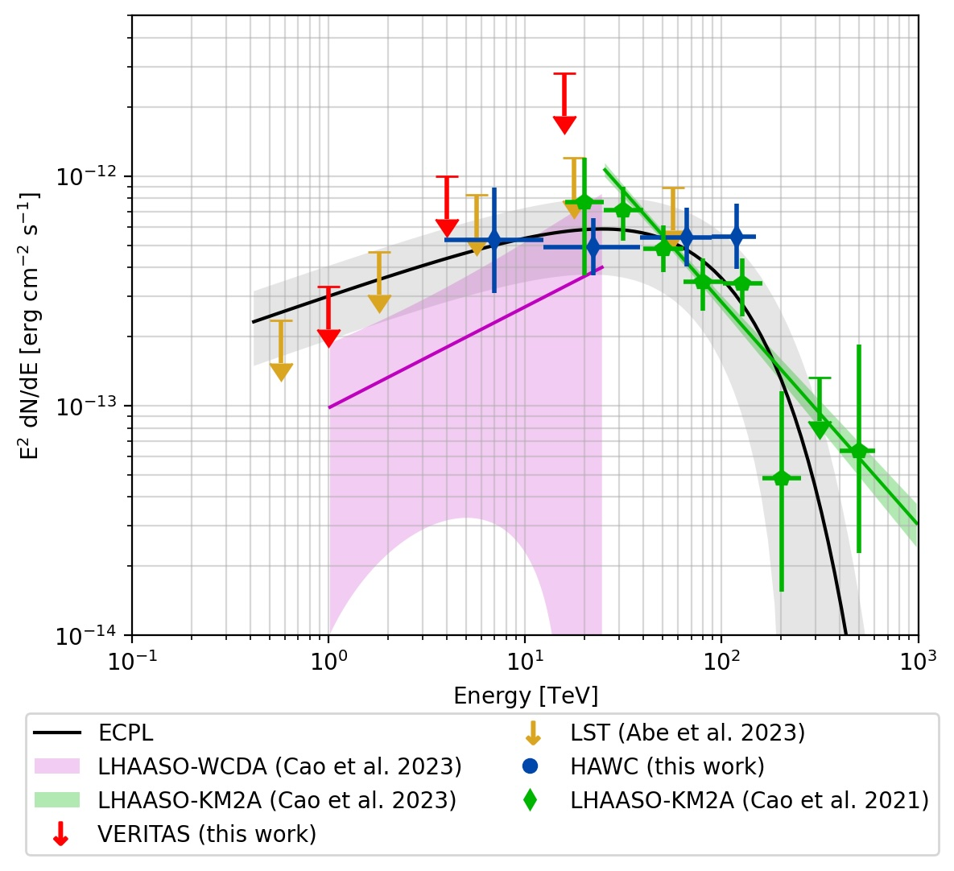
LHAASO results provide a wealth of new potential PeVatron targets for VERITAS.
Matthew will report on these in more detail later today. But a common feature of many is a low energy (<10 TeV) spectral hardening, which places them below the sensitivity of VERITAS and other IACTs.
LHAASO J2108+5157 is a bright LHAASO source with no clearly identified counterpart at other wavelengths.
VERITAS and LST-1 limits confirm the <10 TeV spectral hardening measured by WCDA.

Slide 17


The most exciting gamma-ray science during the design phase of VERITAS in the late 1990’s was extragalactic.
The Crab was the only convincing Galactic source.
All known TeV sources were point-like.
EGRET 1994 (18 GeV photon)
Mrk 421, 1992
The VERITAS design is optimized for maximum sensitivity to point sources in the energy range 100 GeV - 10 TeV (Weekes, 2001)

Slide 18
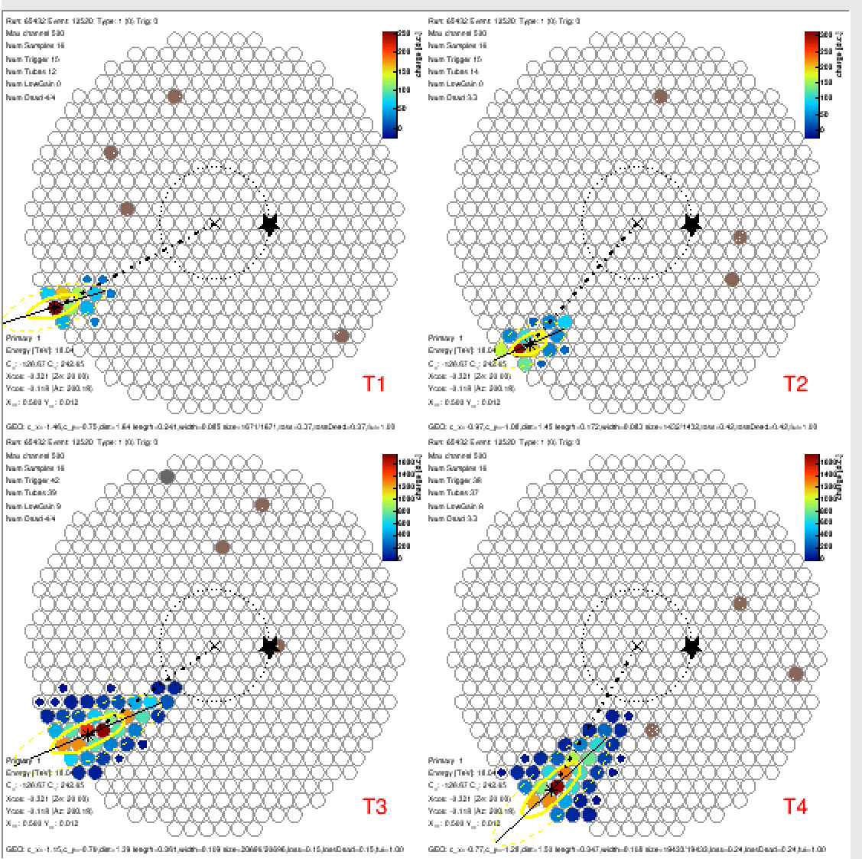
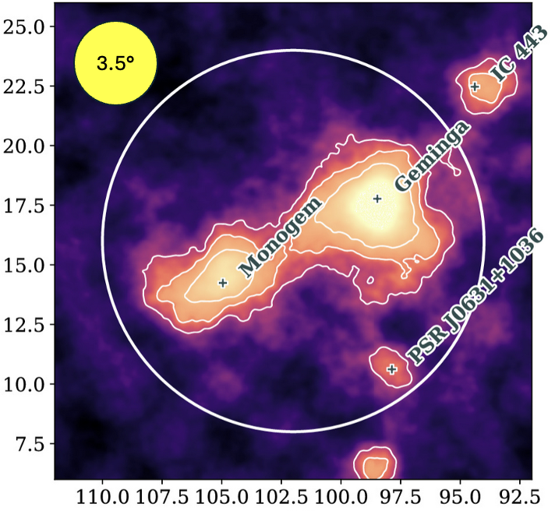
This likely influenced design decisions – such as small cameras.
Difficult to reconstruct high energy events with large core distances.
Also adds challenges to modelling the background and analysing very extended sources.
Simulated 18 TeV gamma.
274m core distance

Slide 19
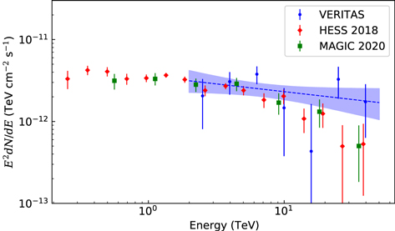
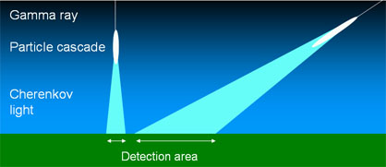
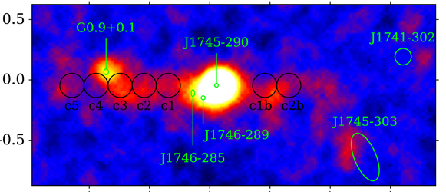
A 4-telescope array with 100m-spacing has an effective collection area largely defined by the size of the Cherenkov lightpool at ~1 TeV (~0.1 km²).
Large zenith angle observations can help. But this is only practical for a limited number of targets and adds systematic errors and other analysis challenges.
LZA observations of the Galactic Center region with VERITAS allowed us to measure emission from the GC ridge up to 40 TeV
Notes:
70875 m²
0.1 km^2

Slide 20
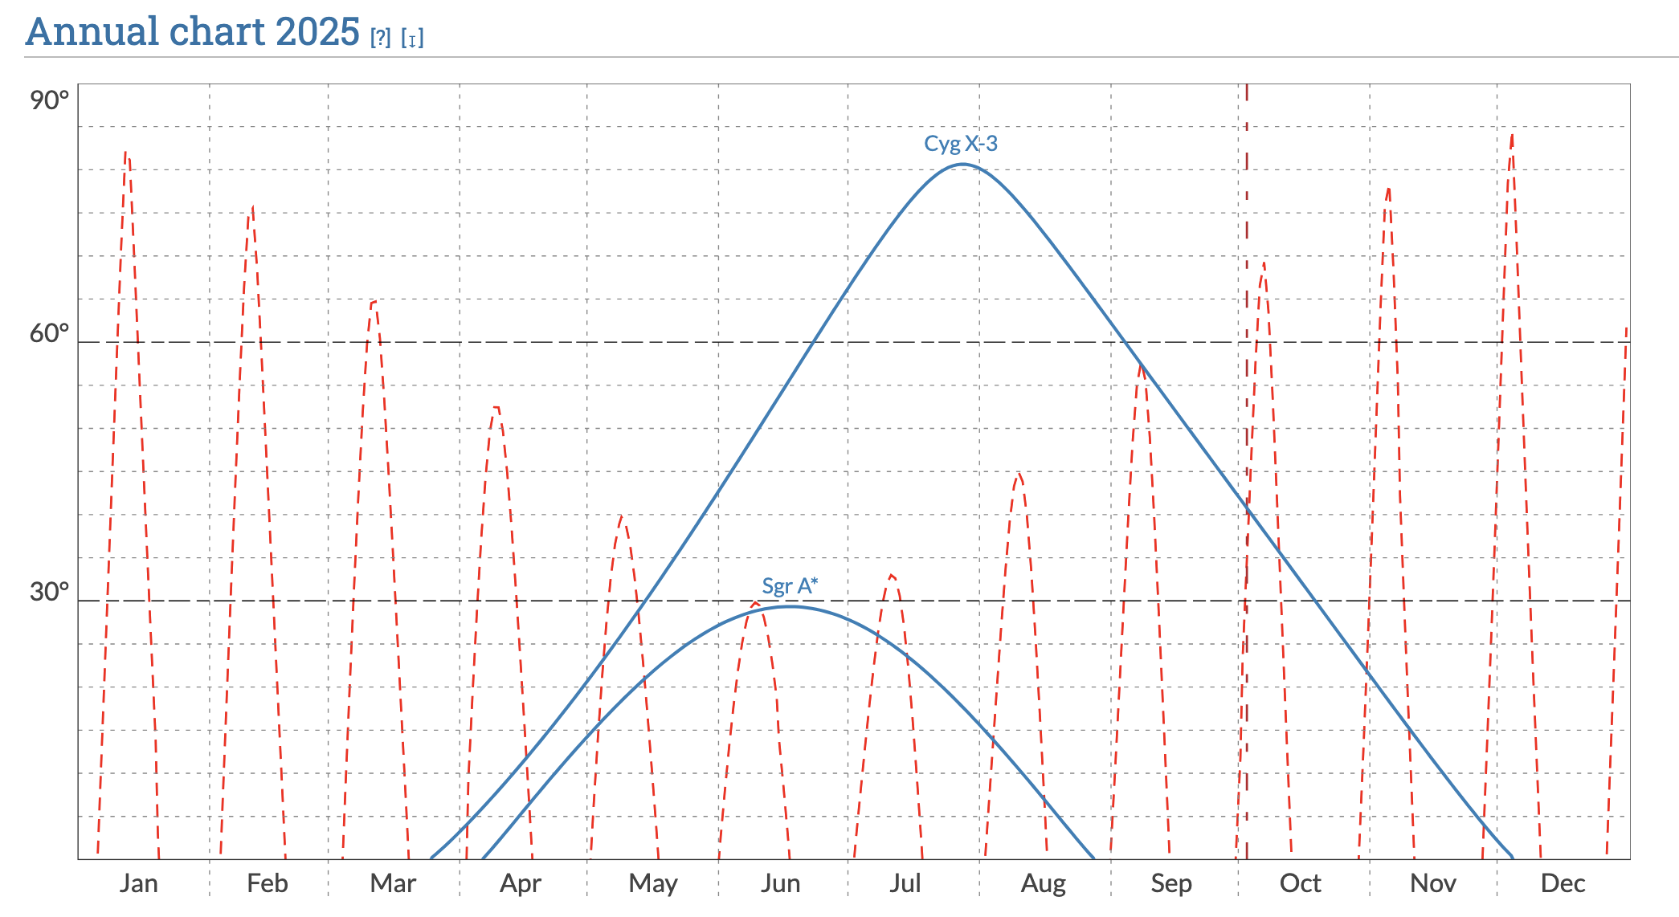
The location of VERITAS also presents challenges for Galactic PeVatron searches.
The most interesting regions of the plane in the north are only visible during the shortest (summer) nights, and severely impacted by the Arizona monsoon season
The inner galaxy is far to the south
Notes:
The blue line is the source elevation at midnight on that date.

Slide 21
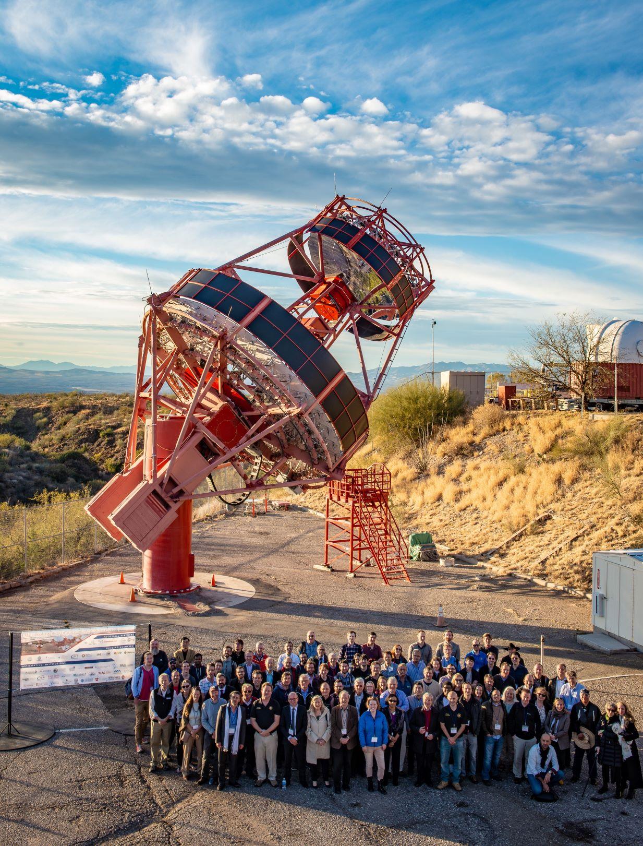
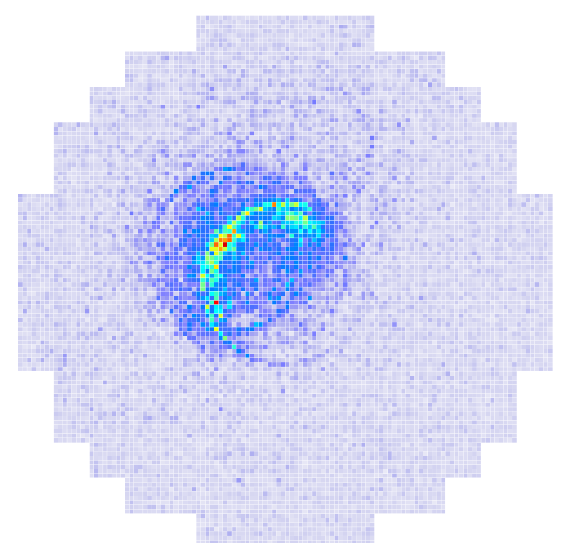
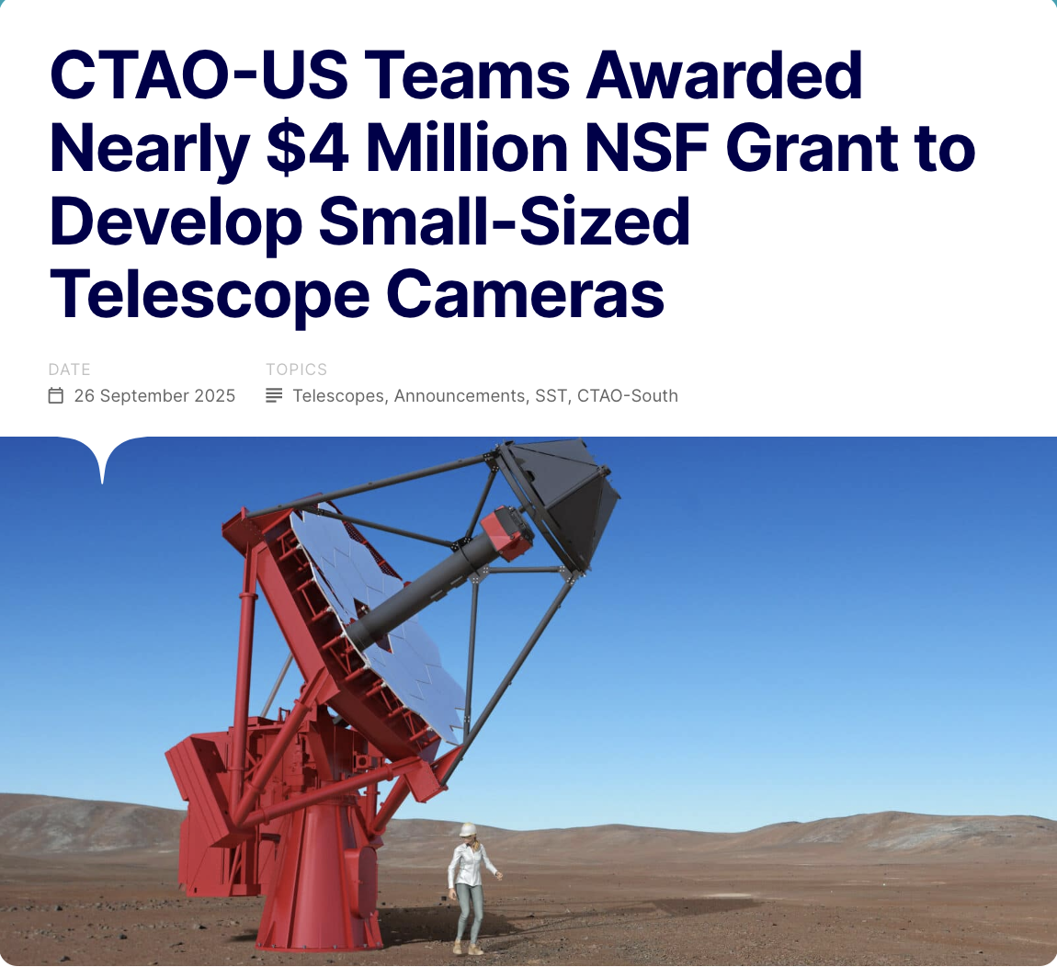
CTAO, LACT and ASTRI will be much better for PeVatrons.
The US is heavily involved in aspects of CTAO which will contribute strongly to PeVatron studies.
The 9m-aperture SCT provides excellent off-axis optical performance.
The high-resolution camera has 11,000 pixels over 8 degrees.
37 4.3m-aperture SSTs provide 3km² effective area in the south
Notes:
The SSTs (37 telescopes) increase the southern array effective area to 3 km^2. The USA is providing 10 cameras.
The pSCT (9m) camera is 8 degrees with 11,000 pixels an superb off-axis optics.

Slide 22
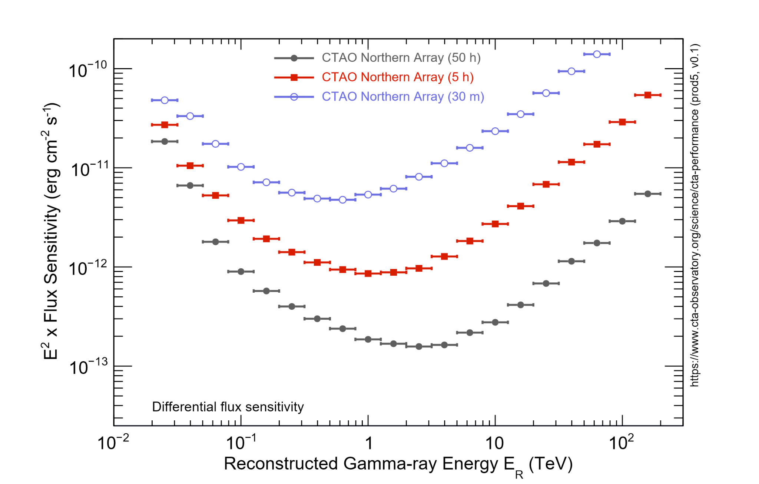
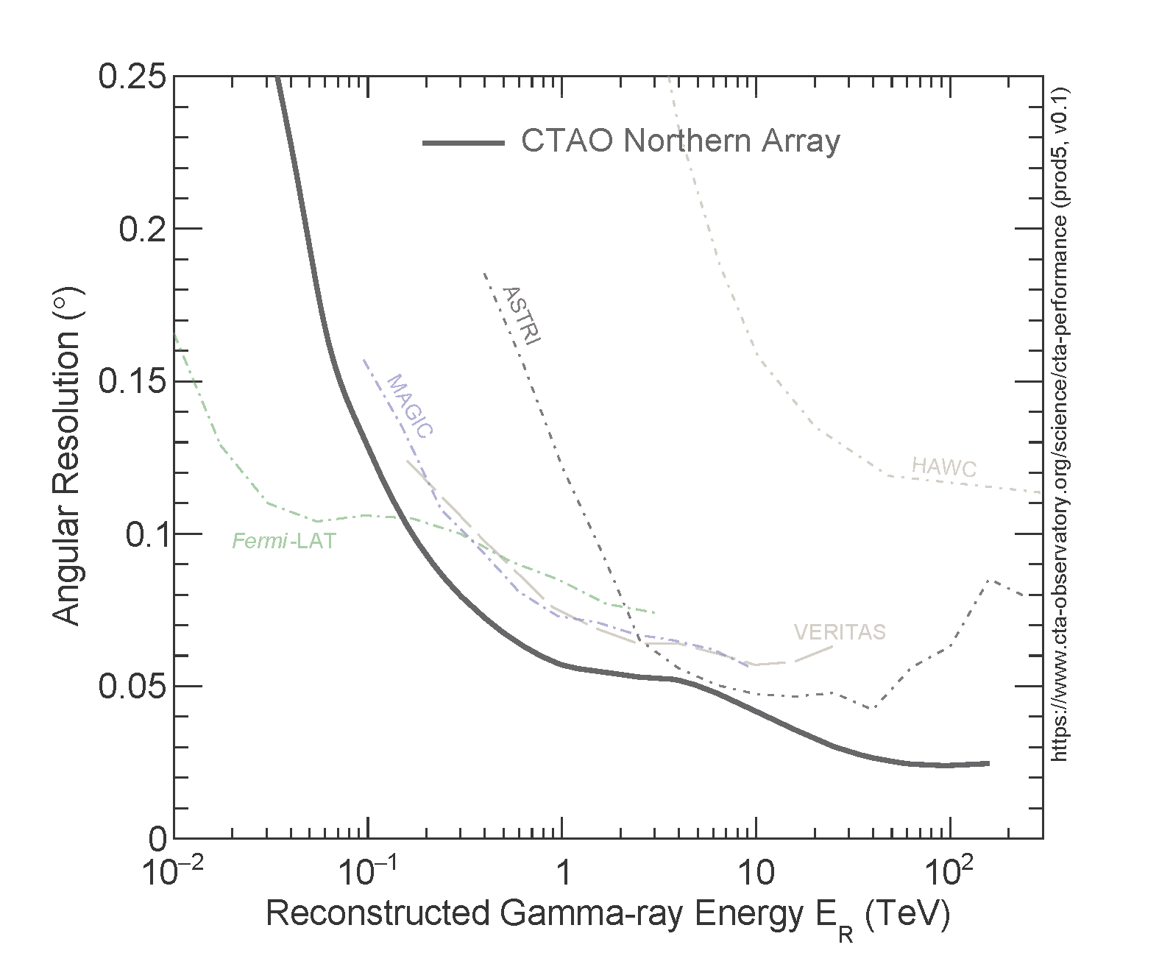
But CTAO is a rather expensive “Swiss army knife”: Designed to do everything, extremely well. Covers 4 orders of magnitude in gamma-ray energy with excellent angular and spectral resolution.
What if the design goal is only the highest energies, above 10s of TeV?
Requires lots of small, cheap telescopes with a wide field -of-view.
Notes:
You might want small telescopes. Wide field of view. And cheap – so you can have lots of them.

Slide 23
PANOSETI
Originally designed as an all-sky optical transient monitor, with two widely separated domes housing many telescopes.
Led by Shelley Wright at UC San Diego, Dan Werthimer (Berkeley), Paul Horowitz (Harvard), Andrew Howard (Caltech).

Slide 24
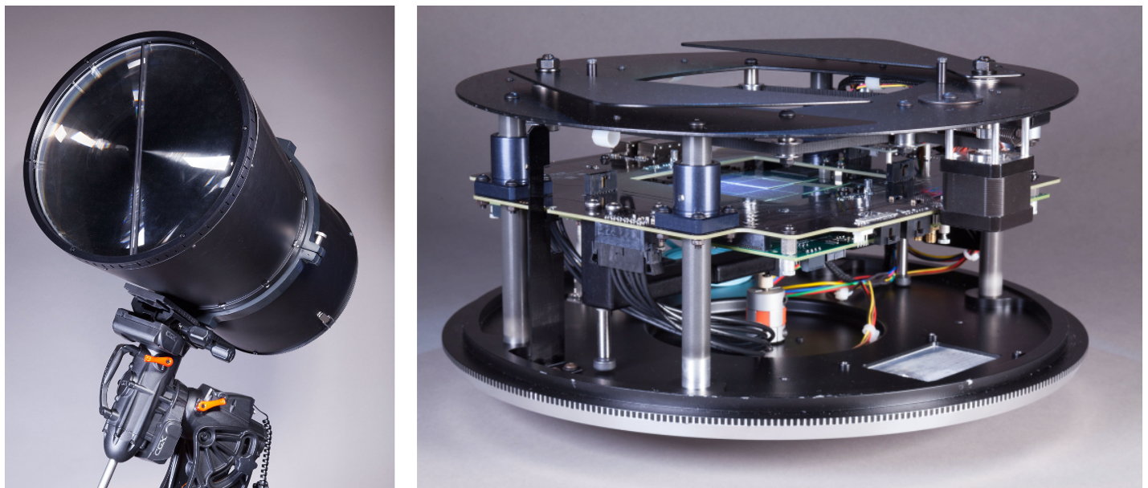
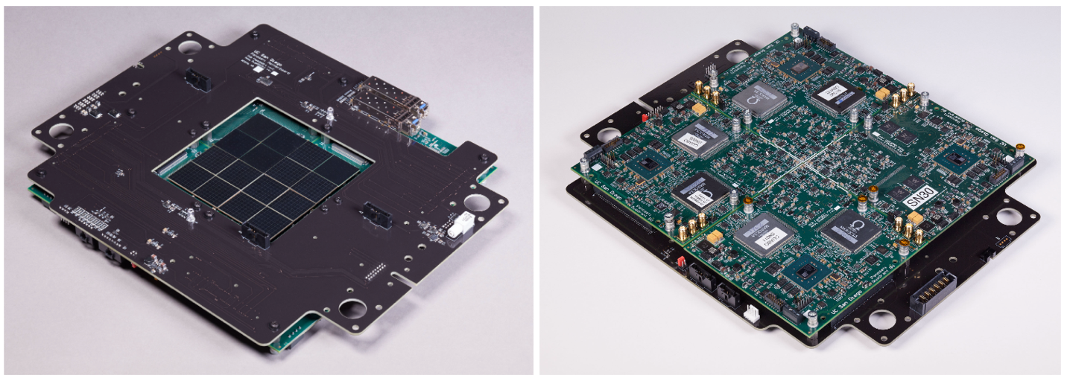
0.46m Fresnel lens
f/1.32
Camera module
Custom-built lightweight aluminium shell.
Off-the-shelf iOptron mount with ZWO guide camera
16, 8x8 SiPM arrays
1024 3mm, 0.3º pixels
9.6ºx9.6º field of view
CITIROC-based ASIC readout

Slide 25
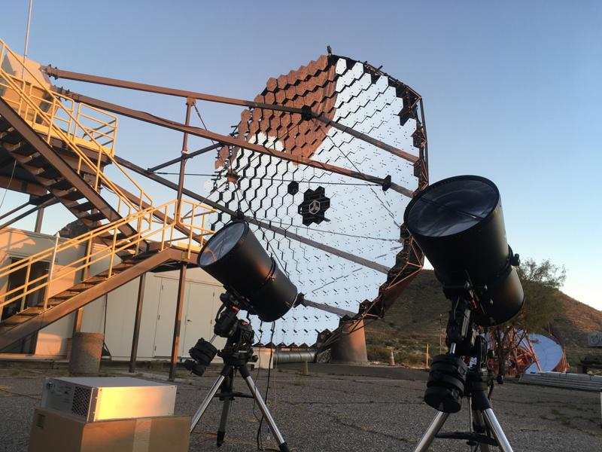
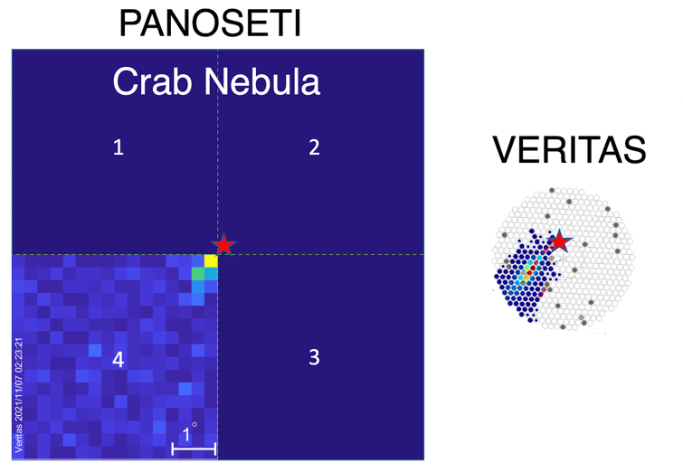
PANOSETI’s background is our signal: Cherenkov emission from cosmic ray and gamma-ray air showers.
As an initial test, we deployed two PANOSETI telescopes at VERITAS, and observed >10 TeV gamma-rays in coincidence.
This led to further collaboration, funding through Elisa Pueschel’s group in Germany, and a revision of the PANOSETI deployment plans.
A 15 TeV gamma-ray from the Crab

Slide 26
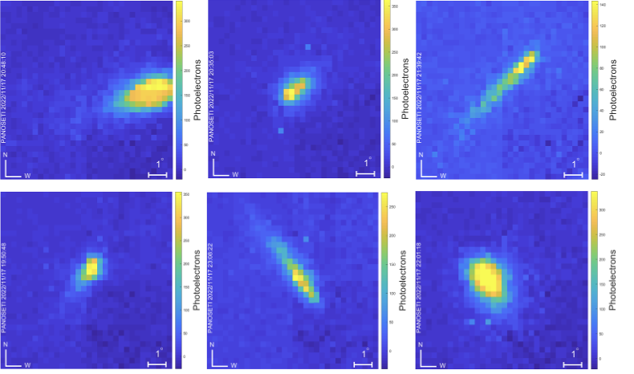
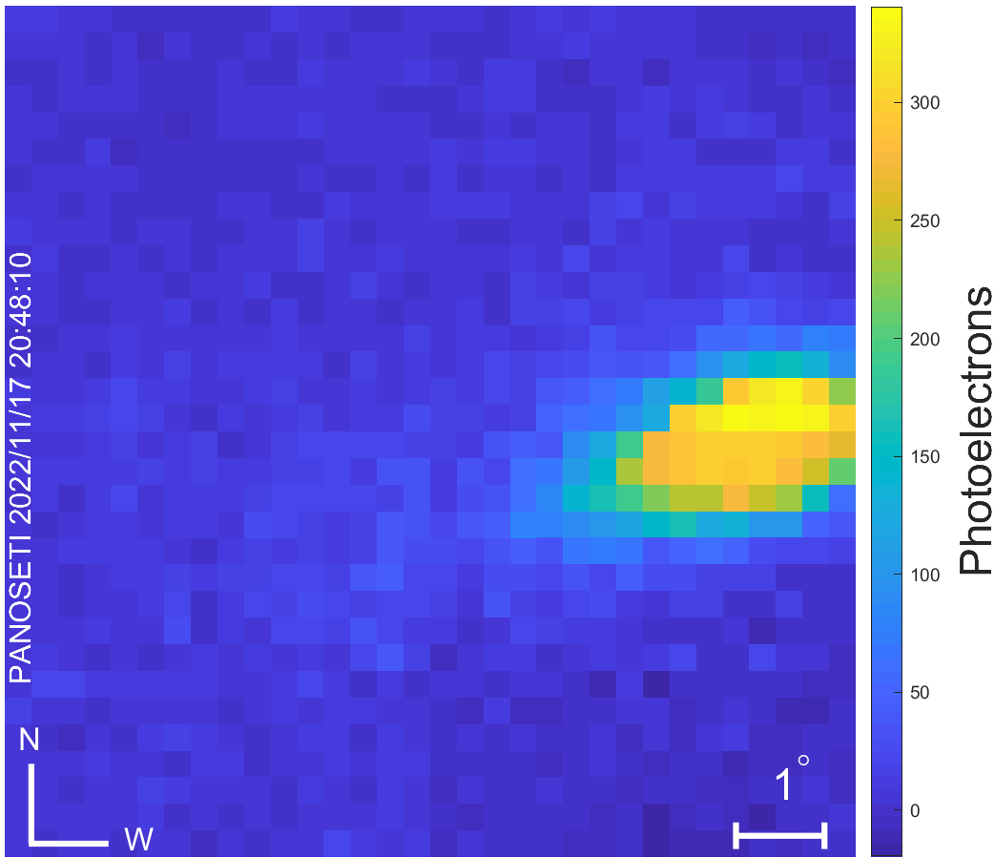
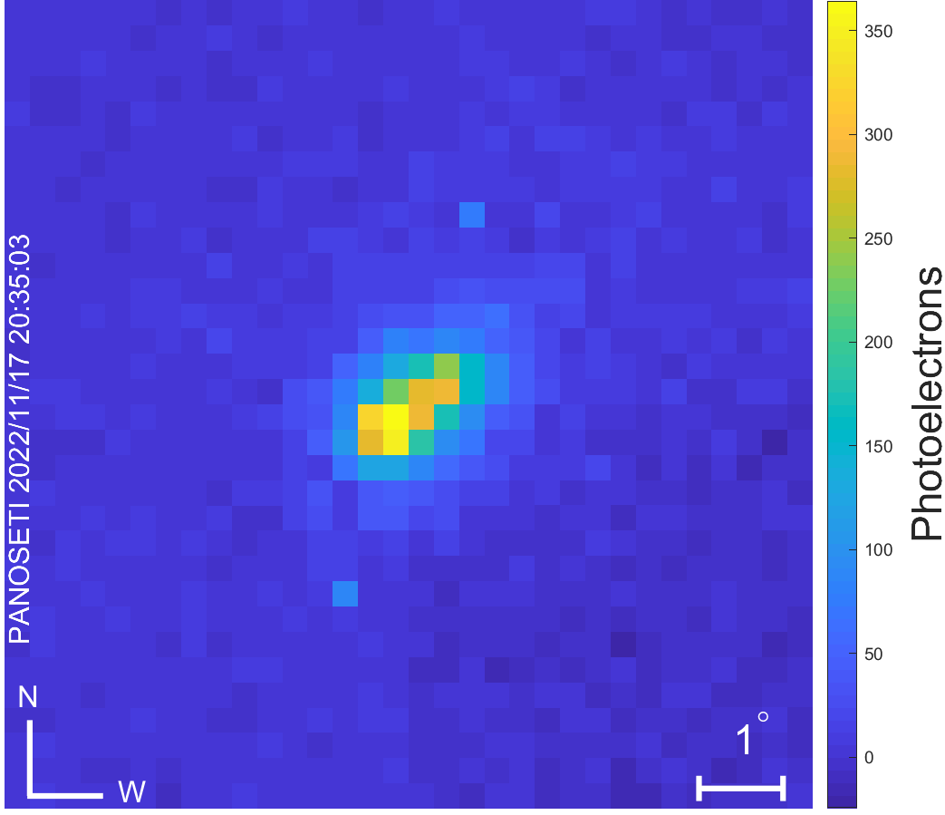
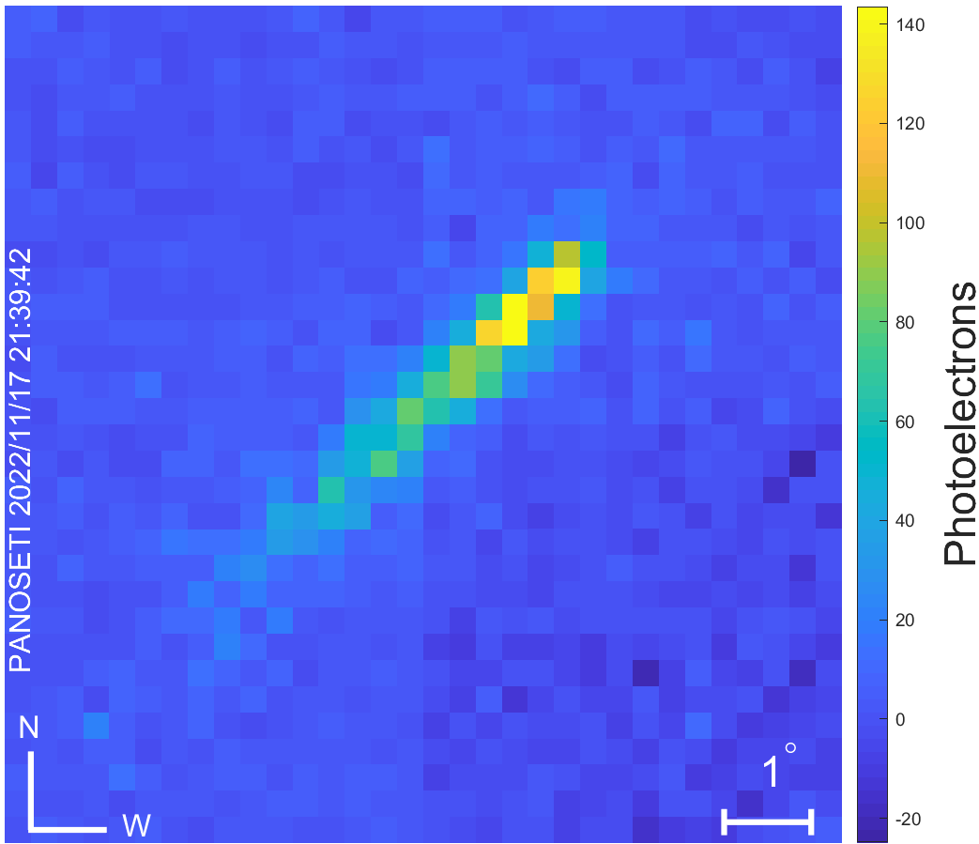
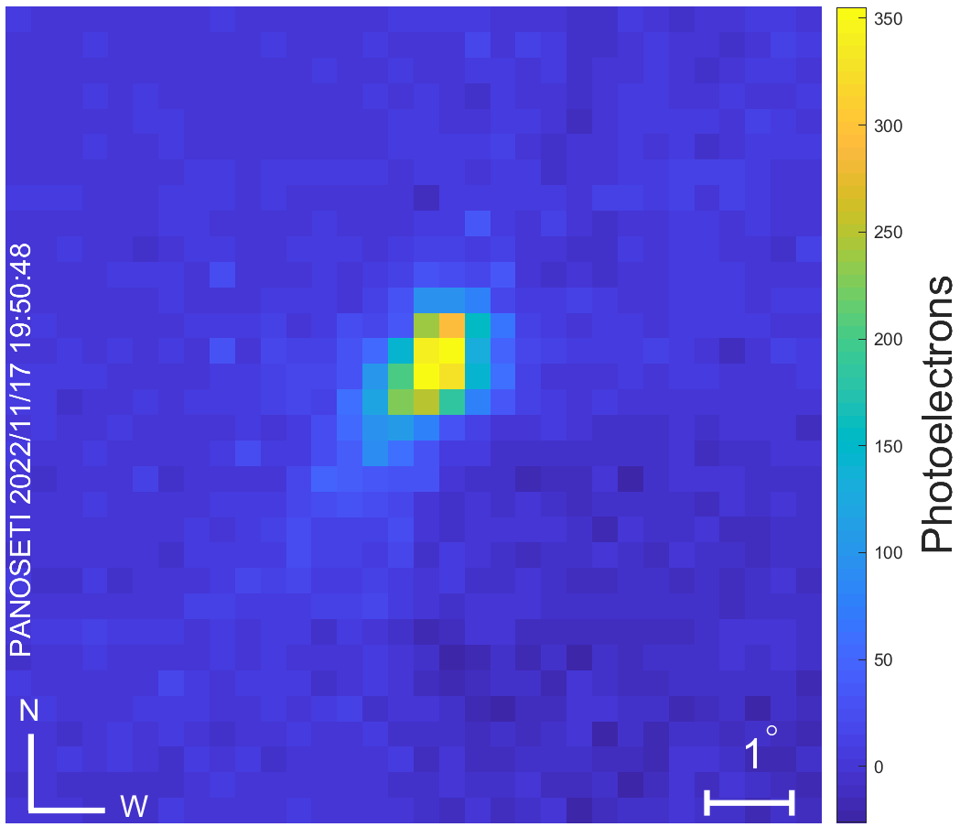
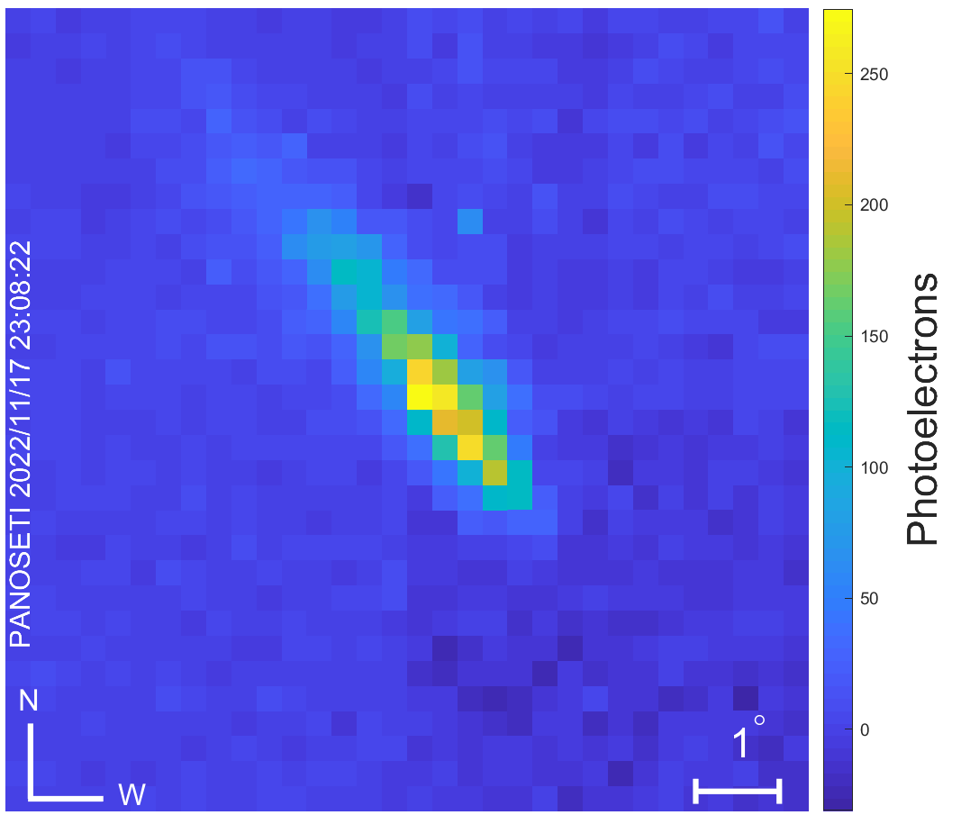
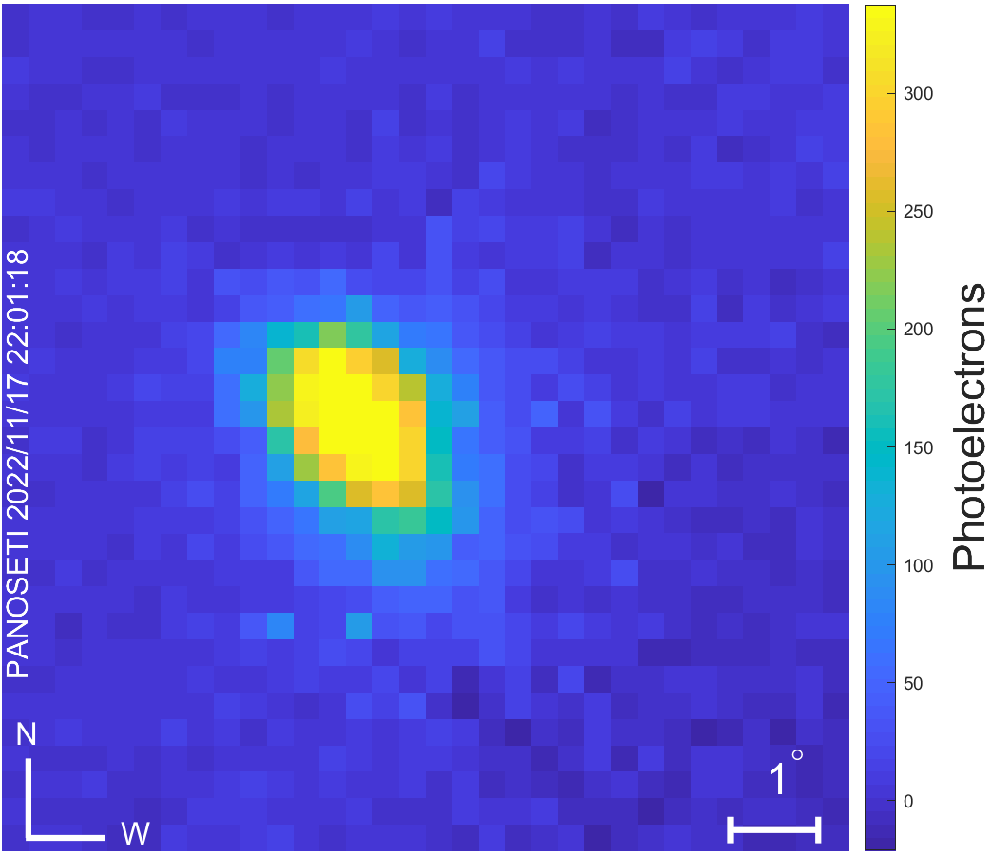
Two small modifications implemented for Cherenkov work
Add a multiplicity trigger (n-pixels from a quadrant)
Read out all four quadrants for every triggered event.
Tested with cosmic ray observations at Lick Observatory.

Slide 27
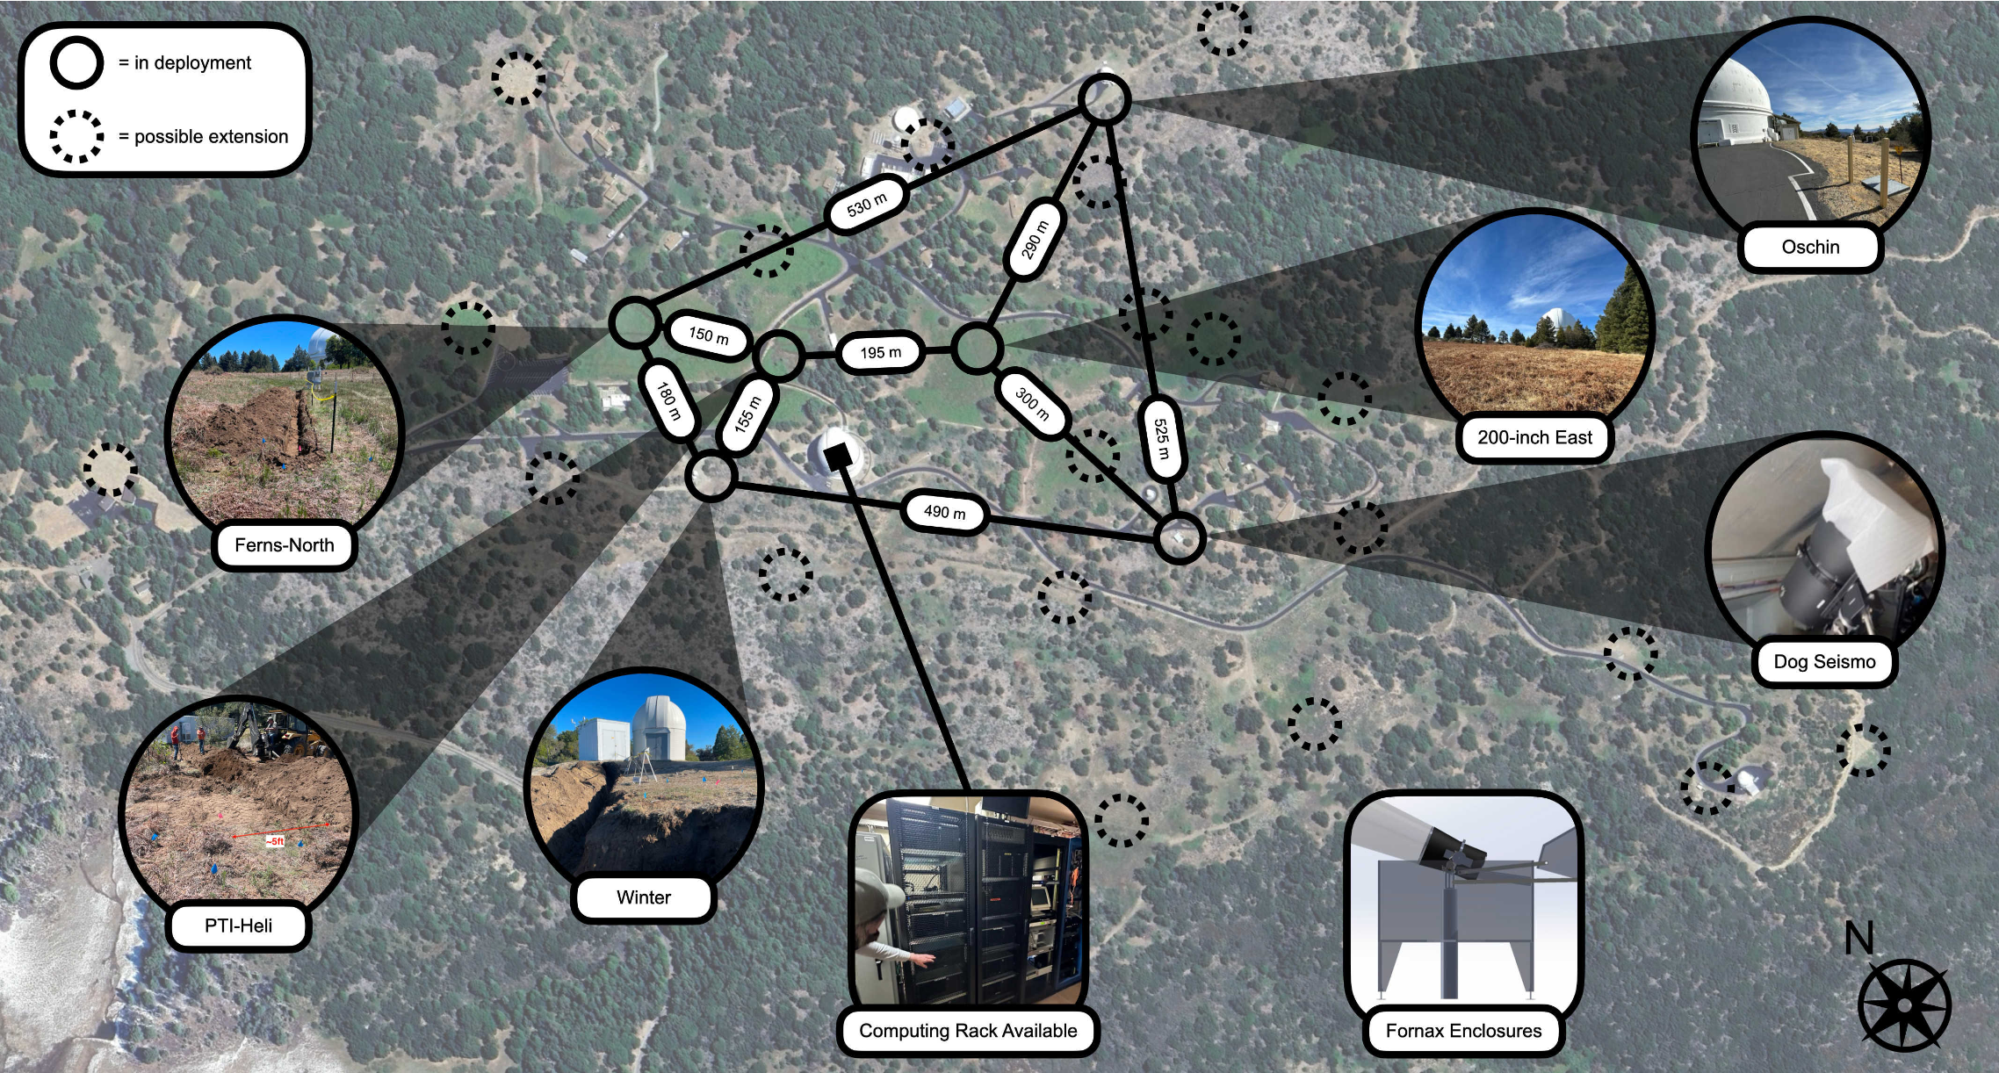
Caltech recently provided enthusiastic access to Palomar Observatory.
2 telescopes operating. 2 more under deployment. 2 more in assembly.
Aiming for 3-4 telescope operations this Fall (2025).
Space for at least 25 telescopes on this site.

Slide 28
PANOSETI priorities for 2025/2026
Deploy and operate the first few telescopes reliably and remotely.
Calibrate tracking, optics and camera.
Update the telescope model and simulate the response.
Demonstrate that the simulations match reality.
Calculate the energy threshold and effective area.
Optimize tools to clean and parameterize images.
Optimize tools to distinguish gamma-rays from the cosmic ray background efficiently.
Detect the Crab Nebula and reconstruct its energy spectrum.

Slide 29
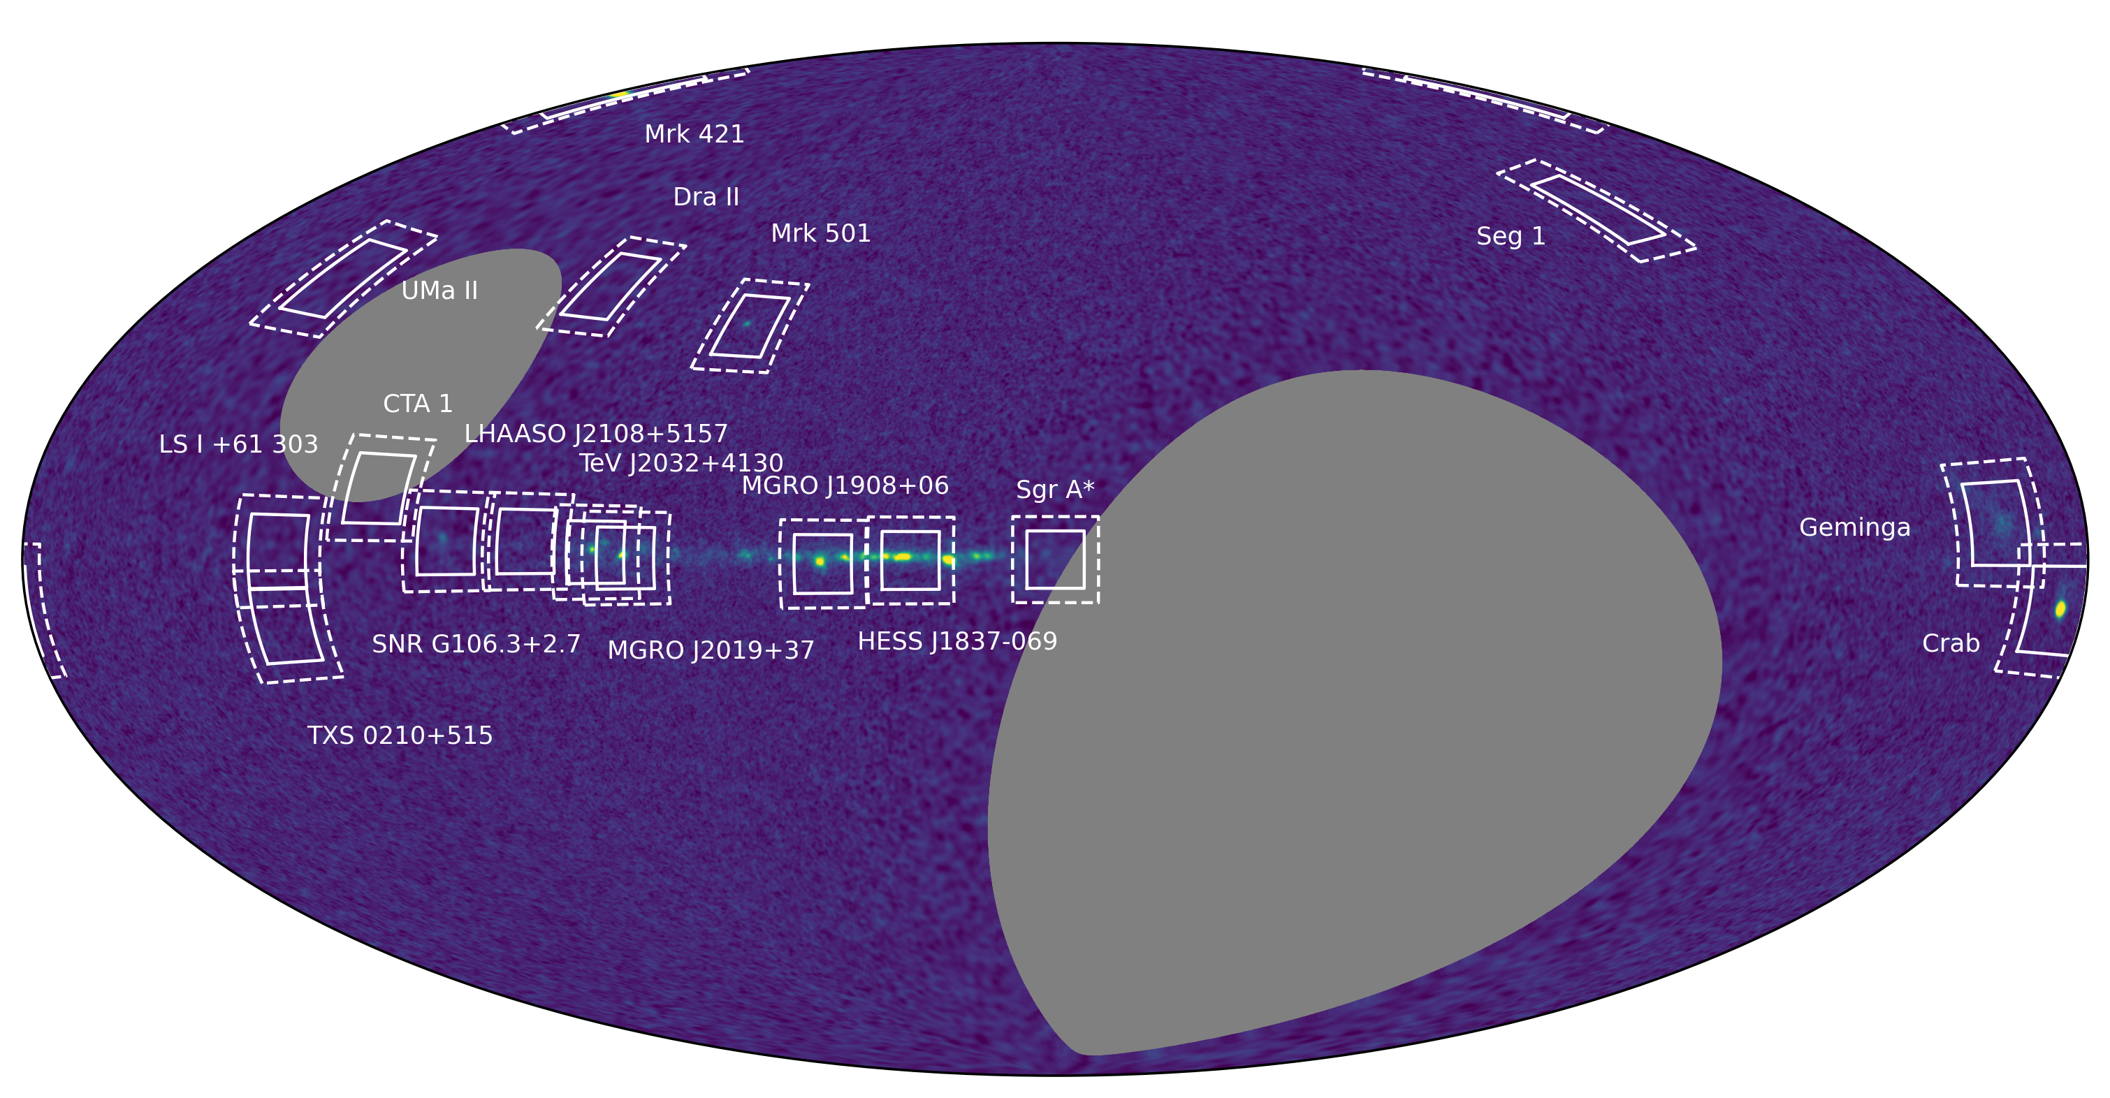
An example annual observing program (still under development)
HAWC Background

Slide 30

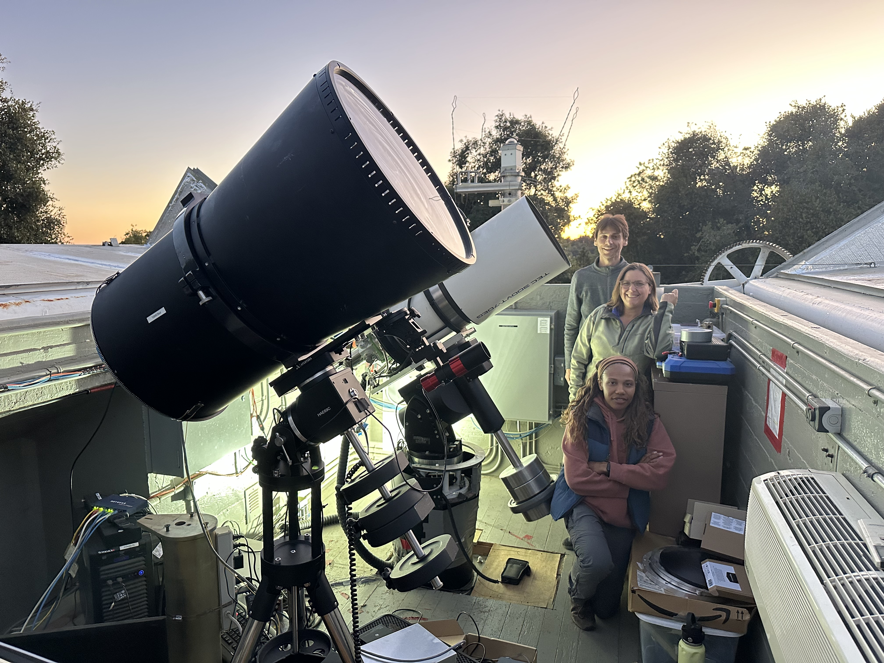
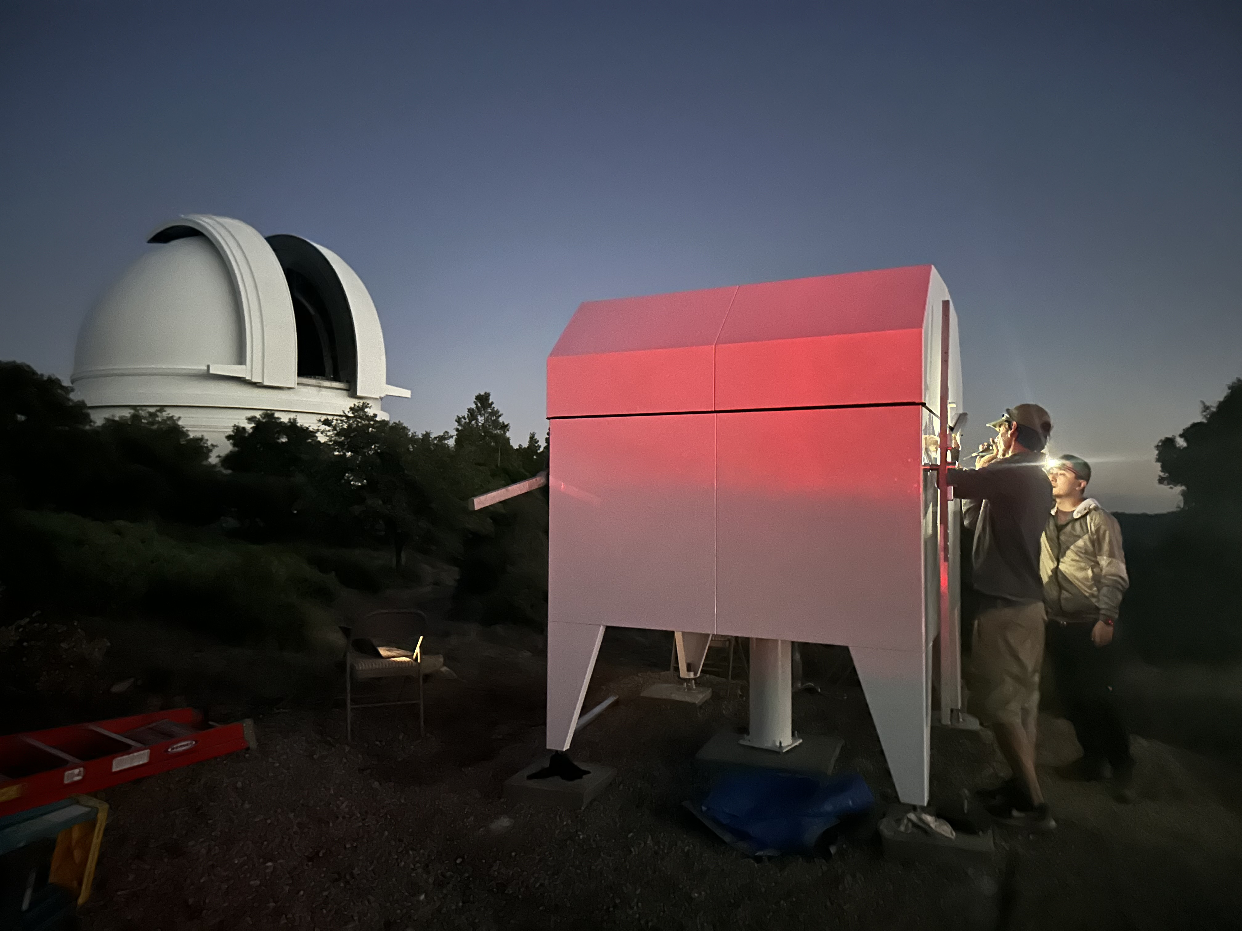
The first PANOSETI telescope at Palomar, installed inside an existing dome.
A custom enclosure for the second telescope. Based upon the HATs design (by Fornax).

Slide 31
PANOSETI Prospects
PANOSETI telescopes are inexpensive, low environmental impact, and quick to construct and deploy.
If we can demonstrate good performance there are lots of potential applications:
Standalone arrays.
One or a few large arrays
Many small arrays (combining data e.g. with gammapy)
Enhancements to particle detector arrays.
Outriggers for Cherenkov telescope arrays.
Provides one potential path to >10 km² (100km² ?!) effective area.
This is required to study the “super-PeVatron” sky.
Notes:
30 PANOSETIT scopes exceeds LHAASO

Slide 32
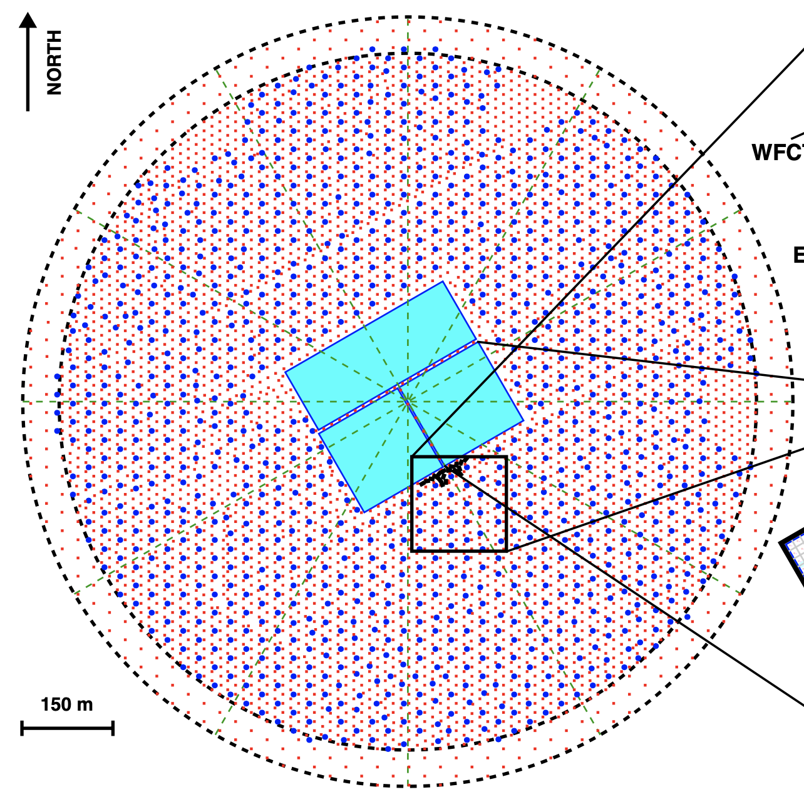
24 telescopes could cover the same physical area of LHAASO, with effective area extending well beyond this.
<2M$ hardware cost.
1128 m
282m

Slide 33
BACKUP

Slide 34
Multiple smaller arrays provide even larger effective area (at the cost of angular resolution), and do not need to be co-located.
282m
282m
282m
282m

Slide 35


Slide 36


Slide 38

The missing historical supernova remnant: SN 1181
First observed between August 4 and August 6, 1181 AD.
Recorded in multiple texts by Chinese and Japanese astronomers. At peak, as bright as Vela (m=0).
Appeared in the constellation Cassiopeia and was visible and motionless against the fixed stars for 185 days.
Previously associated with PWN 3C 58 / PSR J0205+06449
3C 58 was studied by VERITAS (22 hours, no detection, pulsar limits published)
Detected by MAGIC: 81 hours, 5.7 sigma, 0.65% Crab
Re-assessment places 3C58 outside of the region given by historical constraints and suggests an age of ~5kyr:
3C58 is not the remnant of SN 1181.

Slide 39

Pa 30: the remnant of SN 1181
Discovered in 2013 by Dana Patchick, an amateur astronomer searching for planetary nebulae in WISE data.
Highly structured nebula 3 arcminutes in diameter, with long filaments extending radially from a very hot central star driving a high-velocity wind.
The nebula's angular size, estimated 2.3 kpc distance, and 1100 km s⁻¹ expansion velocity are consistent with an explosion date around 1181 AD.
Association first proposed by Ritter et al. in 2021.
Fesen, Schaefer & Patchick. 2023
Notes:
This very hot star, one of the hottest stars in the Milky Way (about 200 000 degrees Celsius), has a fast stellar wind with speeds up to 16,000 km/s. Luminosity of 40,000 Lsun.
We conclude its appearance is due to the central star’s extremely high-speed winds blowing over a lumpy shell of supernova ejecta. High speed winds produced throughout the lifetime of the remnant accelerate lower density ejecta material which is then photo-ionized by the central star.

Slide 40


Pa 30: the remnant of SN 1181
Properties of the remnant and its central star are best-explained by an unusual progenitor – a merger between CO and ONe white dwarfs, leading to a low-luminosity Type Iax supernova explosion.
Rare sub-type of Type Ia supernovae in which the merging white dwarfs are not fully destroyed by the supernova explosion, leading to a double-degenerate merger product described (colourfully!) as a “zombie star”.
Ko et al. 2024
Notes:
This very hot star, one of the hottest stars in the Milky Way (about 200 000 degrees Celsius), has a fast stellar wind with speeds up to 16,000 km/s.

Slide 41

Caltech recently provided enthusiastic access to Palomar Observatory.
2 telescopes operating. 2 more under deployment. 2 more in assembly.
Aiming for 3-4 telescope operations this Fall (2025).
Space for at least 25 telescopes on this site.

