Slide 1
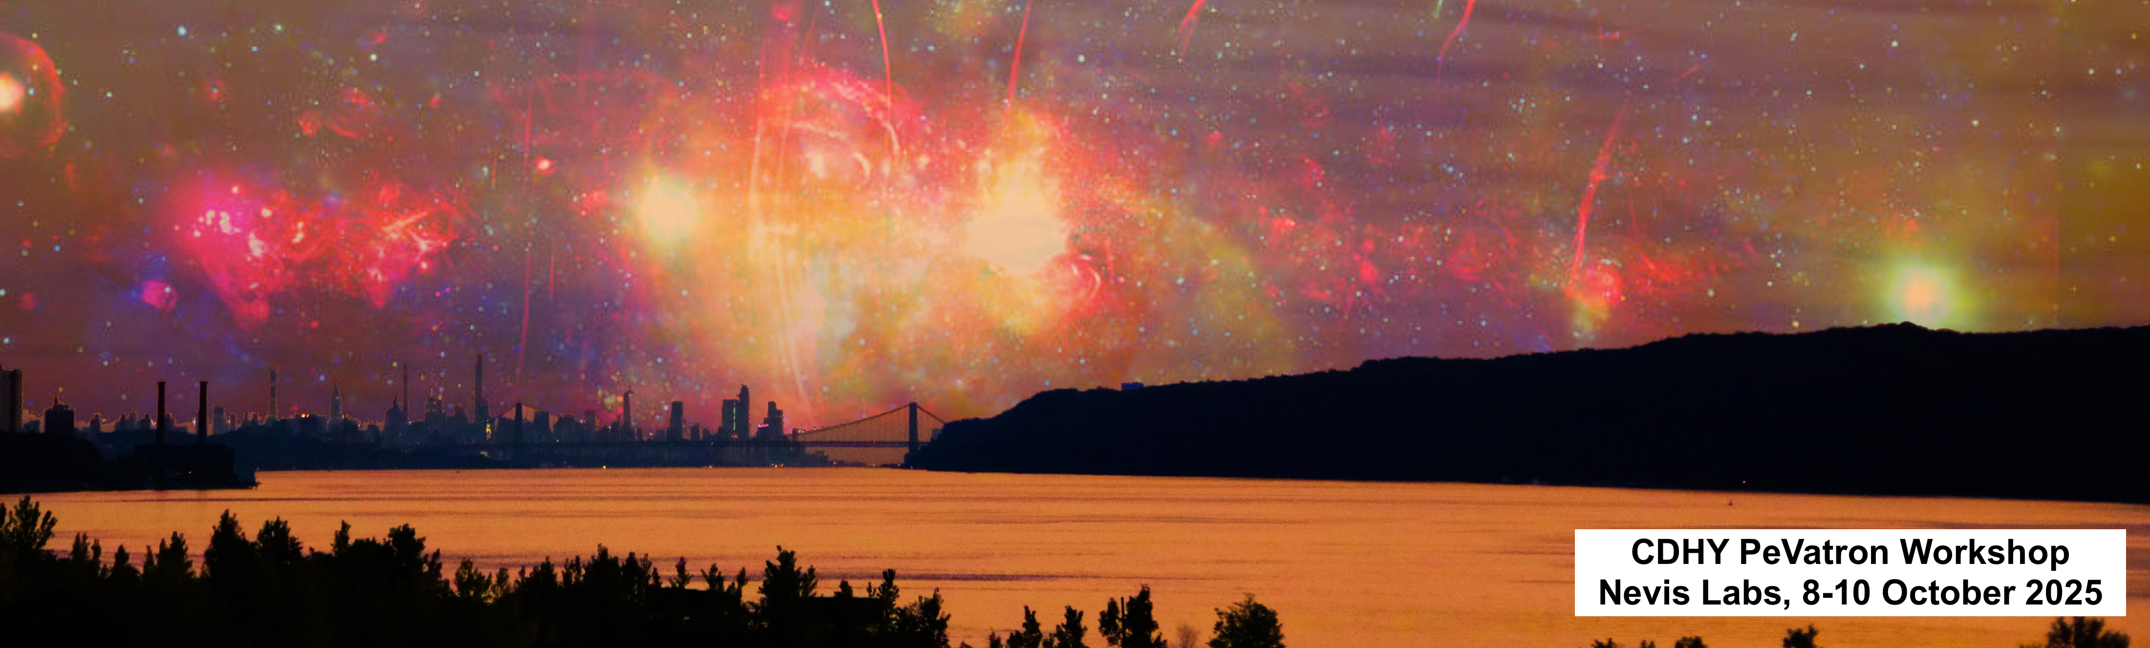

Going Beyond One-Zone: A Multi-Zone SED Model for PWNe
Hongjun An, Chanho Kim, Jaegeun Park, Haneul Jeong

Slide 2
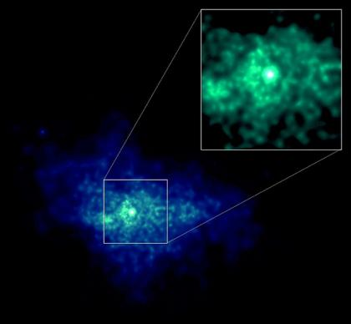

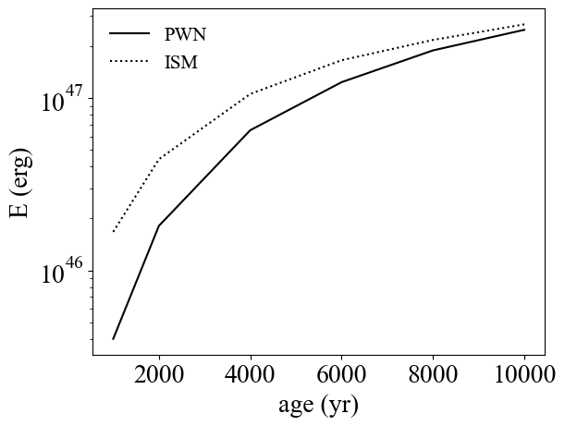
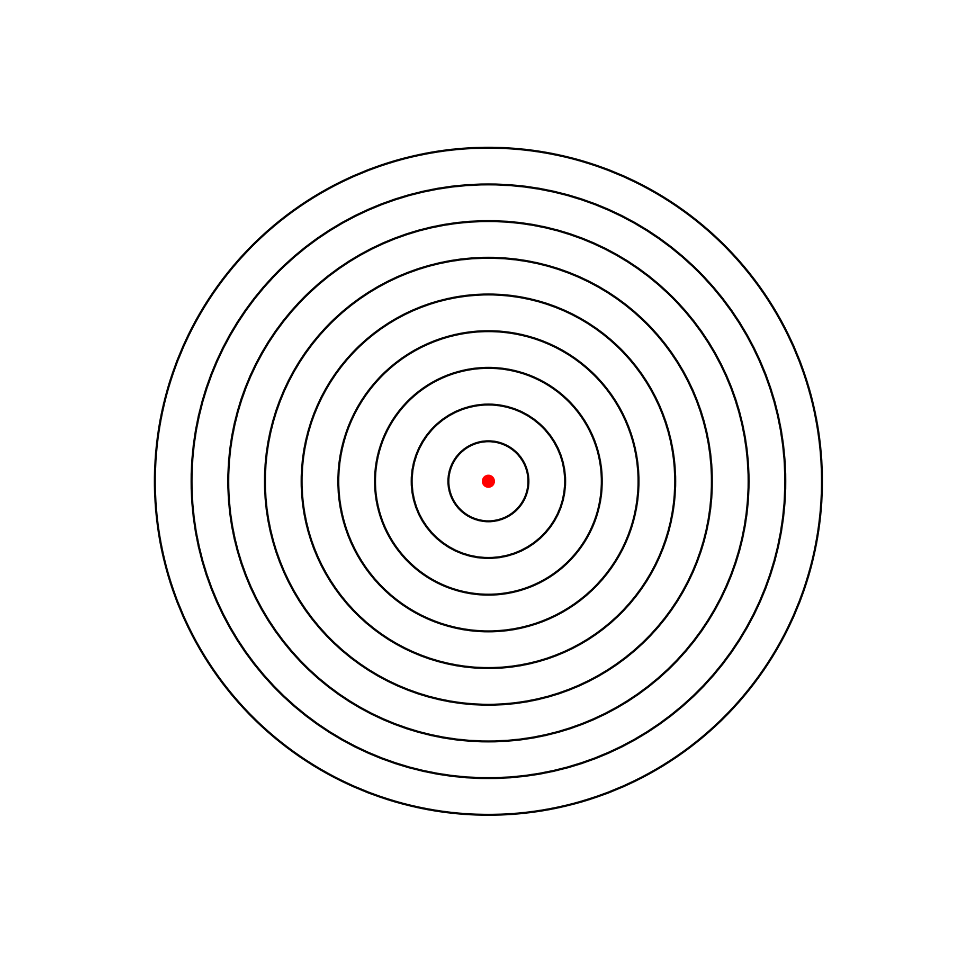
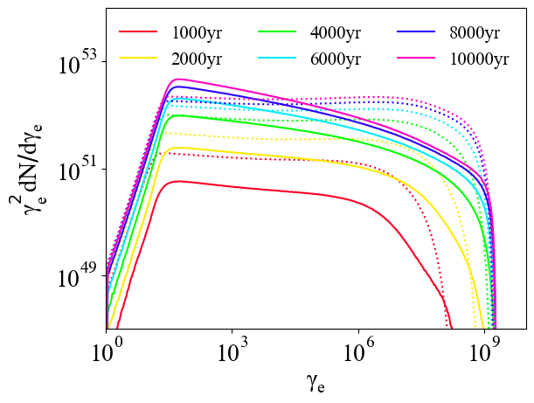
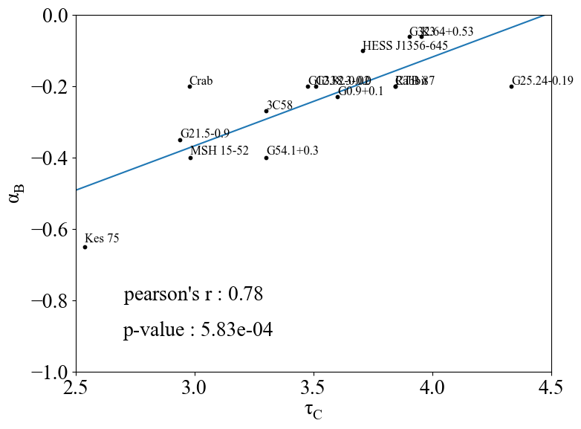
OUTLINE
Brief introduction to Pulsar Wind Nebulae (PWNe)
Stationary Multi-Zone PWN Model -- Results
Incorporating PWN evolution: theoretical and observational studies
Comparison of Multi-Zone PWN model results
Summary and Future Work
G54.1+0.3
Credit: NASA/CXC
$$E_{part}$$
Within PWN
Escaped
$$α_{B}=0.3\log_{10}\left(t\right)−1.4$$
log

Slide 3
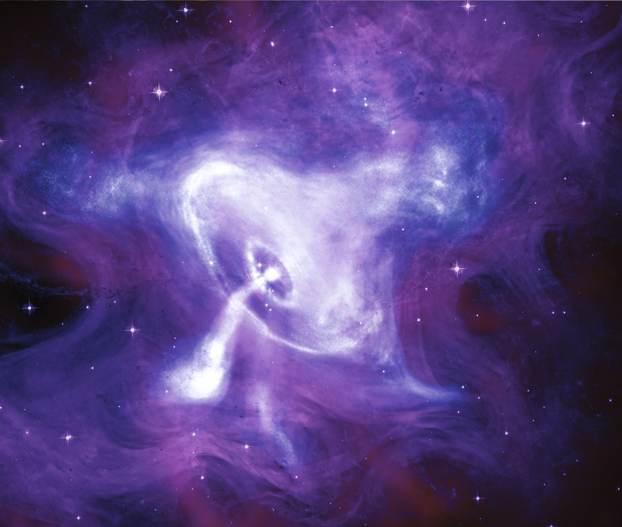
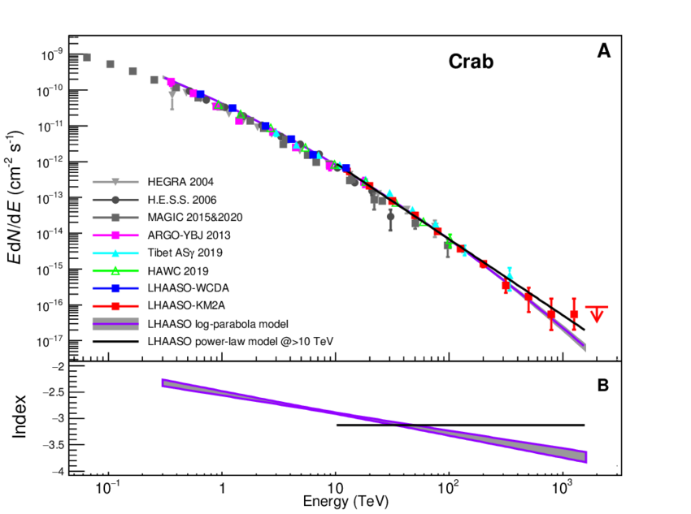
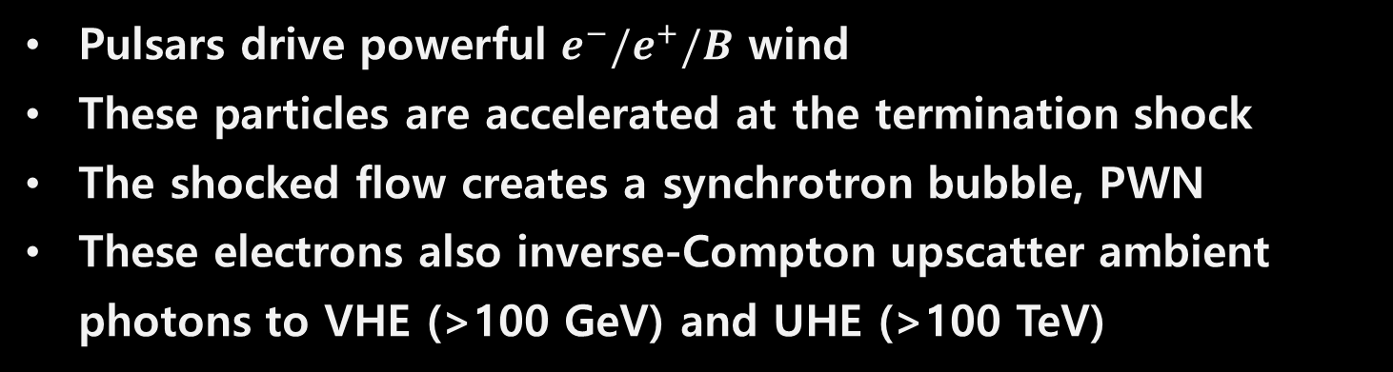
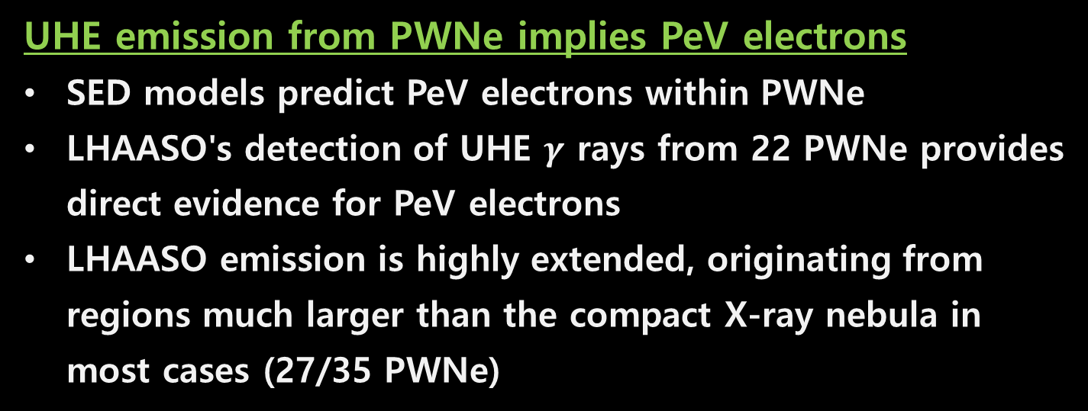
Pulsar wind nebulae are potential sources of PeV electrons
Pulsars drive powerful $e^{−}/e^{+}/B$ wind
These particles are accelerated at the termination shock
The shocked flow creates a synchrotron bubble, PWN
These electrons also inverse-Compton upscatter ambient photons to VHE (>100 GeV) and UHE (>100 TeV)
Termination Shock
PWN
Pulsar
UHE emission from PWNe implies PeV electrons
SED models predict PeV electrons within PWNe
LHAASO's detection of UHE $γ$ rays from 22 PWNe provides direct evidence for PeV electrons
LHAASO emission is highly extended, originating from regions much larger than the compact X-ray nebula in most cases (27/35 PWNe)
Composite image of the Crab nebula (X-ray: NASA/CXC/SAO; Optical: NASA/STScI; Infrared: NASA-JPL-Caltech)
Cao et al. (2021)
PeV

Slide 4
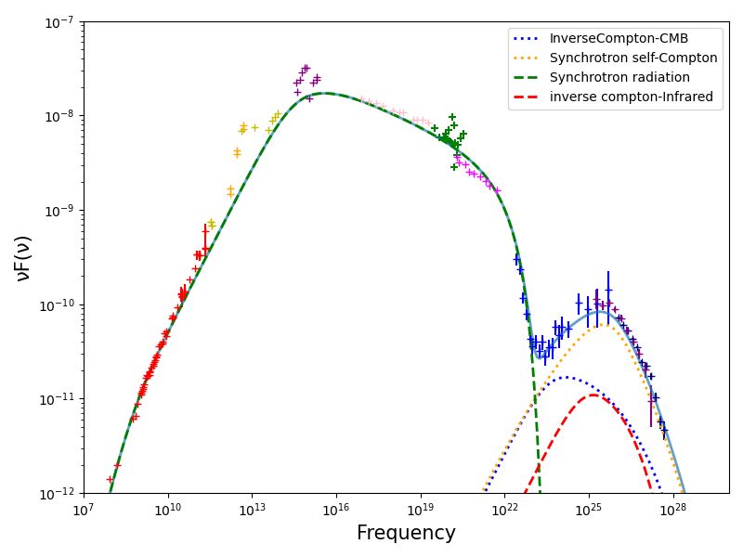

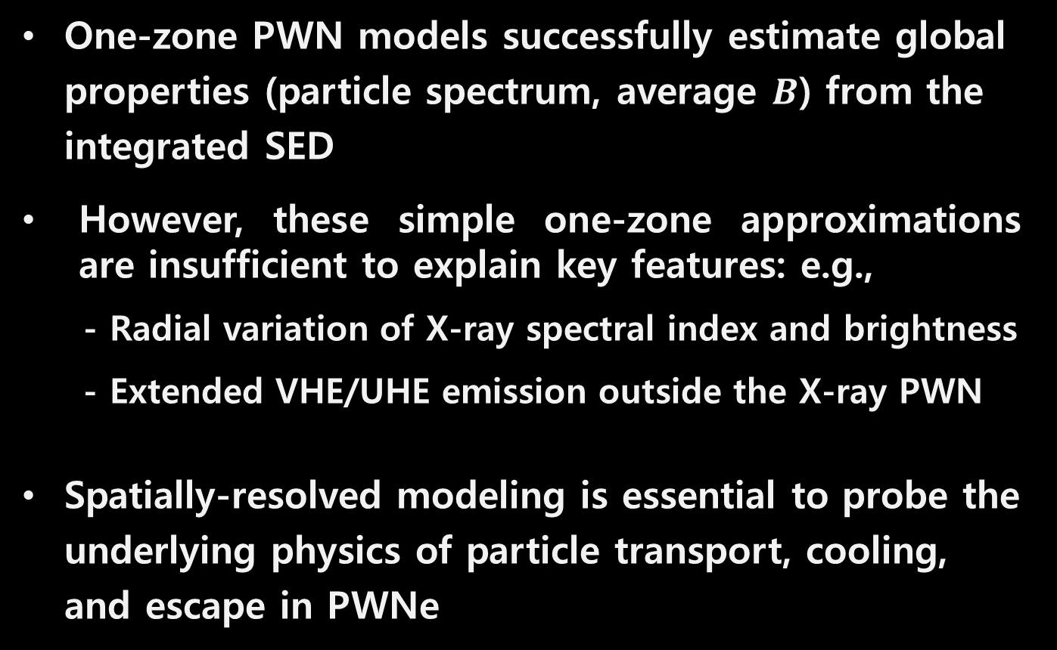





SED modeling provides key information on the PWN
One-zone PWN models successfully estimate global properties (particle spectrum, average $B$) from the integrated SED
However, these simple one-zone approximations are insufficient to explain key features: e.g.,
- Radial variation of X-ray spectral index and brightness
- Extended VHE/UHE emission outside the X-ray PWN
Spatially-resolved modeling is essential to probe the underlying physics of particle transport, cooling, and escape in PWNe
Crab
$$p_{2}$$
$$p_{1}$$
$$\frac{B^{2}}{u_{rad}}$$
$$γ_{br}$$
$$γ_{max}$$
$$γ_{min}$$
3C 58; a19

Slide 5
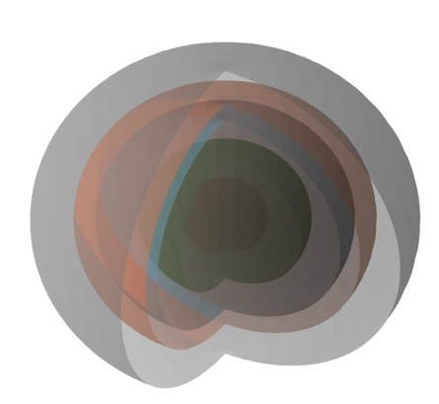
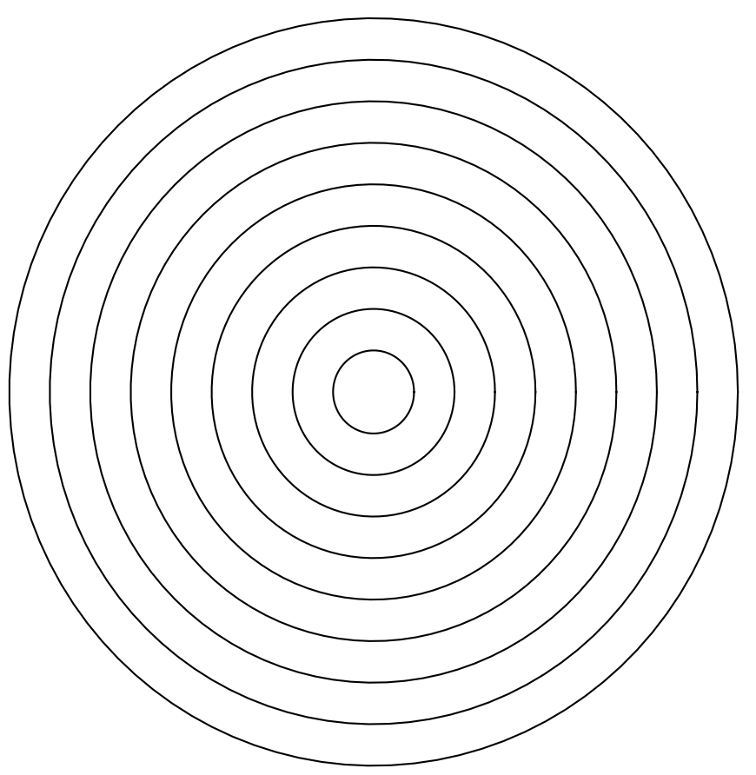
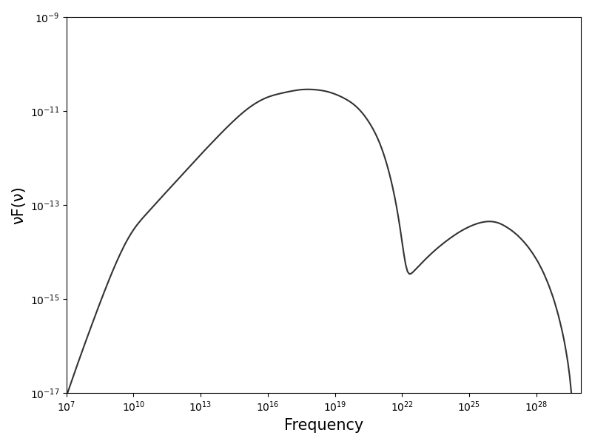
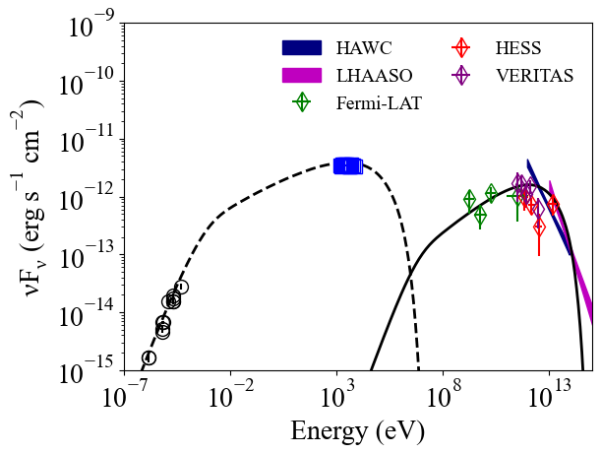
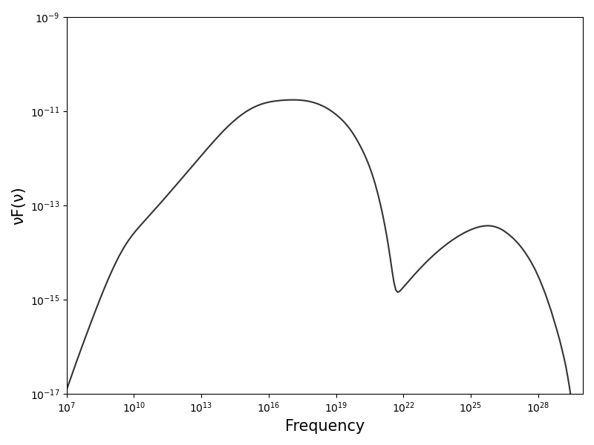
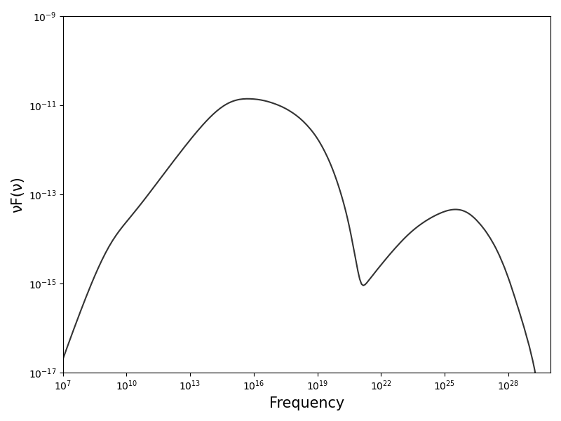
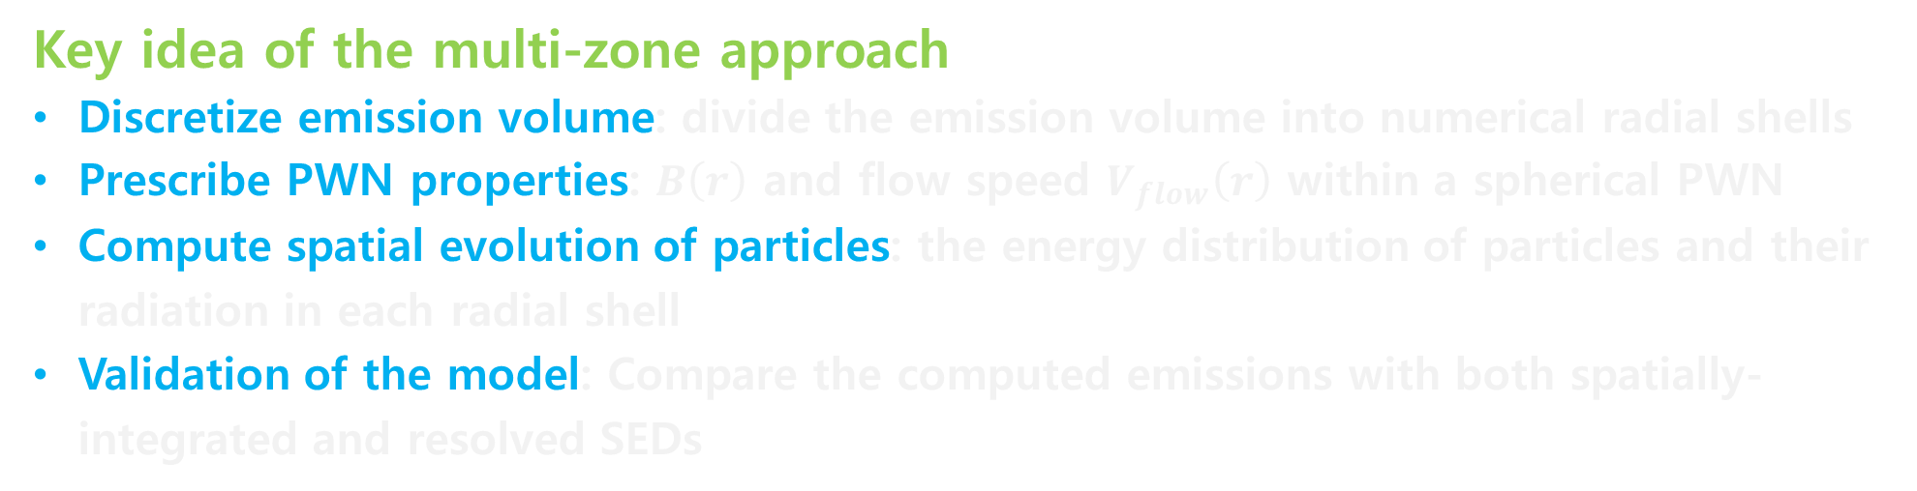

A stationary multi-zone model with spherical symmetry
G54.1+0.3
$$R_{TS}$$
Spatially-resolved SEDs
Spatially-integrated SED
Key idea of the multi-zone approach
Discretize emission volume: divide the emission volume into numerical radial shells
Prescribe PWN properties: $B\left(r\right)$ and flow speed $V_{flow}\left(r\right)$ within a spherical PWN
Compute spatial evolution of particles: the energy distribution of particles and their radiation in each radial shell
Validation of the model: Compare the computed emissions with both spatially-integrated and resolved SEDs

Slide 6
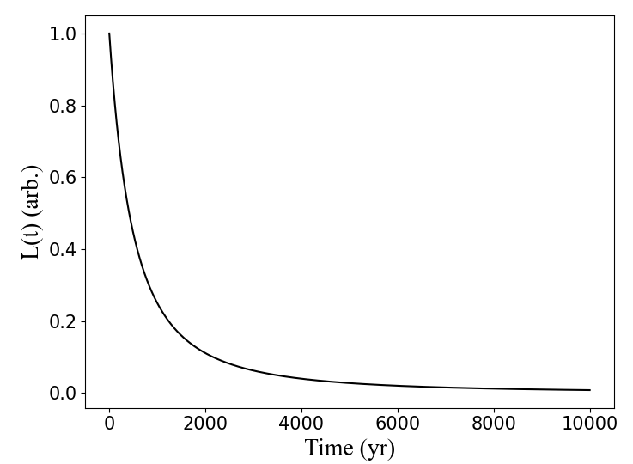
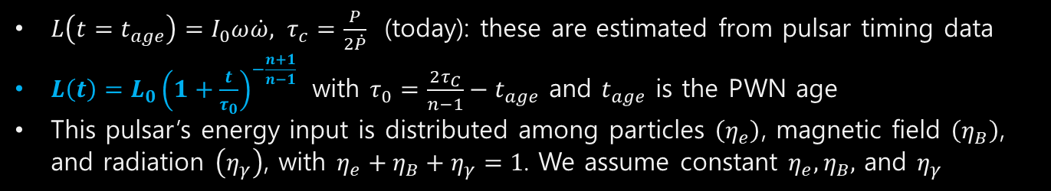


Multi-zone model: A pulsar supplies energy to its PWN
Pulsar spin-down luminosity: the only time-varying parameter in our stationary model
$L\left(t=t_{age}\right)=I_{0}ω\dot{ω}, τ_{c}=\frac{P}{2\dot{P}}$ (today): these are estimated from pulsar timing data
$L\left(t\right)=L_{0}{\left(1+\frac{t}{τ_{0}}\right)}^{−\frac{n+1}{n−1}}$ with $τ_{0}=\frac{2τ_{C}}{n−1}−t_{age}$ and $t_{age}$ is the PWN age
This pulsar’s energy input is distributed among particles $\left(η_{e}\right)$, magnetic field $\left(η_{B}\right)$, and radiation $\left(η_{γ}\right)$, with $η_{e}+η_{B}+η_{γ}=1$. We assume constant $η_{e}, η_{B},$ and $η_{γ}$
Evolution of $L\left(t\right)$
$$t_{age}$$
Injected particle distribution: $\frac{dN}{dγdt}$ (prescribed)
e.g., For PL $\frac{dN}{dγdt}=N_{e}{\left(\frac{γ}{γ_{b}}\right)}^{−p_{1}},$ $p_{1}$ can be estimated from X-ray observations ($p_{1}=2Γ−1$)
Normalization of the particle distribution: the energy budget
Termination Shock
$E_{p}\left(t\right)= \int_{γ_{min} }^{γ_{max}}{γmc^{2}\frac{dN}{dγdt}dγ}=η_{e}L\left(t\right)∝{\left(1+\frac{t}{τ_{0}}\right)}^{−\frac{n+1}{n−1}}$ : decreases with time following $L\left(t\right)$
Termination shock (at $R_{TS}$): injection site
$R_{TS}≈0.05\sqrt{{\dot{E}}_{36}P_{ISM,−10}} pc$ (measured by Chandra images)
Pulsar

Slide 7
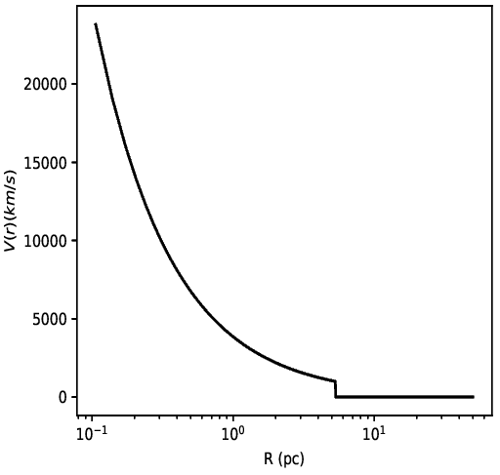
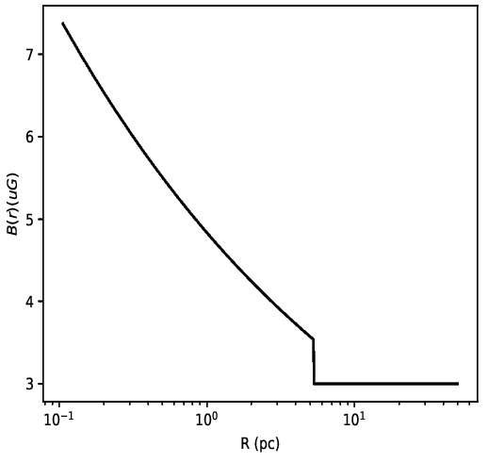


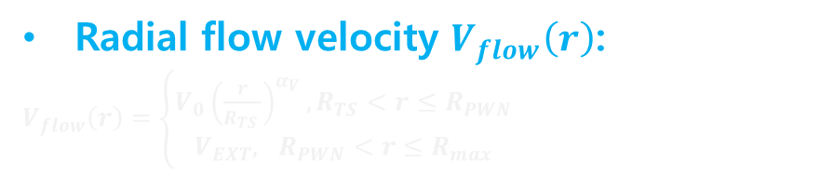
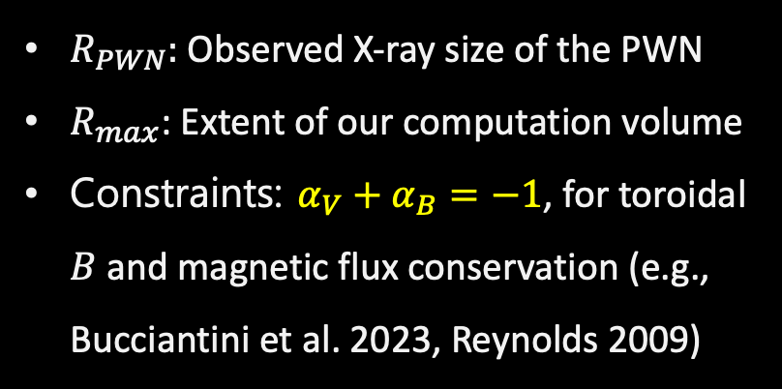






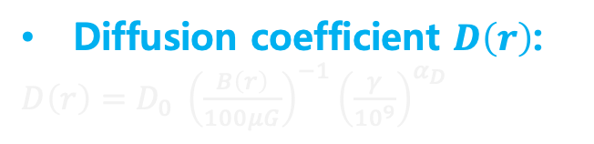
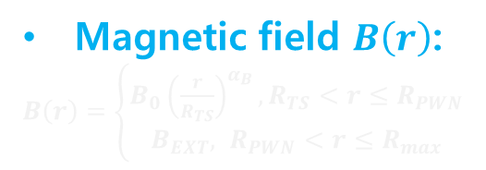
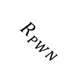

Multi-zone model: we use PL prescriptions for flow velocity and $B$
PWN properties $V_{flow}\left(r\right)$, $B\left(r\right)$, and $D\left(r\right)$: power-law functions with no time dependence
$$R_{PWN}$$
$$r$$
$R_{PWN}:$ Observed X-ray size of the PWN
$R_{max}$: Extent of our computation volume
Constraints: $α_{V}+α_{B}=−1$, for toroidal $B$ and magnetic flux conservation (e.g., Bucciantini et al. 2023, Reynolds 2009)
Radial flow velocity $V_{flow}\left(r\right)$:
$V_{flow}\left(r\right)=\left\{\begin{matrix}V_{0}{\left(\frac{r}{R_{TS} }\right)}^{α_{V}},R_{TS}<r≤R_{PWN} \\ V_{EXT}, R_{PWN}<r≤R_{max}\end{matrix}\right.$
$$R_{TS}$$
$V_{flow}\left(r \right)$
Magnetic field $B\left(r\right)$:
$B\left(r\right)=\left\{\begin{matrix}B_{0}{\left(\frac{r}{R_{TS}}\right)}^{α_{B}},R_{TS}<r≤R_{PWN} \\ B_{EXT}, R_{PWN}<r≤R_{max}\end{matrix}\right.$
$$R_{PWN}$$
$$R_{TS}$$
Diffusion coefficient $D\left(r\right)$:
$D\left(r\right)=D_{0} {\left(\frac{B\left(r\right)}{100μG}\right)}^{−1}{\left(\frac{γ}{{10}^{9}}\right)}^{α_{D}}$
$B\left(r\right)$
$$R_{PWN}$$
Magnetic energy budget:
The magnetic energy within the PWN is a fraction ($η_{B}$) of the pulsar spin-down power: $η_{B}\int_{0}^{t_{age}}{L\left(t\right)dt}=\int_{R_{TS}}^{R_{PWN}}{\frac{{B\left(r\right)}^{2}}{8π}×4πr^{2}dr}$
$$R_{TS}$$

Slide 8
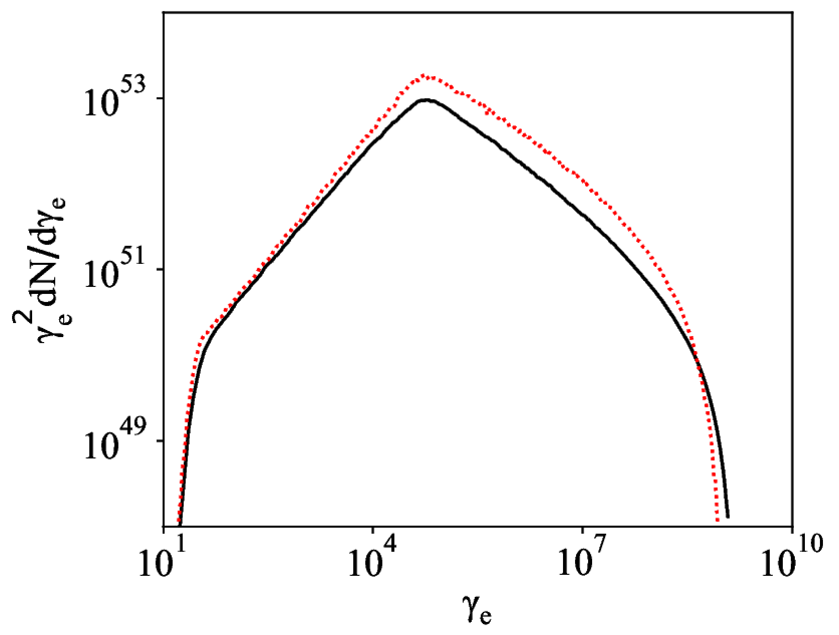
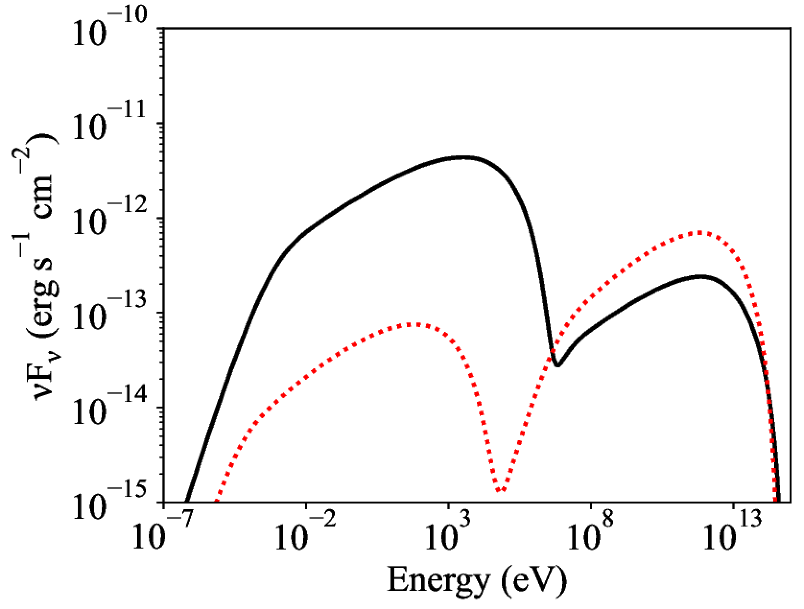
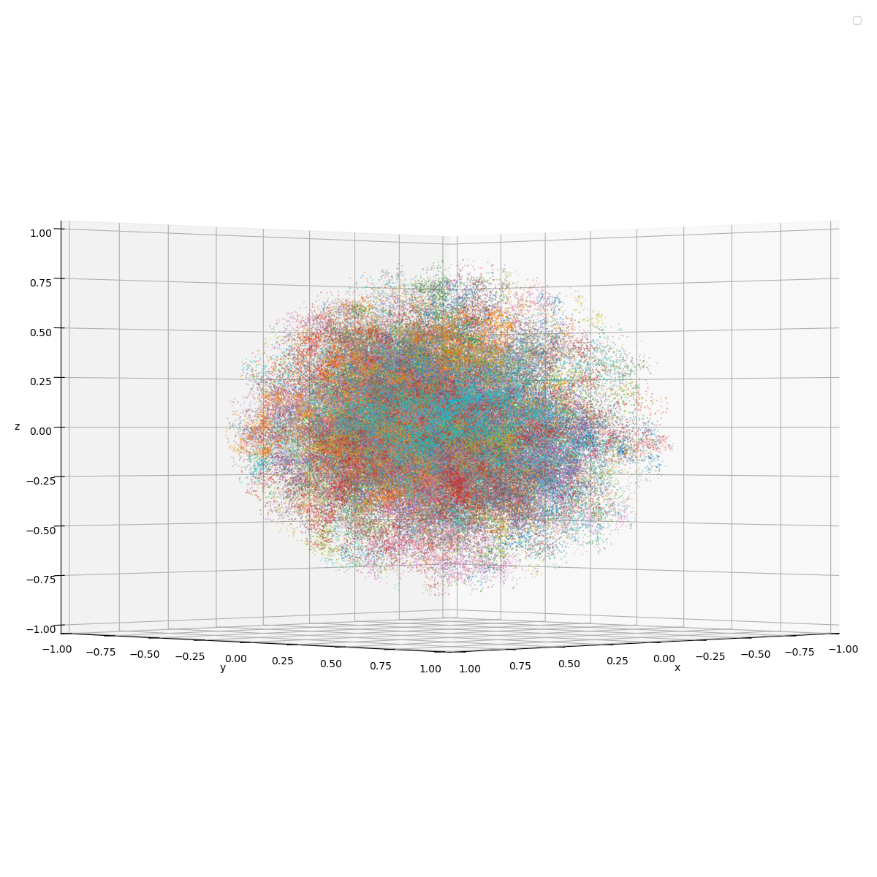
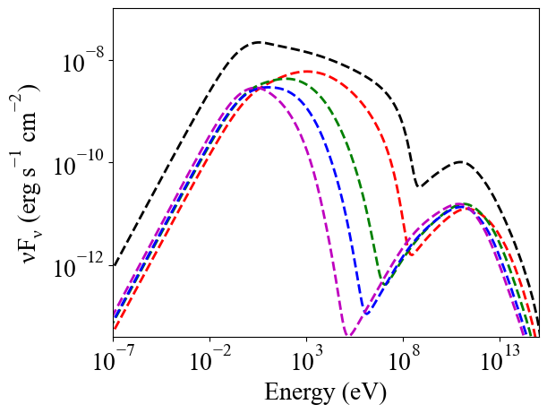

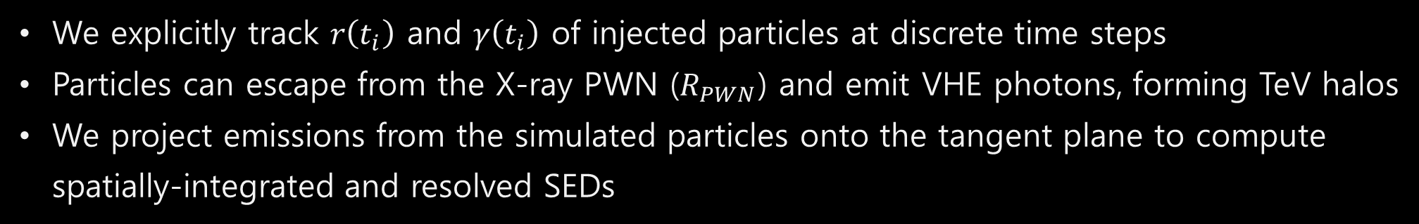






Multi-zone model: we run simulations to compute particle evolution
Particle injection at $R_{TS}(t)$
Particle distribution
$$R_{PWN}$$
Advection
$V_{flow}\left(r\right)×dt$ ( $\hat{r}$ )
Inside $R_{PWN}$
Outside $R_{PWN}$
repeat until $t=t_{age}$
Diffusion (random)
$\sqrt{2Ddt}$ ( $\hat{x}$, $\hat{y}$, $\hat{z}$ )
$D=D_{0}\left(\frac{100μG}{B}\right){\left(\frac{γ}{{10}^{9}}\right)}^{α_{D}}$
Emission SED
Inside $R_{PWN}$
Outside $R_{PWN}$
Position of particles
total radiation
Energy loss of particles
We explicitly track $r\left(t_{i}\right)$ and $γ\left(t_{i}\right)$ of injected particles at discrete time steps
Particles can escape from the X-ray PWN ($R_{PWN}$) and emit VHE photons, forming TeV halos
We project emissions from the simulated particles onto the tangent plane to compute spatially-integrated and resolved SEDs

Slide 9

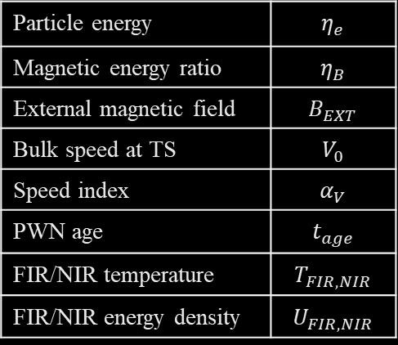

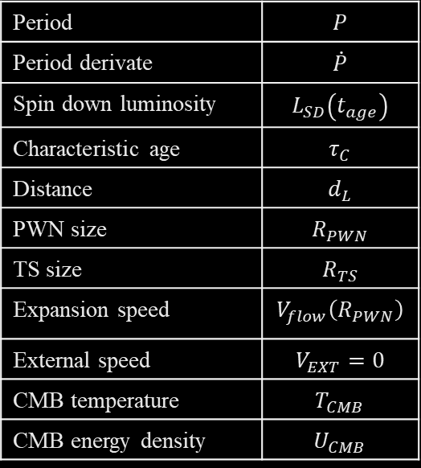

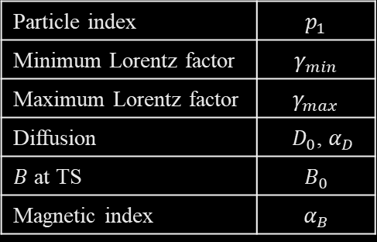


Multi-zone model: we applied the model to PWNe
PWN sample
(Assumed) Known parameters
Free parameters
Target | TeV | TeV size (deg) | Spatially resolved
Crab | HESS J0534+220 | 0.01 | O
G21.5-0.9 | HESS J1833-105 | X | O
MSH 15-52 | HESS J1514-591 | 0.11 | O
3C58 | Magic | X | O
G54.1+0.3 | HESS J1930+188 | 0.0 | O
Kes 75 | HESS J1846-029 | 0.01 | O
Rabbit | HESS J1418-609 | 0.11 | O
K3 | HESS J1420-607 | 0.08 | O
G32.64+0.53 | HESS J1849-000 | 0.09 | O
G12.82-0.02 | HESS J1813-179 | 0.05 | O
HESS J1356-645 | HESS J1356-645 | 0.23 | X
G338.3-0.0 | HESS J1640-465 | 0.11 | X
G0.9+0.1 | HESS J1747-281 | X | O
G25.24-0.19 | HESS J1837-069 | 0.36 | X
CTB 87 | VER J2016+371 | X | O
Period | $$P$$
Period derivate | $$\dot{P}$$
Spin down luminosity | $$L_{SD}\left(t_{age}\right)$$
Characteristic age | $$τ_{C}$$
Distance | $$d_{L}$$
PWN size | $$R_{PWN}$$
TS size | $$R_{TS}$$
Expansion speed | $$V_{flow}\left(R_{PWN}\right)$$
External speed | $$V_{EXT}=0$$
CMB temperature | $$T_{CMB}$$
CMB energy density | $$U_{CMB}$$
Particle index | $$p_{1}$$
Minimum Lorentz factor | $$γ_{min}$$
Maximum Lorentz factor | $$γ_{max}$$
Diffusion | $D_{0}$, $α_{D}$
$B$ at TS | $$B_{0}$$
Magnetic index | $$α_{B}$$
X-ray photon index
Radio emission Pulsar energy budget
X-ray and TeV spectra
TeV extension
Flux and radial profiles of X-ray emission
Particle energy | $$η_{e}$$
Magnetic energy ratio | $$η_{B}$$
External magnetic field | $$B_{EXT}$$
Bulk speed at TS | $$V_{0}$$
Speed index | $$α_{V}$$
PWN age | $$t_{age}$$
FIR/NIR temperature | $$T_{FIR,NIR}$$
FIR/NIR energy density | $$U_{FIR,NIR}$$
$η_{e}+η_{B}+η_{γ}=1$
$η_{e}≫η_{B}$
Interstellar field:
< a few $μG$
$V_{0}$: $α_{V}>−1$
$$α_{B}+α_{V}=−1$$
$t_{age}≤τ_{c}$; $F_{X}/F_{γ}$ helps
Galactic average
GALPROP model
We applied the stationary multi-zone model to a PWN sample

Slide 10
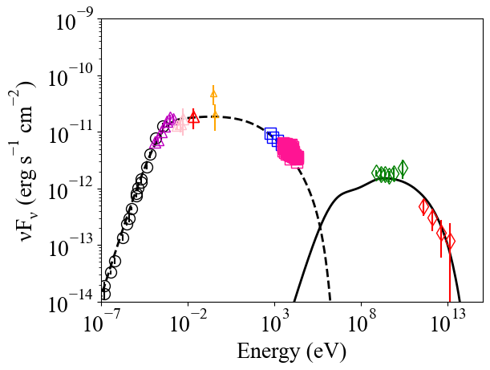
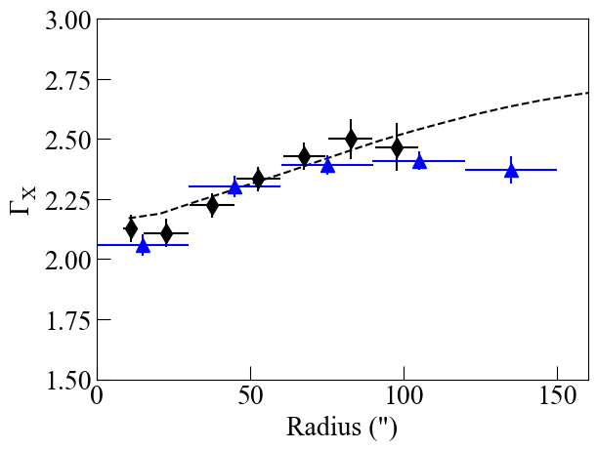
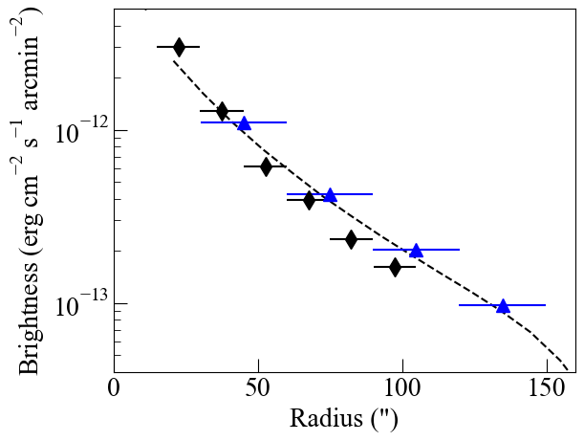
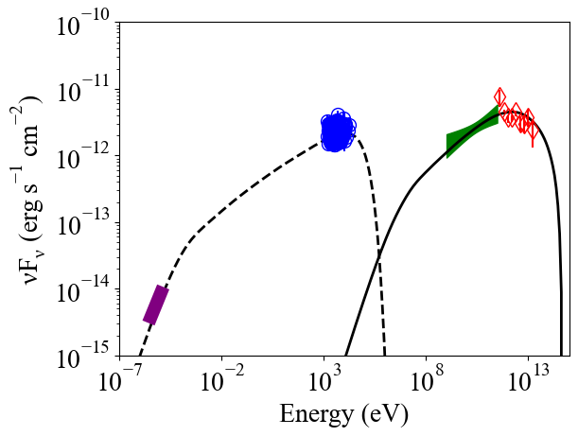
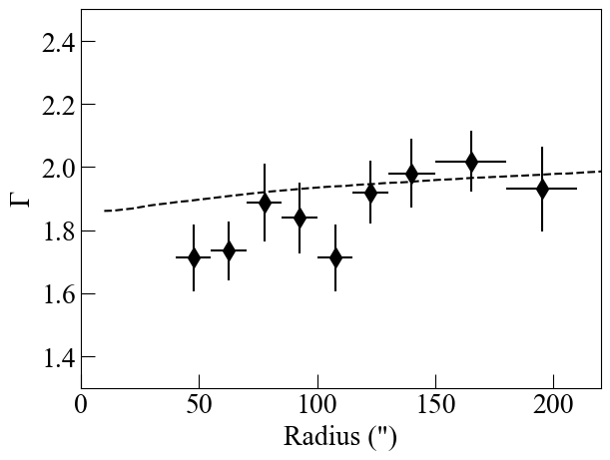
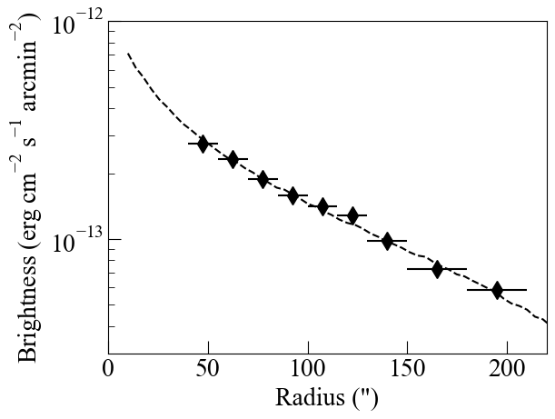
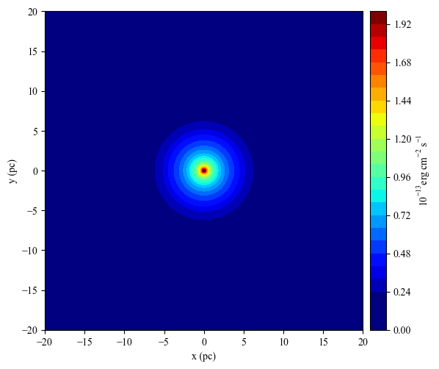
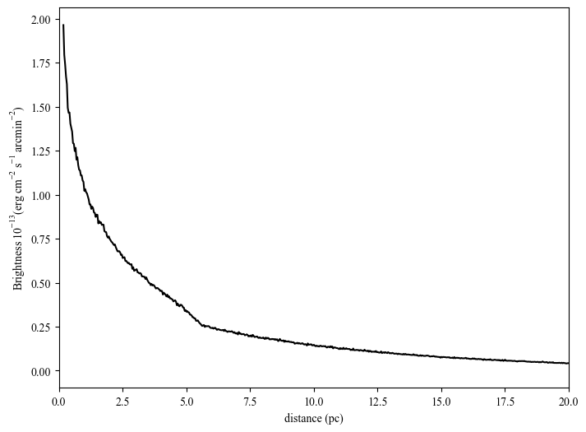
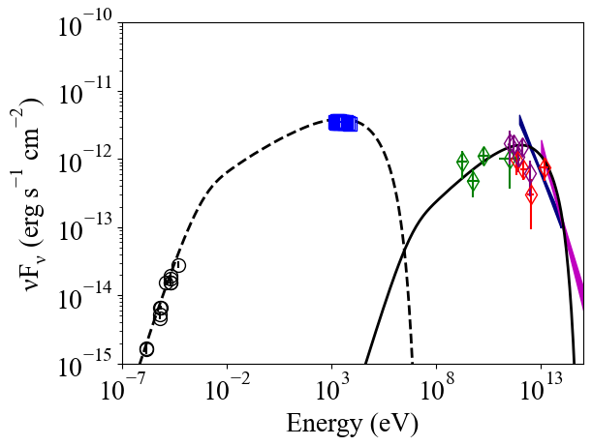
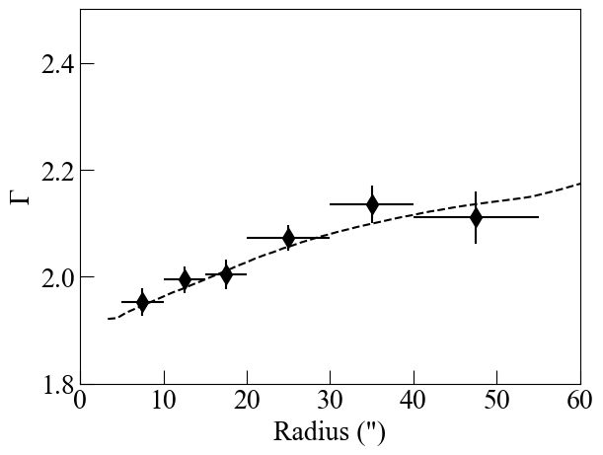
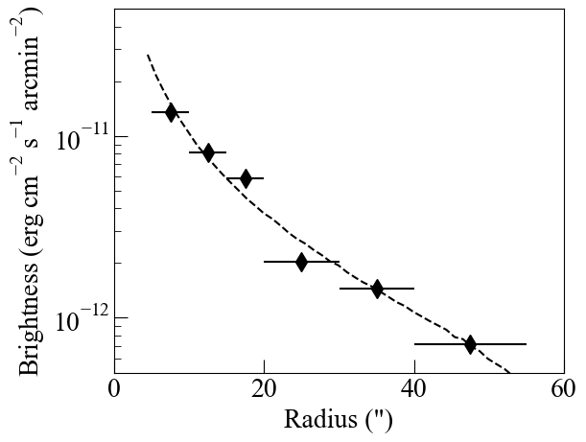
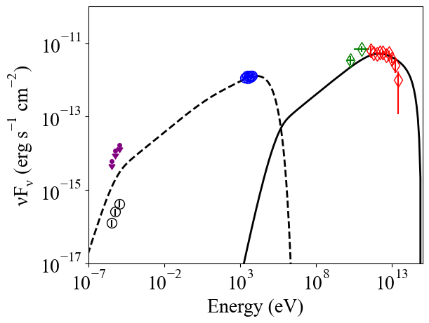
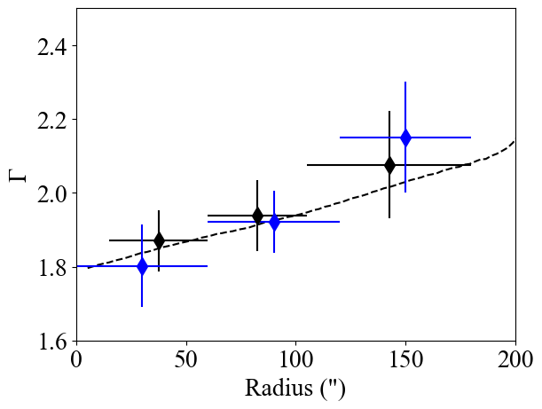










Multi-zone model: Results
3C 58
Rabbit
photon index
surface brightness
1TeV – 10TeV map
Radial profile of brightness
(1TeV – 10TeV )
G54.1+0.3
photon index
surface brightness
K3
100TeV – 1PeV map
Radial profile of brightness
(100TeV – 1PeV )
Kes 75
G32.64+0.53
The model readily explains broadband SEDs and X-ray radial profiles of the PWN sample
It also computes spatially-resolved TeV spectrum
K3 (Park et al. 2023)

Slide 11



Multi-zone model: Incorporating evolutionary effects
Evolutionary PWN models (Gelfand et al. 2009, Bandiera et al. 2023) successfully compute time variations of PWN sizes, magnetic fields, particle distribution, and ..
We approximate the model computations for $R_{pwn}\left(t\right)$ and $R_{TS}\left(t\right)$ with analytic functions: $R_{pwn}\left(t\right)\sim t^{1.1}$ and $R_{TS}\sim 0.05R_{pwn}$
Additionally, we need to revise $B\left(r\right)$ and $V_{flow}\left(r\right)$ to include evolutionary effects:
$B\left(r,t\right)=B_{0}\left(t\right){\left(\frac{r}{R_{TS}}\right)}^{α_{B}\left(t\right)}$and $V_{flow}\left(r, t\right)=V_{0}\left(t\right){\left(\frac{r}{R_{TS} }\right)}^{α_{V}\left(t\right)}$
Bandiera et al. (2023)
Gelfand et al. (2009)
Gelfand et al. (2009)

Slide 12

Evolution of PWN properties: $α_{B}\left(t\right)$ and $α_{V}\left(t\right)$
What is the functional form for $α_{B}\left(t\right)$?
and $α_{V}=−1−α_{B}$
This can be investigated with radial profiles of X-ray photon index and brightness since they are linked to $α_{B}$ and $α_{V}$

Slide 13













Observational constraints on $α_{B}\left(t\right)$ and $α_{V}\left(t\right)$
$$\frac{dlogB_{X}}{dR}$$
$\frac{dΓ_{X} }{dR}$
$$\log_{10}{(B_{X2})}−\log_{10}{(B_{X1})}$$
${dlogB}_{X}$/$dR$
$$Γ_{X2}−Γ_{X1}$$
$$R_{2}−R_{1} (pc)$$
$$R_{2}−R_{1} (pc)$$
log
log
We analyzed a sample of PWNe across different ages to investigate the time dependence of their X-ray spatial variations
The slopes of the radial profiles for both photon index $\left(\frac{dΓ_{x}}{dR}\right)$ and brightness $\left(\frac{dlogB_{X}}{dR}\right)$ seem to correlate with $τ_{C}$
These observational properties are linked to the model parameter $α_{B}$ ($=−1−α_{V}$). So $α_{B}$ also correlates with $τ_{c}$
$$α_{B}\left(t\right)=0.3\log_{10}\left(t\right)−1.4$$
log

Slide 14












Evolutionary multi-zone model: $B_{0}\left(t\right)$ and $V_{0}\left(t\right)$
$$B_{0}\left(t\right)$$
$$V_{0}\left(t\right)$$
$$α_{V}\left(t\right)=1−α_{B}\left(t\right)$$
$R_{PWN} \sim t^{1.1}$, Trend in Gelfand et al. (2009)
$$α_{B}(t)$$
$$R_{TS}\sim \left(0.01−0.05\right)R_{pwn}$$
Key assumptions for $V_{flow}\left(r,t\right)$ and $B\left(r,t\right)$
For temporal evolution of $α_{B}$ and $α_{V}$, we adopt $α_{B}\left(t\right)=0.3 log_{10}\left(t\right)−1.4=−1−α_{V}\left(t\right)$
Time evolutions of the pre-factors $V_{0}\left(t\right)$ and $B_{0}\left(t\right)$ are determined by the pulsar’s energy budget and the PWN expansion speed:
- $η_{B}\int_{0}^{t}{L\left(t\right)dt}=\int_{R_{TS}\left(t\right)}^{R_{PWN}(t)}{\frac{{B\left(r,t\right)}^{2}}{8π}×4πr^{2}dr}$ gives $B_{0}\left(t\right)$
- Assuming $V_{flow}\left(R_{PWN},t\right)=1000 km/s$, we estimate $V_{0}\left(t\right)$
$B\left(r,t\right)=B_{0}\left(t\right){\left(\frac{r}{R_{TS}}\right)}^{α_{B}\left(t\right)}$ $V\left(r, t\right)=V_{0}\left(t\right){\left(\frac{r}{R_{TS} }\right)}^{α_{V}\left(t\right)}$

Slide 15

















































The evolutionary effects are implemented in the model computation
particle injected at $t_{0}$
Escape
$R_{pwn}$ at $t=t_{0}$
termination shock at $t=t_{0}$
termination shock at $t=t_{1}$
particle injected at $t_{1}$
$R_{pwn}$ at $t=t_{1}$
termination shock at $t=t_{2}$
particle injected at $t_{2}$
$R_{pwn}$ at $t=t_{2}$
particle injected at $t_{3}$
$$⋯⋯$$
$$t=t_{0}$$
$$t=t_{1}$$
$$t=t_{2}$$
$$t=t_{3}$$
$$t=t_{4}$$
$$t=t_{5}$$
$$t=t_{6}$$
$$B\left(r,t\right)$$
$$V_{flow}\left(r,t\right)$$
total particles
Compute radiation

Slide 16


















Evolutionary multi-zone model: Results
Young PWNe
Middle-aged PWNe
3C 58, PSR J0205+6449
Rabbit, PSR J1418-6058
G54.1+0.3, PSR J1930+1852
K3, PSR J1420-6048
Kes 75, PSR J1846-0258
G32.64+0.53, PSR J1849-0001
This refined evolutionary multi-zone model also provides good explanations for observational data

Slide 17

Comparison between the stationary and evolutionary models
Both models are equally effective at explaining the observational data, broadband SED, energy-dependent morphology, and VHE/UHE extensions
The evolutionary model demands greater energy injection due to higher energy losses (stronger $B$) at early times: a larger PWN age, a higher $γ_{min}$, $U_{IR}$ and/or present-day $B$ are required to compensate
The strong early-time $B$ also reduces particle diffusion ($∝B^{−1}$). This effect makes the model predict a smaller VHE extent; need to increase $D_{0}$
The derived magnetic and velocity indices $α_{B}$ and $α_{V}$ are largely consistent between the stationary and evolutionary models
Further optimization of parameter values is required for more precise and robust comparisons between the models

Slide 18







Future Work
Explore other prescriptions for $B\left(r,t\right)$ and $V_{flow}\left(r,t\right)$
Predict spatially-resolved VHE/UHE spectra of PWNe (in preparation of CTA)
Test the model with more complicated evolution
Expand the model to account for asymmetric morphology
Suggestions?
$$R_{PWN}$$
$$R_{TS}=0.05R_{pwn}$$
Gelfand et al. (2009)
$$B_{0}\left(t\right) \left(μG\right)$$
2—10 keV
Burgess et al. (2022)

